Slide 1
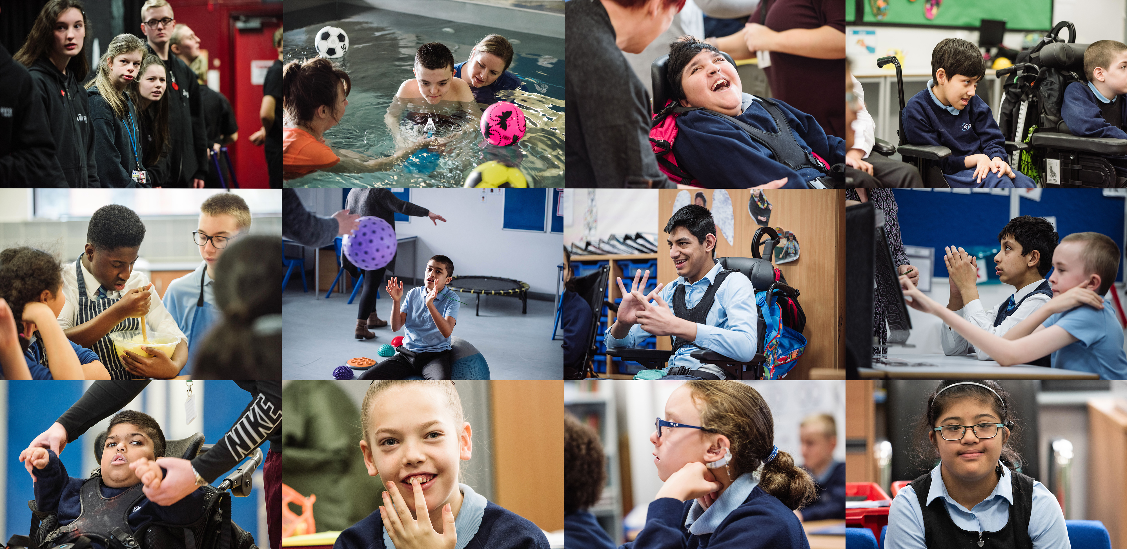

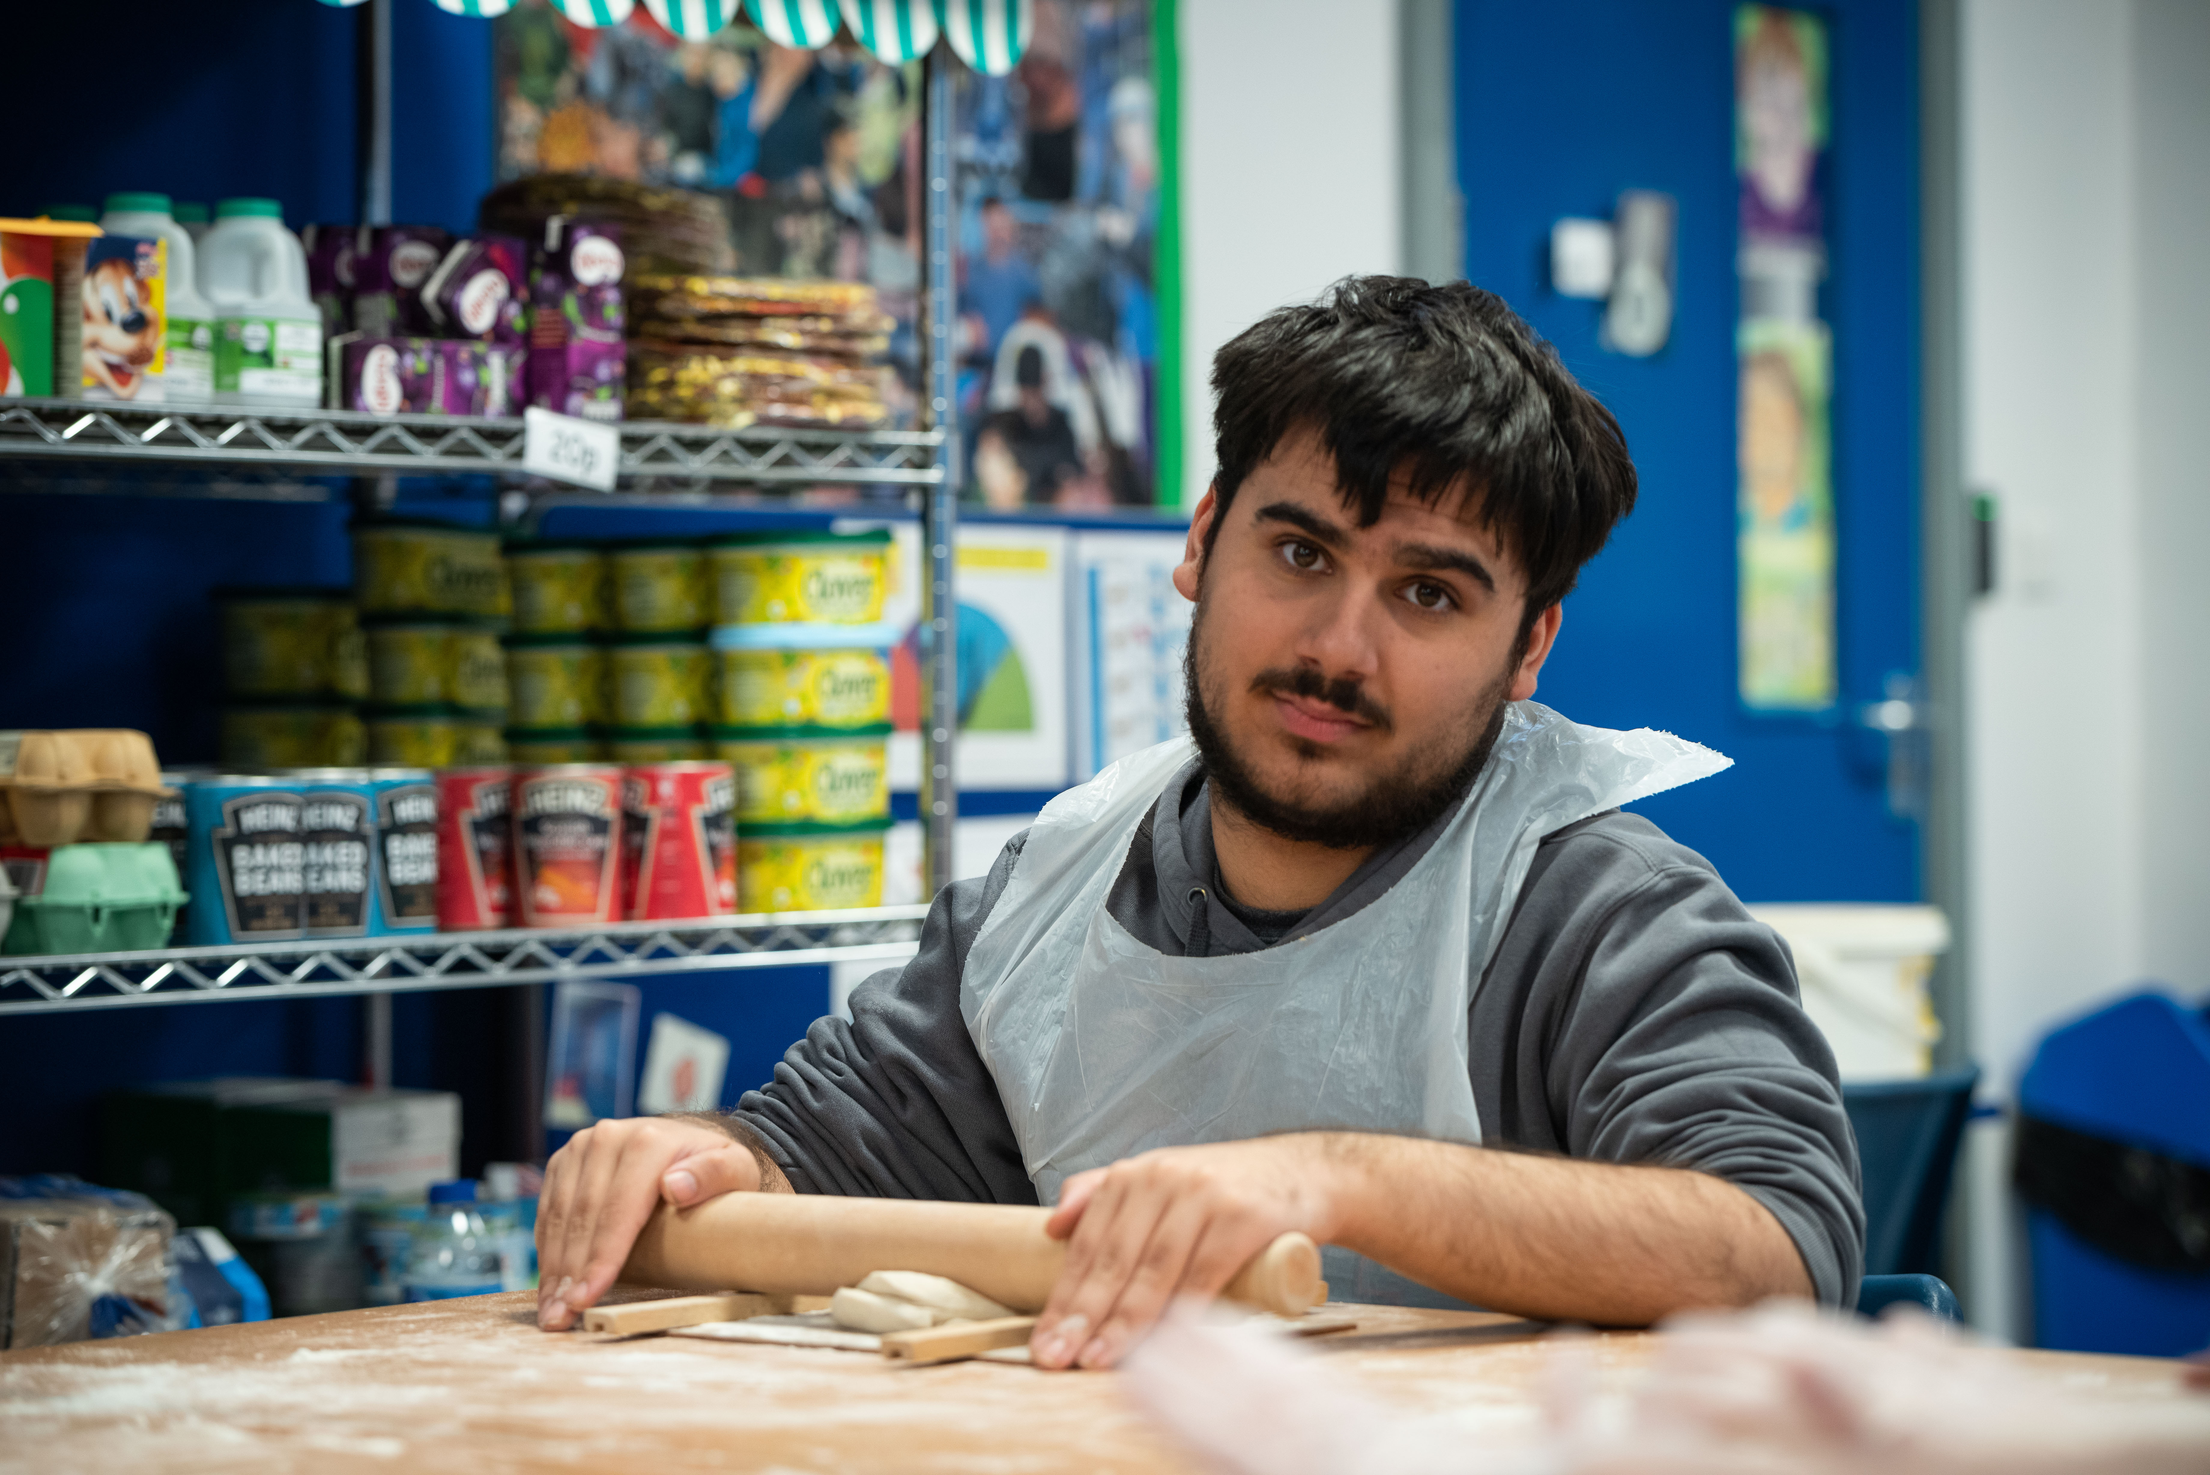
Keeping Children Safe in Education 2026
(KCSIE)
September INSET Day

Slide 2

Sensitive Content Notice
As ever with Safeguarding, you can take time out at any time, with no questions and no judgement.
If you’re affected by the topics discussed in this session, you can:
  Speak to your line manager
  Speak to Staff Support
  Call Education Support on 08000 562 561
  Call Samaritans on 116 123

Slide 3


Why Safeguarding Matters
Trigger Warning: This video contains references to neglect, domestic abuse, parental addiction, child criminal exploitation (CCE) and the death of a young person, which some people might find upsetting.
Notes:
Video is 2mins 45s
Read the trigger warning and remind staff that it is OK to leave the room and come back after the video if they feel this will be too much to watch.
This video is based on a true story
Important takeaway: the need for staff to act immediately on early warning signs and to consistently push for support. Remember – “Think the unthinkable” and keep in mind “it could happen here.”
Case study source:
NSPCC, Recently published case reviews (2026-Norfolk-Jasmine), https://learning.nspcc.org.uk/case-reviews/recently-published-case-reviews
Video link: https://vimeo.com/1205750437?fl=pl&fe=cm

Slide 4

The Safeguarding Team
Paste staff photo here
Designated Safeguarding Lead (DSL): (Name)
Contact Details: (email address)
Paste staff photo here
Paste staff photo here
Paste staff photo here
Paste photo here
DDSL – Safeguarding:
Contact Details
DDSL – Pastoral:
Contact Details
DDSL – Attendance/Medical:
Contact Details
Executive Advisor: Safeguarding and Behaviour
Katie.Cash@newbridgegroup.org
07384460099
Notes:
Edit this slide to include details of your school’s Safeguarding Team. If anyone works part-time, include what days they work for full transparency and to aid effective communication.
Briefly talk through each person and their responsibilities.

Slide 5
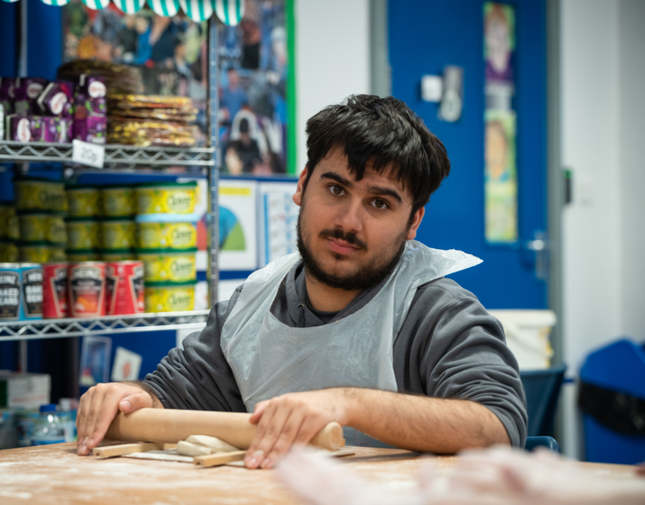
The Role of the DSL
Contact arrangements must survive the DSL being on leave
Robust cover arrangements should be in place
Confidential, shared safeguarding inbox
DSLs must have “appropriate skills & experience”
Reinforces that training for DDSLs at same level as DSL
Information sharing duties have been updated (page 183)
Transitions: It is “good practice for a conversation to take place” between the DSLs where there are concerns, and where something may impact on safety of pupil or others information should be shared in advance.
Notes:
Summary of role as per KCSIE 2026

Slide 6
Today we’ll learn about…
What Safeguarding is
What Safeguarding means for you
What can make some pupils more vulnerable than others
Responding to a Safeguarding disclosure
The 4 main Types of abuse and signs to look out for
How to spot the signs of poor mental health, and support pupils who are struggling
Specific forms of abuse and safeguarding you might see in your setting
Notes:
Explain that the following slides have been produced by The Key and work alongside the mandatory training all staff are required to complete.

Slide 7
Safeguarding means …
Providing help and support to meet the needs of children as soon as problems emerge
Protecting children from maltreatment within or outside the home, including online
Making sure children receive safe and effective care
Taking action to enable all children to have the best outcomes
Preventing impairment
of children’s mental
and physical health
or development
Notes:
Explain that to effectively safeguard children, we need to know what we mean by the term ‘safeguarding’
Ask staff what they understand by the term safeguarding. Give them a couple of minutes to share their answers before continuing with the slide
Explain that essentially, safeguarding means protecting children from harm, so they can grow up safe, happy and healthy
Remind staff that children are children until they are 18 years old
Select to bring up each element in turn. In more detail, safeguarding means:
Providing help and support to meet the needs of children as soon as problems emerge
Protecting children from maltreatment, whether that is within or outside the home, including online
Preventing impairment of children’s mental and physical health or development
Making sure children receive safe and effective care as they grow up
Taking action to enable all children to have the best outcomes
Tell staff that the definition of safeguarding on the slide is set out in the statutory guidance Keeping Children Safe in Education (KCSIE) and that you’ll look at changes to this document in later slides
Source:
GOV.UK – Department for Education (DfE), Keeping Children Safe in Education. https://www.gov.uk/government/publications/keeping-children-safe-in-education--2

Slide 8
Abuse is more common than you may think
We don’t know how many children experience abuse, and we may never know.
However, data suggests that:
1 in children in the UK have been sexually abused.
1 in children in the UK have been physically abused.
1 in children in the UK have experienced neglect.
Around of child sexual abuse is by other children.
Online grooming crimes against children have in the last 7 years.
20
14
10
a third
almost doubled
Notes:
[Please note, when you preview this slide, the answers will already be on the screen. When you play the slideshow, they’ll appear when you select to bring them up]
Get staff to look at the different statistics on screen and think about what the figures might be in the blank spaces. Let them discuss with the person sitting next to them for a couple of minutes
Where appropriate, put these figures in terms of your school size. For example:
If your school has 200 pupils, explain that 1 in 20 is the equivalent of 10 of your pupils having been sexually abused – and 3 of those may have involved a child or teen perpetrator
Highlight that for the penultimate statistic, it’s important to remember that child or teen perpetrators of abuse may well also be victims of abuse
Highlight that abuse is happening increasingly online, and that online grooming cases have been on the rise in the last 6 years
Emphasise that many children do not report abuse ever, and that these figures are an estimate based on service data
Sources:
NSPCC, Statistics on child abuse. https://learning.nspcc.org.uk/statistics-child-abuse
NSPCC, Data shows how criminals are using private messaging platforms to manipulate and groom children. https://www.nspcc.org.uk/about-us/news-opinion/2025/data-shows-how-criminals-are-using-private-messaging-platforms-to-manipulate-and-groom-children/

Slide 9

Section 1
What is safeguarding?
Notes:
Tell staff that first, you’re going to look at what safeguarding is and how safeguarding is a crucial part of what you do as a school

Slide 10
It could happen here… and it does
Data taken from Autumn and Spring ADDOs 25-26
1. Number of safeguarding reports made by staff last year:
2. Number of referrals to our local authority:
3. Number
of child protection plans:
4. Number of children
in need:
Insert number here
Insert number here
Insert number here
Insert number here
Notes:
Explain that now that we’ve seen some national statistics in the previous slide, you’re going to look at your school’s context – see your school’s data below
Select to bring up what each statistic refers to
Briefly talk staff through the information on the slide
NBS: 1. 278 / 2. 29 (missing data for Spring Term) / 3. 5 / 4. 30
NBP: 1. 144 / 2. 10 / 3. 0 (explain the challenges that the thresholds pose in Oldham and this is not for lack of escalation and professional challenge) / 4. 10
NBLC: 1. 401 / 2. 64 / 3. 4 / 4. 20
NBC: 1. 99 / 2. 25 / 3. 1 / 4. 6
SPT: 1. 278 / 2. 51 / 3. 2 / 4. 11
SBL: 1. 77 / 2. 9 / 3. 2 / 4. 4
SBU: 1. 305 / 2. 9 / 3. 3 / 4. 6
HWA: 1. 61 / 2. 77 / 3. 1 / 4. 8
HYD: 1. 151 / 2. 13 / 3. 0 / 4. 1
SLK: 1. 153 / 2. 16 / 3. 6 / 4. 8
HTS: 1. 1117 / 2. 61 / 3. 6 / 4. 16
TAS: 1. 484 / 2. 6 / 3. 6 / 4. 8

Slide 11

Reflection task
What do you think the 3 most common safeguarding issues are in our school?
Why do you think these are the most common issues in our context?
Share your thoughts with the person next to you.
Notes:
Optional reflection task. Delete this slide if you need a shortened version of this section.
This reflection task is ‘think, pair, share’ style. Ask staff to take a moment in silence to think about what the most common safeguarding issues in your school might be and why they think this is the case
Then, ask them to discuss their thoughts with the person next to them. Remind them not to use any names if they’re talking specifically about real-life safeguarding incidents, so they don’t identify a particular child/children
Invite staff to share their thoughts with the room. Take 1 or 2 responses

Slide 12

Our most common safeguarding issues
Issue 1
Issue 2
Issue 3
And in our local area
Issue 1
Issue 2
Issue 3
Notes:
Edit this slide to list the most common safeguarding issues that you have come across in your school, and in your local area. Include adult safeguarding thematics – remember, families are a large stakeholder and they themselves may be impacted by these issues.
If there have been any safeguarding issues that your staff might not expect to happen at your school, you could highlight these, as well as the most common issues. Be mindful of confidentiality – if you feel you cannot summarise common issues without identifying a particular child or children, don’t mention them
Common safeguarding issues in our LA:
Tameside
Adult Safeguarding Issues: self-neglect (extreme poor hygiene, squalid living conditions and refusal of medical help), exploitation and cuckooing (criminal networks taking over the homes of vulnerable residents to use as a base for county lines drug dealing), financial and psychological abuse (deception or coercion targeting elderly or isolated adults dependent on others for care).
Children and Family Safeguarding Issues: Neglect and family risk (inadequate basic care, medical access or emotional support within the home), inconsistent multi-agency safety planning (LA reports highlight difficulties in risk management timelines and repeated instances of harm whilst under protection plans), missing-from-home incidents (persistent volume of YP running away or going missing from local placements on a recurring basis).
Oldham
Complex safeguarding and exploitation (includes CSE, CCE and county lines)
Domestic Abuse (high volume of Operation Encompass)
Child and family neglect (chronic basic care deficits, lack of supervision and environmental neglect)
Cuckooing (Criminal exploitation of vulnerable adults where drug dealers take over a person's home using intimidation or debt bondage)
Dual diagnosis and addiction (combining sever metal health needs with alcohol or substance misuse)
Mental Health and self-harm (high-demand in adolescent mental health services and suicide prevention strategies)
Rochdale
Adult Safeguarding Issues: self neglect (individuals failing to care for their own personal hygiene, health, or living surroundings such as severe hoarding or unhygienic home conditions), financial abuse and exploitation (vulnerable adults targeted by acquaintances or rogue visitors taking control of finances and/or property), physical and medical neglect (unattended medical problems, malnutrition or pressure sores among vulnerable or isolated adults).
Children and Family Safeguarding Issues: child neglect (the most prominent category, representing a large majority of early help and social care referrals due to cyclical poverty and adverse childhood experiences), emotional and domestic abuse impact (Children exposed to unhealthy household conflict, substance misuse, or domestic violence at home), child exploitation (CCE and CSE).

Slide 13
Section 2
What does safeguarding mean for me?
Notes:
Tell staff that now, you’re going to cover any relevant changes to KCSIE for 2026/27, the roles in a school that have safeguarding responsibilities, and what signs of concern to look for in pupils

Slide 14

Changes to Keeping Children Safe in Education and what they mean for you
  Guidance on supporting pupils who are questioning their gender
  Mobile phones in school
  Serious violence
  Harmful sexual behaviour (HSB), sexual harassment and sexual violence
  All staff expected to read part 1 of KCSIE in full
Notes:
Explain that the key changes to KCSIE for 2026/27 are around: supporting pupils who are questioning their gender; mobile phones in school; serious violence; sexual harassment and violence and a new requirement that all staff must read part 1 of KCSIE in full
Tell staff that you’ll go into more detail on these changes on the next slides
There are other changes to KCSIE that you might want to highlight to staff. You don’t have to mention every change, so adapt this list based on your context and priorities:
Volunteers who frequently work with children are now considered to be in regulated activity and will need to have an enhanced DBS check with children’s barred list information (even if they’re being supervised)
Clarification that all staff should be aware that mental health problems can develop into safeguarding concerns, as well as being an indicator that a child has suffered or is at risk of abuse
New information on the role of school staff in supporting pupils with mental health concerns
New information about community-based Early Help and Family Help
Clarification on being alert to the needs of young carers, and the importance of early identification to make sure they receive support
An expanded list of groups of children you should be particularly alert to the need for early support, including:
Children who have exhibited early signs of abusive, violent and/or harmful behaviour
Children repeatedly removed from the classroom or on part-time timetables
Children who are pregnant and/or are parents themselves
Increased references to misogyny throughout the whole guidance
Inclusion of new resources on generative AI in school, and clarifications on harmful uses of AI
Source:
GOV.UK – Department for Education (DfE), Keeping Children Safe in Education. https://www.gov.uk/government/publications/keeping-children-safe-in-education--2

Slide 15
Supporting pupils who are questioning their gender
As a school, we should not “initiate any action” on social transition
Social transition is where a child presents as the opposite sex. It might include:
Being referred to by
a different name
Using different pronouns
Wearing different gender-specific uniform
Participating in gender-specific sports or activities
Staff shouldn’t adopt any changes related to social transition
unless a decision has been made by the school, and parents/carers have been involved
In the “vast majority” of cases, we’ll inform parents/carers of a pupil’s request to socially transition except in “rare circumstances”
Schools must not allow pupils into facilities designated for the opposite sex, including toilets, changing rooms and residential accommodation
If in any doubt, go to the DSL or deputy DSL
Notes:
Tell staff that KCSIE 2026 includes new information on how to respond to a pupil or their parent/carer making a request to socially transition in school
Explain that social transition refers to where a child or their parent has requested that the school make changes, or put support in place, to facilitate the child presenting as the opposite biological sex. It’s not a medical process. A request to transition socially might include the pupil:
Being referred to by a different name
Using a different set of pronouns
Wearing different uniform items
Participating in gender-specific sports or other activities
Using facilities designated for the opposite biological sex (note that you’ll explain this later)
Acknowledge that it can be difficult to know the right action to take in these situations. Tell staff that they shouldn’t adopt any changes relating to social transition, unless a decision has been made by the school and parents/carers have been involved as set out in the KCSIE guidance
Explain that if a child requests changes relating to social transition, staff should talk to the DSL
Explain that your school will make decisions based on the following principles:
Its duty to safeguard and promote the welfare of all children in school
Taking a very careful approach to social transition
Its obligations under the Equality Act and Humans Rights Act
Considering ways the child may be potentially vulnerable in terms of mental health and psychosocial needs, such as their family and peer relationships
The importance of actively involving parents/carers as a matter of priority and treating their views with importance
Explain that if a child who is questioning their gender asks for support from the school, the school should inform parents/carers unless in the “rare circumstances” that involving parents or carers would constitute a great risk to the child than not involving them. Explain that, in these cases, it’s for the DSL to determine what action is needed to safeguard the child
Explain that, under the new KCSIE guidance, schools must maintain single-sex spaces including toilets, changing rooms and residential accommodation (with no exceptions). This means that you cannot allow pupils into facilities designated for the opposite biological sex or allow them to participate in sports designated for the opposite biological sex
Staff should also be aware of the possibility of discriminatory bullying and harassment in the case of children questioning their gender, take steps to prevent it and follow the school’s usual behaviour and sanctions procedures
Tell staff that gender-questioning children may also be vulnerable to other safeguarding concerns – tell staff that you’ll discuss this in more detail in the next section of this training
Tell staff that they can talk to you or another trusted member of senior staff if they’re concerned about how to approach the issue, or your school’s policy towards it
If your school has a policy/procedure on responding to and supporting pupils questioning their gender or wishing to socially transition, tell staff where to find it. If your school is developing a policy, reassure staff that they’ll have this in due course
Source:
GOV.UK – Department for Education (DfE), Keeping Children Safe in Education. https://www.gov.uk/government/publications/keeping-children-safe-in-education--2

Slide 16
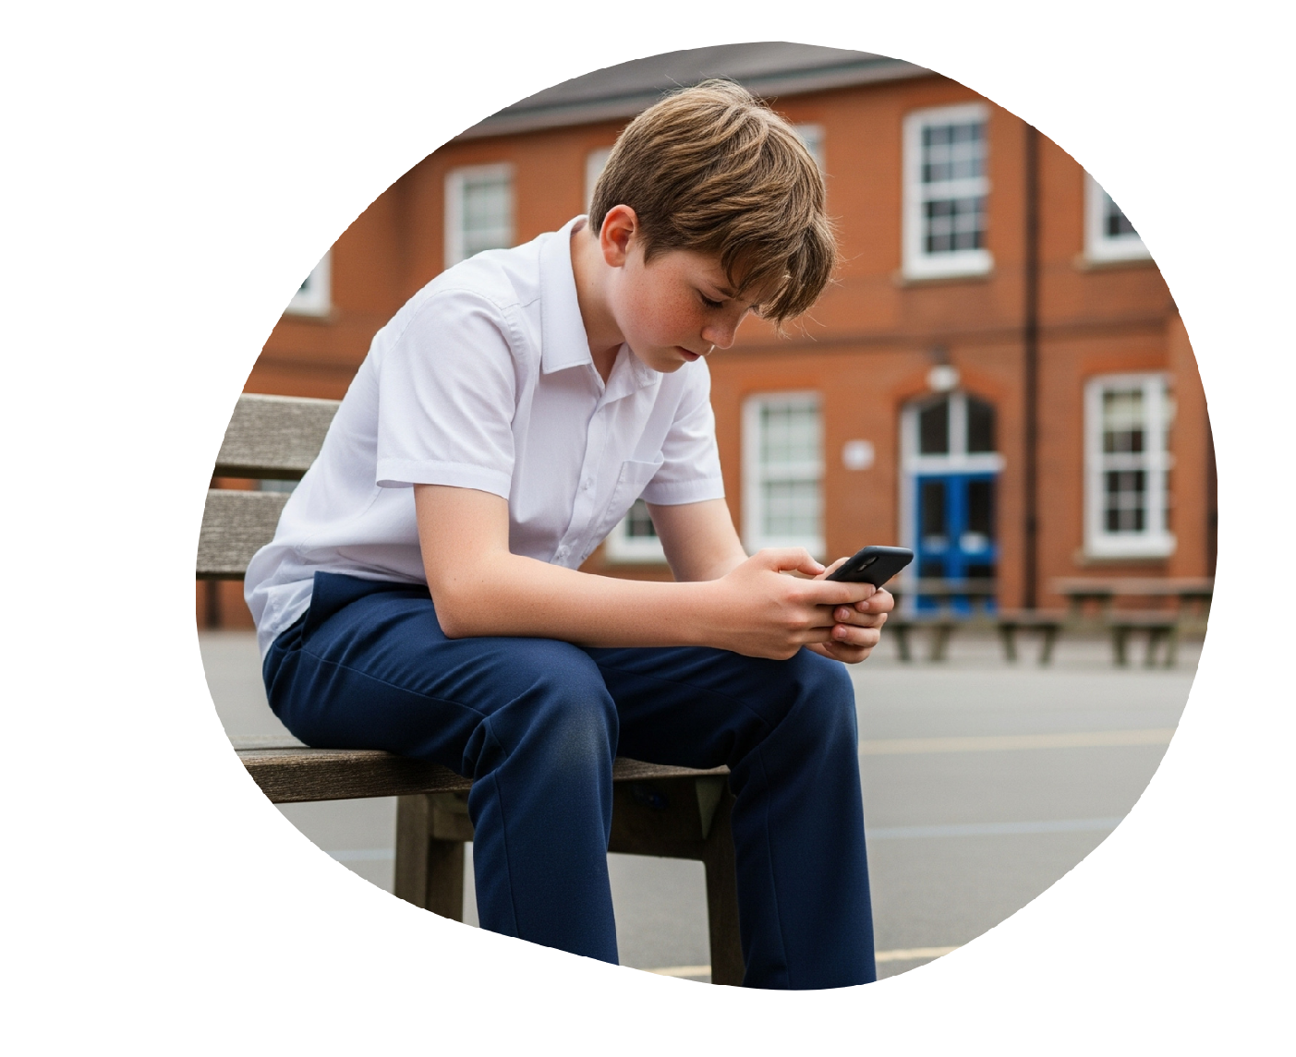

Mobile phones in school
Pupils should not have access to their phones during the school day.
Exceptions in our school include:
[Include details of how this impacts your
behaviour/mobile phone policies]
Notes:
Aany details about your school’s mobile phone policy including exceptions/adaptations
Tell staff that KCSIE 2026 expects all schools to be phone-free. This means that pupils should not have access to their mobile phone throughout the school day, including during lessons, the time between lessons, break and lunchtime.
This is also in line with the Children’s Wellbeing and Schools Act 2026 and the DfE’s statutory guidance on mobile phones in schools
Exceptions include [add what adaptions and exceptions your school makes, such as for pupils with medical conditions/pupils with disabilities/pupils with individual circumstance e.g. young carers, college students]
Explain that [your behaviour policy has or will be updated/your mobile phone policy] in line with these new requirements
Sources:
GOV.UK – Department for Education (DfE), Keeping Children Safe in Education. https://www.gov.uk/government/publications/keeping-children-safe-in-education--2
GOV.UK – Department for Education (DfE), Mobile phones in school. https://www.gov.uk/government/publications/mobile-phones-in-schools
Parliament.UK, Children’s Wellbeing and Schools Act 2026. https://www.legislation.gov.uk/ukpga/2026/21/contents/enacted

Slide 17

Serious violence
Serious violence might involve:
  Physical assault
  Carrying, threatening with, or using weapons
  Activity occurring during peer conflict, bullying or criminal exploitation
Notes:
Tell staff that KCSIE 2026 includes new guidance on serious violence
A new section clarifies that serious violence is a continuing safeguarding concern, and that schools have a key role to play in protecting children from violence
Serious violence often occurs in the context of peer conflict or bullying, and it can also be associated with criminal exploitation. It may involve:
Physical assault
Carrying, threatening with, or using weapons
Staff should report any concerns about a child carrying or using a weapon, or expressing the intent to do so to the DSL
Staff should also be alert to the signs that a child might be at risk of being involved in serious violence, especially for pupils with disrupted education or a history of offending
Source:
GOV.UK – Department for Education (DfE), Keeping Children Safe in Education. https://www.gov.uk/government/publications/keeping-children-safe-in-education--2

Slide 18
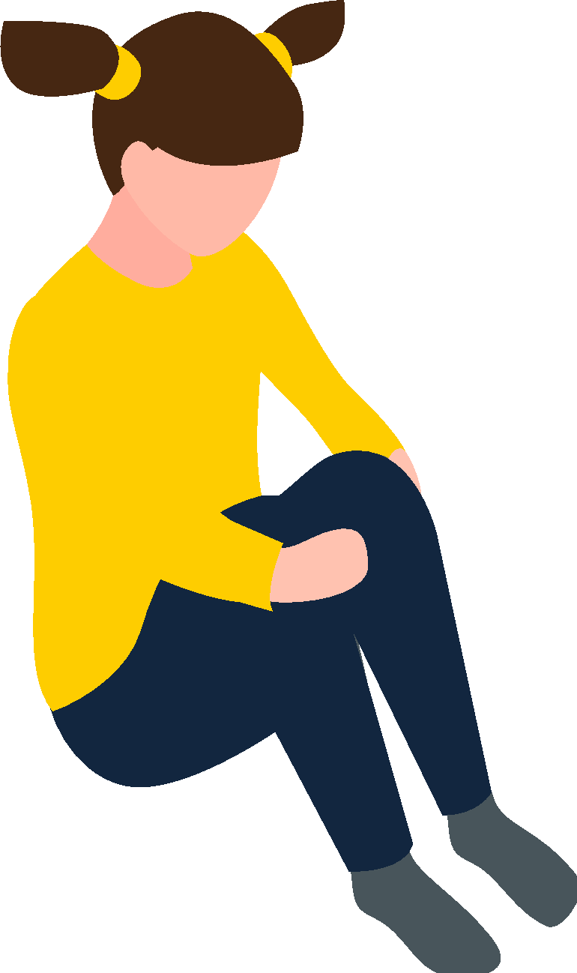
Harmful sexual behaviour, sexual harassment and sexual violence
Harmful sexual behaviour (HSB) between children:
  Exists on a continuum
  Can escalate into sexual harassment or sexual violence
Misogyny is an example of inappropriate behaviour that requires early intervention to help prevent escalation.
Treat all instances of HSB as a safeguarding issue.
Notes:
Tell staff that KCSIE 2026 includes updated guidance on child-on-child sexual harassment and sexual violence, including several changes to how harmful sexual behaviour (HSB) between children is referred to
KCSIE also clarifies that HSB exists on a wide continuum
All instances of HSB should be responded to with the same safeguarding principles, and considered within a child protection context – even if they feel like low-level incidents
KCSIE specifically refers to misogyny as an example of inappropriate behaviour that requires early intervention, to help prevent escalation to more serious abuse
Source:
GOV.UK – Department for Education (DfE), Keeping Children Safe in Education. https://www.gov.uk/government/publications/keeping-children-safe-in-education--2

Slide 19
All staff must now read Part 1 of KCSIE
DfE Part One KCSIE - ALL STAFF MUST READ IN FULL
All school staff need to read part 1 of KCSIE in full – including those who don’t work directly with children
There’s no longer a condensed version (annex A) for staff to read
Notes:
Tell staff that there’s a new expectation that all staff in school must read part 1 of KCSIE in full, to fully understand their safeguarding duties
This includes staff who don’t work directly with children – there’s no longer a condensed version of part 1 (previously called annex A) that these staff can read
Source:
GOV.UK – Department for Education (DfE), Keeping Children Safe in Education. https://www.gov.uk/government/publications/keeping-children-safe-in-education--2

Slide 20





Safeguarding is everyone’s responsibility
TAs
Catering staff
Teachers
Office staff
IT technicians
Notes:
Explain that you’re now going to see how every member of staff can play a role in safeguarding children
Select to bring up the different roles one by one
Acknowledge that you can’t cover every role in school in the time you have today and ask staff to find the role closest to their own on the slide. Ask staff to think about what they, in their role, might notice about a child that could be a cause for concern
Take some feedback from staff. Highlight:
Catering staff will see pupils interacting with each other outside class and overhear conversations. They might notice who’s eating more or less, or children who are stealing food
Office staff might notice high levels of absence, pupils who are often late, and/or parents and carers who are often tricky to get hold of or slow to respond to messages from the school
Teaching assistants might notice changes in behaviour in the pupils they work closely with in lessons
Teachers might notice children doing less well at school, changes in their behaviour and other small changes over time
IT technicians will see what pupils are searching for and trying to access
Taken on their own, these things might not seem like much. But, if staff report them, the DSL can start to build a picture. The staff member’s piece of information could be the final piece of the puzzle that helps the DSL to make a referral to local children’s social care

Slide 21

Look out for changes in a child
Difficulty concentrating and not doing as well at school
Mental health needs
Tiredness
Becoming withdrawn
Self-harming
Mood or behaviour changes
Increased absence from school or lessons
Risk-taking behaviour
Using drugs or alcohol
Notes:
You can choose to put this slide deck into a mentimeter to enhance staff interaction before presenting this slide.
Say that now we've seen that everyone has a role to play and we must always act on concerns, we’re going to look at the common signs that should always be a cause for concern
Ask staff: what have you previously seen that led to you making a report? If you haven’t made a report, what sort of things might you see that should make you worried about a child? Take a few suggestions from staff then select to bring up the signs and talk through them
If you’re choosing to do so, ask staff to connect to an interactive online tool, such as Mentimeter or Kahoot, to suggest changes in a child that might make them concerned
Select to bring the signs up in turn:
Difficulty concentrating and not doing as well at school
Becoming withdrawn
Mood or behaviour changes – for example, becoming more irritable, angry, aggressive or clingy, or displaying attention-seeking behaviour or ‘acting out’
Risk-taking behaviour – this could include behaviour such as stealing, bullying, running away, sexual activity, trespassing, vandalism, fighting or truancy
Mental health needs – this could be signs of depression, anxiety, an eating disorder or post-traumatic stress disorder, for example. Tell staff you’ll cover the common signs of mental health needs to be alert to later in this session
Tiredness
Self-harming – this could include disordered eating
Increased absence from school or lessons, which is also a safeguarding concern because we don’t know where pupils are outside or inside of school
Using drugs or alcohol, especially if they didn’t before
Note these signs are common across multiple different safeguarding issues and types of abuse
Emphasise that:
The key thing to look for is a change in the child. Staff don't need to 'diagnose' an issue or know exactly what it might be, just notice that something might be wrong and act. It’s for others to investigate what the issue might be
Children can try to communicate that something is wrong through their behaviour, either intentionally or unintentionally
Staff should be professionally curious about what might be behind the change they’re seeing
Some of these signs might be innocent – for example, a child might experience mood swings as they go through puberty – but they should always be reported
Sources:
NHS, Spotting signs of child sexual abuse. https://www.nhs.uk/live-well/spotting-signs-of-child-sexual-abuse/
NSPCC, Protecting children from sexual exploitation. https://learning.nspcc.org.uk/child-abuse-and-neglect/child-sexual-exploitation
NSPCC, Spotting the signs of child abuse. https://www.nspcc.org.uk/what-is-child-abuse/spotting-signs-child-abuse/
GOV.UK – Department for Education (DfE), Keeping Children Safe in Education. https://www.gov.uk/government/publications/keeping-children-safe-in-education--2

Slide 22
Reflection task
Eli, a confident and talkative child, has become anxious and quiet, after returning from the summer holidays
Tashan usually plays football with his friends at breaktime,
but he’s been getting into a lot of arguments with them. One argument even turned into a physical fight that you had to break up
Bea has missed a lot of school and is starting to fall behind. Her mum keeps calling the school to say she’s unwell, but it keeps happening and she’s missed at least 1 day a week in the last term
Folayemi usually loves science, but recently she refused to go on a whole-year trip to the museum and asked to stay behind at school instead
Notes:
Optional reflection task. Delete this slide if you need a shortened version of this section
[Delete the yellow text if you’re not adding any scenarios specific to the EYFS]
Ask staff to look at the 4 examples and think about whether there should be a safeguarding referral made. They should discuss this with the person next to them
Take some feedback from staff
Highlight that something in Eli’s home circumstances might have changed over the summer holidays, and that finding out what might be happening at home could be helpful
Highlight that Tashan could be going through some issues with his peers and while this might not necessarily be a safeguarding concern, we should try to find out more so he can be supported
Highlight that Bea’s increased absence from school could be a safeguarding concern in itself
Identify that Folayemi might be avoiding a specific person, or showing a lack of interest in a topic she used to enjoy
In all cases, it doesn’t necessarily mean there’s a safeguarding issue, but we need to notice the signs and report any changes in behaviours we see, just in case
If there are EYFS staff in this session, you can use KeyGPT to come up with a scenario more specific to the EYFS setting and add it to the text on the slide

Slide 23
Summary: key points about what safeguarding is and what it means for you
Safeguarding means making sure children grow up safe, happy and healthy
Always assume ‘it could happen here’
We all have a role to play in safeguarding children – no matter our role
Be alert to changes in a child
The safeguarding team is here to listen to any concerns you have
Notes:
Explain that you’ve now covered the first 2 learning objectives
Read through the main points from this section
Ask staff if they have any questions about what you’ve covered so far

Slide 24
Section 3
Some pupils are more vulnerable than others
Notes:
Tell staff that you’re now going to look at the ways in which some pupils are more vulnerable than others

Slide 25


Some children are more vulnerable than others
SEND or another health need
LGBTQ+
Privately fostered
Social, emotional and mental health needs (SEMH)
Previously in care
Frequently missing from home, care and/or school
At risk of honour or faith-based abuse, e.g. FGM or forced marriage
Repeatedly removed from the classroom, multiple suspensions, part-time timetable, risk of permanent exclusion
Parent or carer
in custody or affected by parental offending
Pregnant or a parent themselves
Notes:
Tell staff that while all children are vulnerable to abuse, there are some we need to pay particular attention to, as they're more vulnerable than others
Select to bring up the groups of pupils who are more likely to need early help or may be at greater risk of harm and run through them. These are pupils who:
Have special educational needs or disabilities (SEND), certain health conditions or specific additional needs
Have social, emotional and mental health needs (SEMH)
Are frequently missing from care, home and/or school, or are persistently absent, including absences for part of the school day
Have a parent or carer in custody, or are affected by parental offending
Have been repeatedly removed from the classroom, have experienced multiple suspensions, are on a part-time timetable, or are at risk of permanent exclusion
Are pregnant or are parents themselves
Are at risk of honour or faith-based abuse, e.g. female genital mutilation or forced marriage
Have returned home to their family from care
Are privately fostered
Are LGBTQ+, or perceived to be
Explain that there are further groups of pupils who are more vulnerable to abuse on the following slide
Source:
GOV.UK – Department for Education (DfE), Keeping Children Safe in Education. https://www.gov.uk/government/publications/keeping-children-safe-in-education--2

Slide 26

Some children are more vulnerable than others
Challenging family circumstances
Young carers
Involved in a gang
At risk of radicalisation into terrorism
Being drawn into
antisocial or
criminal behaviour
At risk of
modern slavery, trafficking or exploitation
Educated at home
Exhibiting early signs of abusive, violent and/or harmful behaviours
Misusing drugs
or alcohol
Family member experiencing poor mental health
Notes:
Explain that this slide is a follow-on from the previous slide, listing further groups of pupils who are more vulnerable to abuse
Select to bring up the groups of pupils who are more likely to need early help or may be at greater risk of harm and run through them These include pupils who:
Are in challenging family circumstances – for example, living around drug and alcohol misuse or domestic abuse
Are at risk of radicalisation
Are at risk of modern slavery, trafficking or sexual or criminal exploitation
Are misusing drugs or alcohol
Have exhibited early signs of abusive, violent and/or harmful behaviours
Have a family member experiencing poor mental health
Are educated at home and therefore less visible to the services that are there to keep them safe and supported in line with their needs
Are showing signs of being drawn into antisocial or criminal behaviour, including gang involvement and association with organised crime groups or county lines
Are involved in a gang
Are young carers
Note that early help means providing support as soon as a problem emerges at any point in a child’s life, from the foundation years through to the teenage years
Source:
GOV.UK – Department for Education (DfE), Keeping Children Safe in Education. https://www.gov.uk/government/publications/keeping-children-safe-in-education--2

Slide 27


Be even more alert to our …
Children with SEND and SEMH needs
They can be more vulnerable because they might:
Rely on others more, or be more innocent or trusting
Find it harder to tell someone about their abuse
Be less likely to understand their experiences as abuse
Be more prone to isolation or bullying
Find it harder to communicate their feelings and emotions
Signs of abuse might also be missed or dismissed.
Many forms of SEND are invisible – this doesn’t mean these
children are less vulnerable.
Always use professional curiosity: think ‘Why?’ or ‘What might be going on here?’
Notes:
Tell staff you're going to look at a particular group in more detail now: pupils with special educational needs and disabilities (SEND) and social, emotional and mental health needs (SEMH)
Highlight that children with disabilities are over 3 times more likely to be abused than other children
Explain they're more vulnerable as they might:
Rely on others for assistance and care, giving abusers more opportunities to abuse them. They might be more prone to trusting others, and/or naïve when it comes to abusive behaviour. For example, they may be more likely to believe lies told to them by strangers on the internet, or more likely to assume that an abusive family situation is normal
Find it harder to communicate their abuse. This could be due to communication barriers caused by their speech, language and communication needs, or because they’re more isolated and have fewer opportunities to tell someone about abuse
Be less likely to understand that what they're experiencing is abuse. This doesn’t mean they aren’t harmed by abuse, though – they’re still experiencing harm
Be more prone to isolation and/or bullying by their peer group due to their SEN or disability
Find it harder to communicate their feelings and emotions
Signs of abuse can also be missed, as they're seen as symptoms of their SEN or disability or caused by their SEN or disability. For example, bruises might be assumed to be caused by disability equipment or problems with mobility. Or, children experiencing abuse or attempting to tell someone about their abuse might self-harm or display inappropriate sexual behaviour, or other repetitive or challenging behaviours, which are misinterpreted as part of their needs or disabilities
Remind staff that:
All forms of SEND are different, and even 2 pupils with the same form of SEND may have different strengths and weaknesses. All these risk factors may or may not be true for any individual
SEND is more than the stereotyped use of wheelchairs and/or blindness or deafness – a lot of SEN and disabilities are invisible, and it can be easy to forget that these children are also vulnerable. For example, neurodivergent pupils can be particularly good at ‘masking’, where they hide their struggles and act as though everything is fine when it’s not
Give staff an example. Either use an (anonymous) example from your context if you have one, or share the example below:
A 15-year-old girl – ‘Maria’ – was the victim of criminal exploitation and sexual exploitation
Maria had SEN and speech and language difficulties, which she received support for at school
Maria was targeted by a gang in her local area on her way to and from school
On one occasion Maria went missing, and was found 3 hours away from her home by the police
It turned out the gang had used Maria to transport class A drugs, which is known as ‘county lines’
Maria’s speech and language issues meant she found it difficult to communicate what had happened to her
The gang also gave her a sense of belonging that she lacked with her peers at school
It later emerged Maria had been sexually assaulted by 2 different men in the gang
So, what should staff do?
Be even more alert to children with SEND and any signs that something might be wrong
Always use professional curiosity. Think ‘Why?' or ‘What might be going on here?’
Sources:
GOV.UK – Department for Education (DfE), Keeping Children Safe in Education. https://www.gov.uk/government/publications/keeping-children-safe-in-education--2
Safeguarding network, Specific Risks for Children with Additional Needs. https://safeguarding.network/content/safeguarding-resources/specific-risks-children-additional-needs/
GOV.UK – Ofsted, Social care commentary: protecting disabled children. https://www.gov.uk/government/speeches/social-care-commentary-october-2017

Slide 28
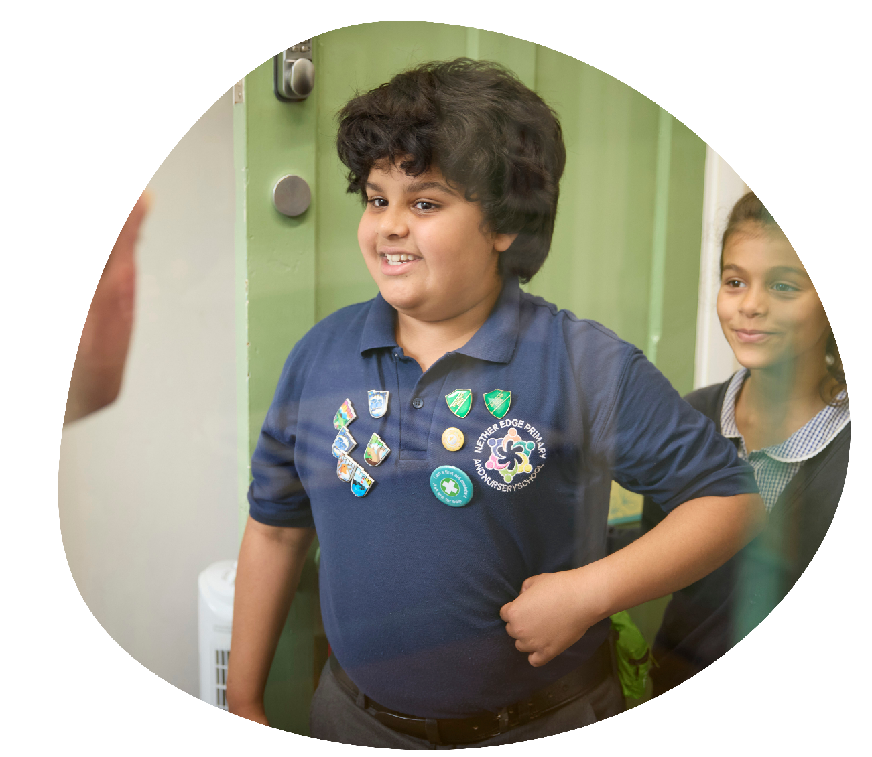
Be even more alert to our …
Children who are LGBTQ+
They can be more vulnerable because they might:
Be a more likely target for bullying
Be at higher risk of homophobic, biphobic or
transphobic hate crimes
Feel different and isolated from their peers
Not have a trusted adult to talk to about how they feel
Pupils who may be perceived to be LGBTQ+ share the same risk factors as those who are
Notes:
Tell staff you're going to look at another particular group in more detail now: pupils who are, or are perceived to be, LGBTQ+
Highlight that nearly half of LGBTQ+ children experience bullying in school, and 1 in 10 find themselves having to leave their family home due to rejection or an unsafe environment
Explain they may be more vulnerable as:
They may be a more likely target for bullying and/or hate crimes related to their sexuality and/or due to questioning their gender. They may be aware that they are in some way different from their peers, or that they don’t fit in, and can’t be themselves
They may not be ‘out’ to friends or family and may be worrying about coming out at home or to their friends. If they’re worried about coming out to family, it’s likely that they don’t have a trusted adult to share their concerns with
Children who are LGBTQ+ may be more at risk of experiencing abuse or homelessness due to rejection by their family
Emphasise to staff that pupils don’t need to be LGBTQ+ to be subject to bullying or abuse. They may still be on the receiving end of this abuse if they are perceived to be LGBTQ+, regardless of their own identity
KCSIE 2026 emphasises that schools should be aware of the potential vulnerabilities of children who are questioning their gender, including the possibility of complex mental health needs and psychosocial needs, e.g. relating to family relationships, and relationships with peers or their broader social environment including discriminatory bullying
Sources:
GOV.UK – Department for Education (DfE), Keeping Children Safe in Education. https://www.gov.uk/government/publications/keeping-children-safe-in-education--2
NSPCC, Safeguarding LGBT+ children and young people. https://learning.nspcc.org.uk/safeguarding-child-protection/lgbtq-children-young-people

Slide 29
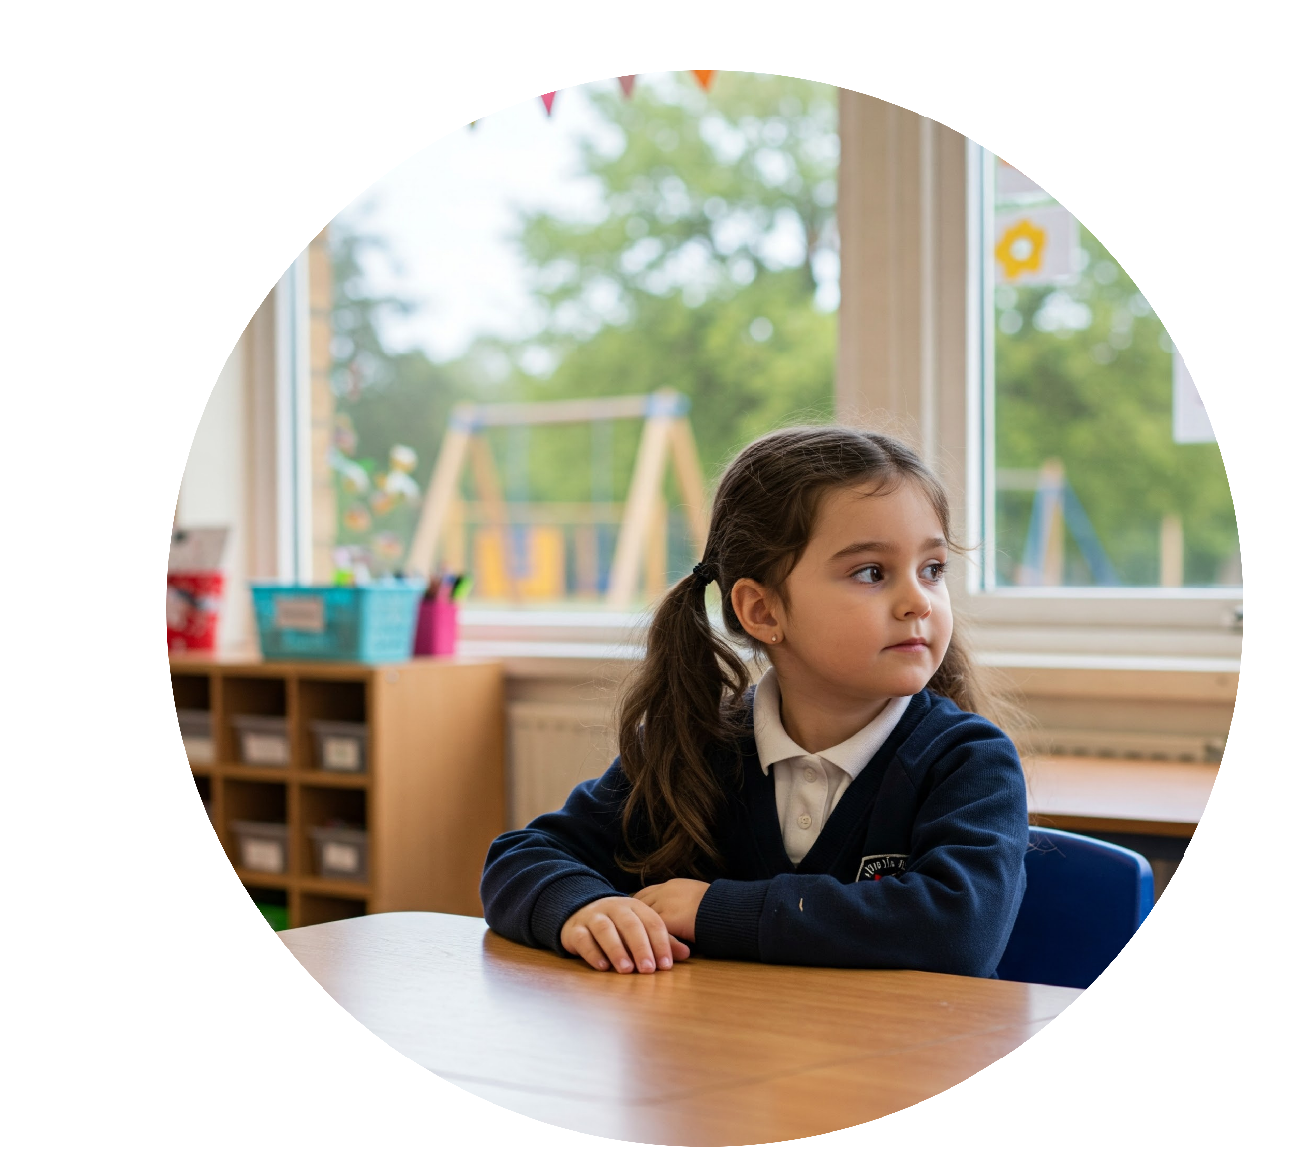
Reflection task
Read the example scenario below.
What factors might make this pupil more at risk of abuse?
Meet Kirat, a pupil in year 8. Kirat has autism and sometimes finds it difficult to talk when she’s stressed or overwhelmed.
Normally, Kirat is engaged and interested in her schoolwork, but recently she’s been less focused. She’s started being late to class and missing lessons.
Kirat is a looked-after child and has a new carer who she has only known for a few months.
Notes:
Optional reflection task. Delete this slide if you need a shortened version of this section.
Allow staff a couple of minutes to read through the example scenario, and reflect on the factors that make the pupil more at risk of abuse
Invite staff to feed back to the room, and take 1 or 2 responses
You’ll expect to hear staff highlight the following factors (remember to edit the points below if you created a new scenario):
Kirat has SEN, including communication challenges
Kirat might be more at risk as a looked-after child
Kirat’s home circumstances have changed, with her having a new carer
Kirat has been less focused and absent from class – this change in behaviour could flag a concern

Slide 30
Summary: some pupils are more vulnerable than others
Remember that all children are vulnerable, but some groups are more vulnerable than others
Be even more alert to children with SEND and SEMH, and children who are, or are perceived to be, LGBTQ+
Remember, all pupils can be victims of abuse, so we need to stay alert to the signs
Notes:
Explain that you’ve now covered the first 3 learning objectives
Read through the key points on the slide
Ask staff if they have any questions about what you’ve covered so far

Slide 31
Section 4
Responding to a safeguarding disclosure
Notes:
Tell staff you're now going to look at responding to a disclosure of a safeguarding incident, and what your safeguarding responsibilities mean in practice
In this section you’ll cover:
What to do if a child makes a disclosure
The ways in which children communicate abuse
Writing safeguarding reports

Slide 32
Let’s discuss …
What are some of the key things to remember when taking a disclosure from a pupil?
Notes:
Delete this slide if you need a shortened version of this section.
Give staff 2 minutes to discuss the question in small groups or pairs, and to try and think of 2 or 3 examples
Once the time is up, ask someone from each group to give an answer

Slide 33

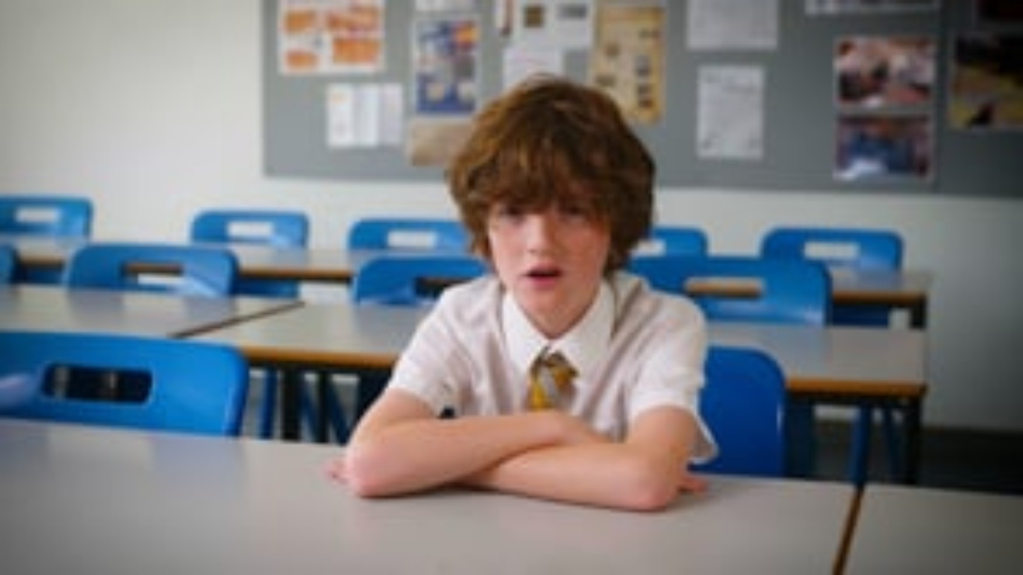
Listen to Dylan’s experience
Trigger warning: This video contains reference to neglect and emotional abuse.
Notes:
[Select play to start the video: 1:33]
Remind staff that children might not know how to, or be ready to, report or even speak about abuse
Children might not tell someone about abuse because they:
Don’t recognise their experiences as harmful
Are ashamed or embarrassed
Have been threatened (or a family member has been threatened)
Are being blackmailed
Are worried about not being believed or about what might happen next
Feel they don’t have anyone to turn to
Are worried that they might get a family member in trouble
Disabilities, sexual orientation, vulnerabilities and language barriers might also affect children’s ability or willingness to talk about abuse
In particular, younger children might not have the language to describe their abuse
It’s important staff can respond appropriately if a child does tell them about abuse, so we’re going to spend some time looking at this now. We’re going to start by watching a video where you see a child tell an adult about a harmful experience they’re in
Note afterwards that the child in the video is played by an actor, but the story is real
Source:
GOV.UK – DfE, Keeping Children Safe in Education. https://www.gov.uk/government/publications/keeping-children-safe-in-education--2
Video link: https://vimeo.com/1205751001/a2d31c192a

Slide 34
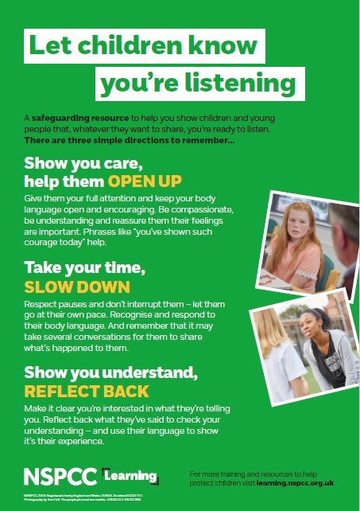

If a child makes a disclosure …
Do …
Find a calm, quiet space to talk
Let the child lead the conversation
Practise ‘active listening’
Ask open questions
Reassure them that they’re not in trouble and will be kept safe
Reflect on what they’re saying
Be clear about what you’ll do next
Ask the child if it’s OK for you to take notes, or to write down what they’ve told you afterwards
If you think a child won’t feel comfortable if you’re taking notes, try to take notes immediately after the conversation instead.
Notes:
Ask staff: imagine you’re the adult hearing this from Dylan – what should you do now?
Take some feedback from staff
Select to bring up the ‘dos’ on the slide and talk through them. Make sure to draw out any points that staff didn’t mention in their feedback
Find somewhere where you can talk comfortably. Listen fully, be supportive and take Dylan seriously
Let him lead the conversation – it might be tempting to interrupt during any pauses, but don’t
Ask open questions, not closed or leading questions
Reassure Dylan that he won’t get into trouble for sharing the information, and that he’ll be kept safe
Reflect on what he’s saying, to check your understanding and make it clear you’re interested in what he’s telling you
Be clear about what happens next – including who you’ll need to tell – but reassure Dylan that you’ll only talk to people who really need to know
If you need to take notes, ask the child if they’re comfortable with that first
Tell staff that if they feel a child won’t feel comfortable if they’re taking notes, they should try to do this immediately after the conversation instead
Source:
GOV.UK – DfE, Keeping Children Safe in Education. https://www.gov.uk/government/publications/keeping-children-safe-in-education--2

Slide 35

If a child makes a disclosure …
Don’t …
Give the child the impression they’re creating a problem
Blame the child for what’s happened, in any way
Ask leading questions that suggest an answer
Make promises about keeping things confidential
Make further investigations yourself
Criticise the alleged perpetrator
Be overly emotional
Barriers to Disclosing ​
•Not having a trusted adult to talk to / lack of trust in adults.​
•Not understanding that they are being abused.​
•Fear of not being believed.​
•Shame, embarrassment, feelings of guilt, self-blame.​
•Previous poor responses to disclosures.​
•Fear of the consequences for themselves or others.​
•Worry about the impact on others.​
•Fear of getting into trouble / being told off.​
•Fear of preserving family or community honour.​
​
Notes:
Select to bring up the ‘don’ts’ on the slide and talk through them. Make sure to draw out any points that staff didn’t mention in their feedback
Don’t give Dylan the impression that he’s creating a problem by telling you about what’s happened
Don’t promise confidentiality – be honest that you’ll need to tell someone else
Don’t try and gather further information from other parties involved. It’s the DSL’s job to co-ordinate what happens in response to safeguarding concerns, such as allegations of abuse and neglect. If staff confront the alleged abuser (in this case, Dylan’s mum) themselves or try to investigate it, they could make things worse for the child
Don’t criticise the alleged perpetrator – this can make the situation more emotionally charged for the child
Don’t be overly emotional – this can make it more difficult for the child to make a disclosure. Be supportive but as calm as possible
Source:
GOV.UK – DfE, Keeping Children Safe in Education. https://www.gov.uk/government/publications/keeping-children-safe-in-education--2

Slide 36
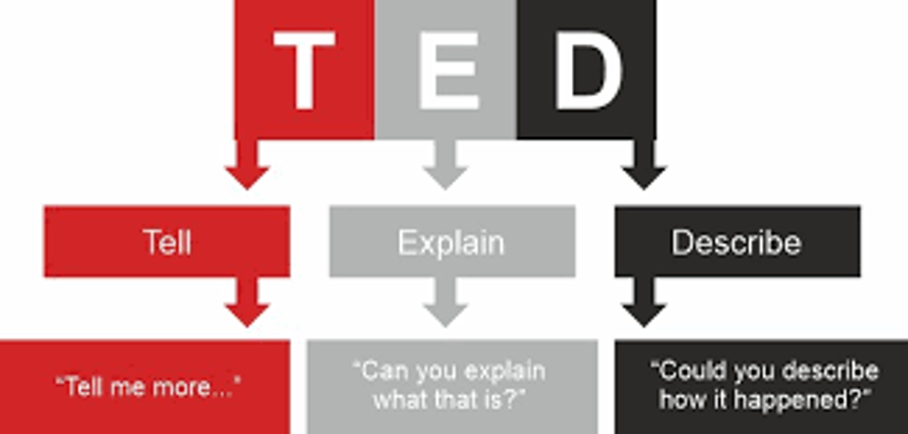
Remember
Be professionally curious
(with pupils, with families, with professionals)
Think the unthinkable and take the unbelievable seriously
Remember, it could happen here
Deal with the facts
Keep the child at the center
Think TED – DO NOT ask leading questions
Explain your next steps clearly to the pupil

Slide 37


Let’s practise responding to a pupil
Practical activity
Time for activity: 6 minutes
What to do:
With your shoulder partner, use the scenarios in section 1 of your activity packs, to practise responding to a disclosure
Swap around, so you both have the chance to respond to a scenario
Think about how you’d respond, and what your next steps would be
Notes:
For this activity, staff should get into pairs
Tell staff they’re now going to do an exercise to practise responding to a safeguarding disclosure
Putting the learning into practice in a safe environment will help them to use it in a real situation
They’re going to split off into pairs, and each take 1 scenario of a disclosure (they can find them in section 1 of their activity packs)
One staff member will roleplay as the pupil making the disclosure, and the other will practise responding to it
They should spend about 3 minutes on each scenario
If they have time, discuss what they would do next in the situation
Make sure everyone knows who they’re paired with, and which scenario they’re looking at
Once the 6 minutes are up, get everyone back together and move on to the next slide

Slide 38




Children might try to communicate abuse in different ways:
“I don’t want to go home”
Self-harm
Writing stories featuring abusive families
Acting inappropriately for their age
Changes in behaviour
Notes:
Tell staff that children might also try to tell someone about their abuse indirectly. This is sometimes known as an ‘indirect disclosure’
Select to bring up the different ways a child might try to tell someone about abuse indirectly. They might:
Communicate through behaviour – for example, self-harming, becoming withdrawn or ‘acting out’ to try to communicate their distress
Act inappropriately for their age – for example, sexual language and behaviour in younger children might be a sign of sexual abuse
Make ambiguous verbal statements, such as “I don’t want the holidays to start” and “I don’t want to go home – I want to stay at school”
Communicate non-verbally – for example, writing a letter or drawing pictures, unexplained injuries in unusual locations (bruises, burns or marks), flinching when touched or approached, poor personal hygiene or consistently unkempt appearance, inappropriate clothing for the weather, noticeable weight loss or gain, appearing constantly tired, hungry or unwell, avoiding eye contact
Changes in behaviour – changes in behaviour or mood can indicate a concern, such as attention-needing behaviour or being more withdrawn and quieter than usual or refusing personal care when they would ordinarily accept this
Tell staff they should be on the lookout for these behaviours
If they notice any, they should ask the child if everything is OK and chat to them about the behaviour they’ve noticed, and/or ask another member of staff who the child trusts to do the same
If in doubt, they could talk to the DSL about the best way forward
This might lead to children telling them directly about abuse they’ve experienced, which will help you get the child the help they need

Slide 39

Can you spot a ‘good’ safeguarding report?
Report 1
Date: 14 September 2026
Time: 4:30pm
Dylan came to see me in my classroom at lunchtime today and said that he wanted to talk to me about things happening at home.
He said that his mother is often angry with him, especially if she’s been drinking, and he’s worried about how she treats his brother Kai.
Dylan said his mother hasn’t done any laundry or food shopping recently, and he’s had to come into school without lunch. Kai also told him that he’s hungry.
He said that he’s tired, struggling to focus, and worried about his little brother.
Notes:
Tell staff that they’re now going to think back to Dylan, who made a disclosure about his home life. You’re going to look at 2 reports that a staff member might make about his disclosure
Ask staff time to read report 1 and think about whether this is a good report or not and why
Let staff know that they can also read the report in section 2 of their activity pack, and give them time to do so

Slide 40
Can you spot a ‘good’ safeguarding report?
Report 2
Date: 14 September 2026
Time: 1.30pm
Dylan came to see me in my classroom at lunchtime today and said that he wanted to talk to me about things happening at home. He said that his mother is often stressed about money and cross with him, and that it’s worse “at night after she’s had a drink”. He tries to stay out of her way and is worried that she will shout at his little brother Kai.
Dylan said his mother hasn’t been doing laundry, and he’s worried that his clothes smell at school. He also reported not getting fed breakfast, and last week he came into school without a packed lunch. Today, there was nothing to put in Kai’s lunchbox either.
He said that he’s tired, hungry, struggling to focus on school because his head is “fuzzy”, and that his body “hurts a lot”.
Notes:
Give staff time to read report 2 in section 2 of their activity pack
Ask 1 or 2 members of staff to feed back to the group about which report is better
Explain that the example report 1 summarises what happened but lacks detail about some of the things Dylan said. The report also lacks detail about where and when events happened. For example, we know that Dylan came to school without lunch, but we don’t know when this happened
Explain that the example report 2 shows a model report. This is the level of detail staff should be writing down – whether it’s an allegation of abuse or reporting a safeguarding concern
Emphasise that they should always make a report immediately afterwards, or as soon as possible if they can’t do it straight away, so their report is as accurate as possible
Where they can’t make the report immediately, it’s crucial to hold the key details of who, what, where and when in mind
They should use the pupil’s own words as much as possible when writing the report
Highlight that:
Poor record keeping is often mentioned in serious case reviews
Their report may be used as part of a statutory assessment process, or as evidence in court. Not keeping accurate records can stop children getting the help they need

Slide 41

High Quality Safeguarding Recording
how small — that an adult working in or on behalf of a school may have acted in a way that is inconsistent with the staff code of conduct, including inappropriate conduct outside work, and that does not meet the harm threshold or require a referral to the Local Authority Designated Officer (LADO).
Use Full names and roles
Describe a clear sequence of events
Stick to factual observations
Use concise and simple sentences
Use direct quotes
Select relevant categories
Record actions taken or required
Link students
Date and time
Attach supporting files
Always review before submitting
Ensure accuracy for legal purposes
Notes:
Describe a Clear Sequence of Events: When possible, outline the events in the order they occurred to provide a clear understanding of how the incident unfolded.
Stick to Factual Observations: Record what you directly observed, avoiding any interpretation or assumptions about the event.
Use Concise and Simple Sentences: Keep your descriptions clear, and free from unnecessary details or embellishments.
Use Direct Quotes: Whenever possible, include the exact words of the student or other individuals involved, and use quotation marks to clearly distinguish their speech.
Select Relevant Categories: Choose at least one category for the incident, or more if applicable.
Record Actions Taken or Required: Include any actions you took, or that need to be taken, to provide a full picture of the incident and where it's at.
Link Students: If other students are involved, please ensure that they are linked into the incident for accurate record-keeping.
Date and Time: If you're adding the incident after it occurred, you can update the date and time to reflect when it actually took place, if necessary. The actual date and time of logging will be recorded in the incident 'History' log.
Attach Supporting Files: Under the 'Files' section, you may attach any relevant documents or files that support the incident.
Always Review Before Submitting: Double-check your incident log for any errors or missing information before you submit it.
Ensure Accuracy for Legal Purposes: Remember, CPOMS incident and action logs may be used as official evidence in legal proceedings.

Slide 42

Record keeping
Records should include:
A clear and comprehensive summary of the concern
Details of how the concern was followed up and resolved
A note of any action taken, decisions reached and the outcome
Notes:
As well as making a robust initial report, follow-up records also need to be kept up to date
KCSIE says that all concerns, discussions and decisions made, and the reasons for those decisions, should be recorded in writing
Records should include:
A clear and comprehensive summary of the concern
Details of how the concern was followed up and resolved
A note of any action taken, decisions reached and the outcome
If staff are not sure about what they need to record, they should talk to the DSL
Source:
GOV.UK – DfE, Keeping children safe in education. https://www.gov.uk/government/publications/keeping-children-safe-in-education--2

Slide 43


What happens after you make a report
You have a concern or
a child tells you about abuse
If the child is in immediate danger and the DSL/deputy DSL isn’t available:
Make a referral to your LA’s children’s social care: [add contact details – see slide notes]
Call the police if appropriate
You report it to the DSL or deputy DSL
The DSL decides what to do next
Further support within school
Family help assessment
Referral to
children’s social care
Contact family, carer and/or social worker
Notes:
[In advance, edit this slide to include the contact details for your local children’s social care team, and your local police force]
Tameside:
You can call the Multi Agency Safeguarding Hub on 0161 342 4101
Monday to Wednesday 8:30am to 5pm
Thursday 8:30am to 4:30 pm
Friday 8:30 – 4pm
After these times, you can contact the Emergency Duty Team on 0161 342 2222
Or you can speak to someone at Childline on 0800 1111. Calls are free and confidential. You can also contact someone through the Childline website
Oldham
You can call the Multi Agency Safeguarding Hub on 0161 770 7777
Rochdale
Children Social Care Team. ehash@rochdale.gov.uk or 0300 303 0440
Adult Social Care Team. adult.care@rochdale.gov.uk or 0300 303 8886
Talk through what happens when staff report concerns. Select to reveal each point as you make it
A member of staff has a safeguarding concern about a child, or a child tells them about abuse that’s happened to them
If they think a child is in immediate danger and the DSL or deputy DSL, or another member of the senior leadership team, isn’t available, they can make a referral to the local authority’s children’s social services themselves, and contact the police if appropriate
Immediate danger means that a child is suffering harm or is likely to suffer harm
To decide whether a child is in immediate danger, staff should ask themselves: if I don’t do something now, will they come to harm? (Note that this will always be subjective)
Staff should still tell the DSL or deputy DSL as soon as possible after making a referral
In most cases though, staff will make a report to the DSL first
Reiterate that their job isn’t to investigate, just to report
The DSL will then decide what to do next
The child might receive support within school, using your school’s own pastoral support processes
The child and their family might get a family help assessment
The DSL might make a referral to the LA children’s social care team. If the LA makes a statutory assessment for a child in need plan or child protection plan, staff might be involved in the assessment. If so, the DSL will support the staff member with this
If staff do not hear about what happened following a referral, they should speak to the DSL. While the DSL will aim to keep staff informed, they are often managing a number of concerns at once, so please feel confident in seeking an update if needed.
Source:
GOV.UK – DfE, Keeping Children Safe in Education. https://www.gov.uk/government/publications/keeping-children-safe-in-education--2

Slide 44

Share any concerns about other members of staff
If you have concerns about … | Speak to … | How …
A member of staff | Headteacher | Contact details
A volunteer | Headteacher | Contact details
The headteacher | Chair of governors | Contact details
If there’s a conflict of interest in reporting to the headteacher, you can seek advice from the central HR team.
LADO details: [add name and contact details here – see notes for contact details]
Remember: think the unthinkable
Notes:
Edit this slide to include the names and contact details of your headteacher and chair of governors, and the contact details of your local authority designated officer (LADO)
Tameside LADO:
Laurie Warburg
0161 342 2482 or 0161 342 4343 option 3
07808212203
laurie.warburg@tameside.gov.uk
ladoreferrals@tameside.gov.uk (this is where all LADO referrals must be sent)
Oldham LADO:
Collette Morris
0161 770 0008
07974619094
colette.morris@oldham.gov.uk
Wendy Nicholls
0161 770 0008
07974619094
wendy.nicholls@oldham.gov.uk
Rochdale LADO:
Louise Hurst
lado@rochdale.gov.uk
0300 303 0350
Highlight that as well as safeguarding issues outside school, we need to be aware of the potential for abuse in school by staff:
We need to ‘think the unthinkable’ – staff and volunteers may also abuse pupils
We should always report any concerns we have
Tell staff that they should report anything where a member of staff has done, or they think they might have done, any of the following:
Behaved in a way that has harmed a child, or may have harmed a child
Possibly committed a criminal offence against or related to a child
Behaved towards a child or children in a way that indicates they may pose a risk of harm to children
Behaved or may have behaved in a way that indicates they may not be suitable to work with children
Tell staff how to report allegations against other staff members
Make sure you cover who to report to, which will depend on who the concern is about, and how to report
Explain that concerning behaviour outside of school should also be reported
Highlight that supply staff, trainee teachers, contractors and volunteers are also covered by your procedures for handling allegations and safeguarding concerns
Mention that if there is a conflict of interest in reporting an allegation to the headteacher, staff should report it directly to the LADO
Sources:
GOV.UK – DfE, Keeping Children Safe in Education. https://www.gov.uk/government/publications/keeping-children-safe-in-education--2
Independent Inquiry into Child Sexual Abuse, The residential schools investigation report. https://www.iicsa.org.uk/reports-recommendations/publications/investigation/residential-schools

Slide 45
Act on ‘nagging doubts’, too
Low-level concerns are named as such simply because they do not meet the threshold of an allegation. All low-level concerns must be reported so that we can foster a culture of vigilance. Low-level concerns include behaviour that’s:
Report low-level concerns by:
Completing a Forms: Low-Level Concern Form - Part A (All Staff) - Fill Out Form
If the low-level concern is regarding a staff member, talk directly to the Headteacher. Discuss only with the Headteacher.
If the low-level concern is regarding the Headteacher, talk directly to the Executive Headteacher or the Chair of Governors if there is no Executive Headteacher. Discuss only with the Executive Headteacher or Chair of Governors.
If the low-level concern is regarding the Executive Headteacher, talk directly to the Chair of Governors. Discuss only with the Chair of Governors.
The low-level concern form is shared directly to central HR and to the Advisor for Safeguarding and Behaviour so that they are managed effectively and proportionately.
Inadvertent or thoughtless
Inappropriate for
the circumstances
Ultimately intended to enable abuse
Notes:
[In advance, edit this slide to set out how staff should report low-level concerns]
Explain that low-level concerns are concerns where the behaviour of an adult in your school doesn’t follow your staff code of conduct, including inappropriate conduct outside of work, but the behaviour doesn’t meet the ‘harm’ threshold or isn’t serious enough to refer to the LADO
Low-level concerns are part of a spectrum of behaviour, from inadvertent or thoughtless behaviour or behaviour that seems inappropriate, to behaviour ultimately intended to enable abuse
Give examples for each of the ‘bubbles’ on screen:
Inadvertent or thoughtless – a member of staff sends a pupil out of the classroom to deliver a note to the office. The child does not return after a few minutes, but the member of staff doesn’t note this and makes no effort to find out where they’ve gone
Inappropriate for the circumstances – a teacher shows pupils photos from their private Instagram page, revealing their username
Intended to enable abuse – a teacher asks a pupil for their mobile phone number in order to message the pupil privately
Give an example:
The report from the Independent Inquiry into Child Sexual Abuse talks about teachers who abused children being in positions of high esteem, and using their position to allow them to spend time alone with children
In the case of one teacher, a pupil believed they were in a “romantic relationship” with their teacher and their teacher led them to believe that they were “in love”
It was only later as an adult, that the victim realised that this was part of the manipulation their teacher used to abuse them
Essentially, if staff feel uneasy or uncertain about another member of staff’s behaviour towards or around children, they should report it. Just because it doesn’t meet the ‘harm’ threshold doesn’t mean it’s insignificant, or not worth acting on
Small concerns can help to build a picture
In the previous example, 1 adult had said they thought the teacher’s behaviour was ‘a bit close for comfort’
Staff should ask themselves whether anything feels off or ‘a bit close for comfort’ for them – and report anything that bothers them
Highlight any differences in allegations procedures for reporting low-level concerns that staff need to know about
Remind staff that these procedures also cover concerns about supply staff, volunteers and contractors
Remind staff to make written records
Sources:
GOV.UK – DfE, Keeping Children Safe in Education. https://www.gov.uk/government/publications/keeping-children-safe-in-education--2
Independent Inquiry into Child Sexual Abuse, The residential schools investigation report. https://www.iicsa.org.uk/reports-recommendations/publications/investigation/residential-schools

Slide 46
Low-level concern: yes or no?
Practical activity
Working 1-to-1 with a pupil in a private room with a closed door
Yes
Allowing a pupil to connect with them on social media
Yes
Chatting to a group of pupils about their hobbies at lunchtime
No
Failing to report pupils trying to access inappropriate websites
Yes
Allowing pupils to work in a classroom without adult supervision
Yes
Notes:
[Please note, when you preview this slide, the answers will already be on the screen. When you play the slideshow, they’ll appear when you select to bring them up]
Select to bring up each potential low-level concern in turn
Ask staff: is this a low-level concern?
Take 1 or 2 responses for each, then select to bring up the answer
4 of these are low-level concerns, as while no harm has been committed, the behaviour in each is inappropriate, inadvertent or thoughtless, or could be ultimately intended to enable abuse

Slide 47

Key points about responding to a safeguarding disclosure
Take a child seriously if they make a safeguarding disclosure
Reassure them they have done the right thing and explain your next steps
Be alert to children trying to communicate abuse in other, more indirect ways
Always report any concern you have – no matter how small – immediately
A good report:
  Includes as much detail as possible about what happened, when and where
  Uses the child’s own words, as far as possible - quotes
Notes:
Give staff a minute to read these key points or read them out for staff
Ask staff if they have any questions about what you’ve covered so far

Slide 48
Section 5
The 4 main types of abuse and signs to look out for
Notes:
Tell staff you’re now moving on to the next learning objective. You’re going to look at the 4 main types of abuse and how to spot them, so staff can carry out their safeguarding duties more effectively

Slide 49

Let’s discuss …
What do we mean by ‘abuse’?
What would you define it as?
Where can abuse take place?
Notes:
Optional discussion task. Delete this slide if you need a shortened version of this section
First, ask staff what they think we mean by ‘abuse’
Give them some prompts:
What would they define abuse as?
Where can abuse take place?
Take answers from 1 or 2 members of staff

Slide 50
Let’s take a look …
Abuse is a form of maltreatment of a child, where someone inflicts harm on a child or fails to act to prevent harm.
‘Harm’ can include ill treatment that isn’t physical, as well as the impact of witnessing the ill treatment of others.
Children can be at risk of abuse in situations both outside and within their families.
It can happen online and offline.
Notes:
Explain that:
Abuse is a form of maltreatment of a child, where someone inflicts harm on a child or fails to act to prevent harm
‘Harm’ can include ill treatment that isn’t physical, as well as the impact of witnessing ill treatment of others – for example, witnessing domestic abuse in the home
Children can be at risk of abuse in situations outside, as well as within, their families
It can happen online and offline, and technology can be used to facilitate offline abuse
Children may be abused by adults or by other children
Source:
GOV.UK – DfE, Keeping Children Safe in Education. https://www.gov.uk/government/publications/keeping-children-safe-in-education--2

Slide 51
There are 4 main types of abuse
Physical abuse
Neglect
Sexual abuse
Emotional
abuse
Notes:
Explain that you’re going to look at the 4 main types of abuse. These are:
Physical abuse
Sexual abuse
Emotional abuse
Neglect
Emphasise that in most cases, multiple issues will overlap with one another
The critical thing, though, is to be professionally curious and be able to spot that something might be wrong
Sources:
GOV.UK – DfE, Keeping Children Safe in Education. https://www.gov.uk/government/publications/keeping-children-safe-in-education--2

Slide 52
Select ONE of the following scenarios that is relevant for your school context… delete the other slides

Slide 53
This is Piotr …
He’s missed quite a few days of school recently
He keeps forgetting his PE kit
He tells you he can’t concentrate because his tooth has been hurting for weeks and it’s getting worse
You ask him what he’s doing on the weekend, and he says he’s looking after his siblings, as his dad will be at work
Notes:
Introduce staff to Piotr. Tell staff that:
He’s missed quite a few days of school recently
He keeps coming into school without PE kit or trainers, and says that he’s just forgotten his bag again
He tells you he can’t concentrate because his tooth has been hurting for weeks and it’s getting worse
You ask him what he’s doing on the weekend, and he says he’s looking after his siblings, as his dad will be at work
Let staff know that Piotr might be suffering from neglect, but there may also be signs here of material poverty, which we’ll talk about later

Slide 54
This is Piotr …
He is 14 years old with profound and multiple learning disabilities (PMLD) who requires full personal care and has complex medical needs including a gastrostomy tube for feeding.
Staff have noticed he has been consistently arriving at school with unwashed clothing, with a strong odour of urine, and his gastrostomy site appears red and crusty.
During personal care routines, staff observe he has developed a severe nappy rash, and his skin appears dry and flaky, indicating possible dehydration.
According to the medical records, his medication has not been prescribed at home, and his gastrostomy bag is often empty when he arrives.
Piotr who usually responds positively to familiar staff with eye contact and smiles, has become withdrawn and appears lethargic.
His parents are difficult to contact and have missed two medical appointments at school without explanation. During a review, they mentioned financial difficulty due to a benefits delay.
Notes:
Let staff know that Piotr might be suffering from neglect, but there may also be signs here of material poverty, which we’ll talk about later

Slide 55
This is Piotr …
Staff notice he’s wearing the same unwashed clothes daily and his coat is too thin for the winter weather.
His lunchbox is often empty or contains only crisps, and he’s started eating leftovers from other pupils’ plates.
Piotr’s communication difficulties mean he struggles to explain why he’s hungry, but he’s increasingly distressed at lunchtimes.
He has started to refuse to go home.
The class teacher has noticed he has stopped bringing in his sensory items that usually help him regulate. They have also noticed that he appears more withdrawn than usual.
Notes:
Let staff know that Piotr might be suffering from neglect, but there may also be signs here of material poverty, which we’ll talk about later

Slide 56
This is Piotr …
Piotr has been arriving at school increasingly late over the past 3 weeks, often appearing hungry and asking peers for food, which sometimes triggers aggressive outburst when met with a response that requires any wait time.
His clothes are visibly dirty and too small, with the same unwashed hoodie worn daily despite cold weather.
Staff notice personal hygiene has deteriorated significantly.
Piotr experiences frequent meltdowns when asked about things relating to home i.e. PE kit, letters etc.
He is increasingly struggling to manage strong feelings such anxiety, shame and anger – this is heightened during any transition i.e. breaks, lunchtimes, between lessons etc.
During an intervention, he mentions his mum “is really stressed about money” and that there’s no heating at home. When asked about his weekend, he becomes withdrawn and says he spent most of it alone while mum was out working.
Piotr’s concentration has declined dramatically, and he frequently falls asleep at his desk.
Notes:
Let staff know that Piotr might be suffering from neglect, but there may also be signs here of material poverty, which we’ll talk about later

Slide 57
This is Piotr …
Piotr arrives at school in the same unwashed clothes for the third consecutive week, with a strong odour that other children have started to comment on.
His packed lunch contains only a packet of plain crackers, and he's been observed taking food from other pupils' lunchboxes.
Staff notice Piotr is increasingly withdrawn during sensory activities and appears tired, struggling to engage even with his usual favourite tasks.
His communication book shows no entries from home for over two weeks, and when the class TA gently asks about his weekend, Piotr becomes distressed and says "Mummy's always sleeping now."
During a swimming session, staff observe that Piotr's shoes have holes in the soles and he has no proper coat despite the cold weather.
The school office has also received multiple calls from the family's energy supplier about unpaid bills.
Notes:
Let staff know that Piotr might be suffering from neglect, but there may also be signs here of material poverty, which we’ll talk about later

Slide 58

Neglect: what to look out for
Severe and persistent illnesses and infections
Missing school, or consistently being collected late
Being a carer for siblings or other family members
Signs of malnutrition
Not having appropriate clothes, shoes or equipment for school
Affluent neglect
Poor medical and dental care
Being hungry, stealing or hiding food
Issues with hygiene
– regular cases of head lice, long fingernails, dirty skin
Notes:
Clarify that it’s very unlikely that 1 child would have all these signs – in reality, a child would most likely only have a few signs. This is why we have to keep a very careful watch, and stay vigilant to the signs
Explain:
Neglect is when a parent or carer doesn’t meet their child’s basic physical and/or psychological needs, to the point that there’s likely to be serious negative effects on the child’s health or development
Neglect is the most common reason for a child protection plan
It could involve:
Not providing adequate food, clothing and shelter (including excluding the child from their home or abandonment)
Failing to protect a child from physical or emotional harm or danger
Not making sure a child has proper supervision
Not getting medical care or treatment for a child
Failing to meet or respond to a child’s basic emotional needs
Explain that it can be hard to distinguish between neglect and material poverty. For example, a parent or carer might not be able to provide sufficient food, clothing or shelter due to poverty
Explain that there’s also affluent neglect, which is the neglect experienced by children from wealthier families. It can be harder to spot and is sometimes overlooked. Affluent parents may work long hours, leaving children unsupervised or with nannies (or other childcare) or grandparents, which can leave children feeling emotionally neglected. Wealthier parents may have a more relaxed attitude to alcohol, drugs and sexual activity, and colluded boundaries with their children. These parents may also have issues with alcohol or substance abuse, mental ill health, or domestic abuse – these issues can affect any type of family
Sources:
GOV.UK – DfE, Keeping Children Safe in Education. https://www.gov.uk/government/publications/keeping-children-safe-in-education--2
GOV.UK, Characteristics of children in need. https://explore-education-statistics.service.gov.uk/find-statistics/characteristics-of-children-in-need
Ann Marie Christian, safeguarding consultant

Slide 59

Neglect and material poverty
More than 1 in 4 children are living in poverty
Families are still struggling to afford food, heating and electricity
Poverty can cause children’s mental and physical health to worsen, and they are more likely to be exposed to crime and violence
Poverty and financial hardship are not the same as neglect – but they do increase the risk of experiencing neglect
Notes:
Highlight the fact that an increase in the number of families living in poverty has made it more difficult to spot signs of poverty vs neglect. Regardless, staff should report any concerns they have, as your school might be able to help the family
Explain:
In the UK, 4.2 million children (more than 1 in 4) children are living in relative poverty
Research from Barnardo’s says that the legacy of the cost-of-living crisis, along with benefit decreases due to inflation, will mean even more families will be living in poverty. As poverty rises, children and young people’s mental and physical health deteriorates and they are more likely to be exposed to crime and violence
Parents and carers may feel shame and embarrassment about their financial difficulties, and may try to hide these issues from the school, so always keep an open mind and don’t assume that a particular family is OK, even if you believe they have a comfortable or affluent lifestyle
Remind staff again that being in poverty is not a safeguarding issue on its own, but it does increase the risk. It’s important to always report any concerns. The school can provide support for families struggling with the cost of living – but we need to know where to target that support
Sources:
GOV.UK, Department for Work and Pensions, Low income poverty projections for children. https://www.gov.uk/government/publications/low-income-poverty-projections-for-children-fye-2025-to-fye-2031-february-2026/low-income-poverty-projections-for-children-fye-2025-to-fye-2031-february-2026
Barnardo’s, Changing childhoods, changing lives. https://www.barnardos.org.uk/research/changing-childhoods-changing-lives

Slide 60


Lots of children have odd bumps and bruises, so it can be tricky to tell when something is wrong.
One day in PE, I noticed Anya had some large bruises on her arms and one on her face. When I asked her about them, she said she got the bruises from playing football with her brother.
The bruises seemed quite big, so I reported it to the DSL anyway.
Notes:
Explain that you’re now going to look at another type of abuse
Read the quote on the slide out to staff. Explain that this is an example of something they might see in school which signifies a child is suffering from physical abuse
Explain that physical abuse is when someone causes physical harm to a child. This can take many forms, including:
Hitting
Shaking
Throwing
Burning or scalding
Poisoning
Drowning
Suffocating
In some rare cases, parents or carers might fabricate the symptoms of, or deliberately induce, illness in a child
Reiterate that even if the signs might be explained, it’s always best to report it just in case
Source:
GOV.UK – DfE, Keeping Children Safe in Education. https://www.gov.uk/government/publications/keeping-children-safe-in-education--2

Slide 61
Physical abuse: what to look out for
Bruises, cuts, scratches or scars
Fractures
Bite marks
Burns or scalds
Vomiting, drowsiness or seizures
Breathing problems
Suspicious illnesses
Notes:
So, what might staff see in a child? Staff should note that if a child has regular injuries, there seems to be a pattern to their injuries or their explanations don’t add up, this should be reported. Select to bring up the signs in turn:
Bruises, cuts or scratches
Broken or fractures bones
Bite marks
Burns or scalds
Other injuries or health problems, such as:
Vomiting, drowsiness or seizures, which could be the effects of poisoning
Breathing problems from drowning, suffocating or poisoning
In cases of fabricated or induced illness: illnesses that are regular, doubtful or hard to explain, or only seen when the child is with the same adult(s)
Children might also show changes in behaviour, such as:
Being scared to go home
Using their hair or fringe to cover marks
Not wanting to do PE as they want to keep their skin covered
Being more withdrawn, or having more outbursts
Sources:
GOV.UK – DfE, Keeping Children Safe in Education. https://www.gov.uk/government/publications/keeping-children-safe-in-education--2
NSPCC, Physical abuse. https://www.nspcc.org.uk/what-is-child-abuse/types-of-abuse/physical-abuse/
Ann Marie Christian, safeguarding consultant

Slide 62
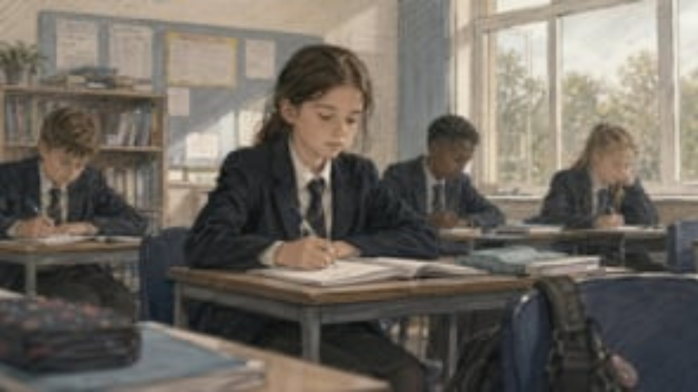



Meet Louise …
Notes:
[Select play to start the video: 0:44]
Explain that you’re now going to look at another type of abuse
Play the video
Explain that Louise is suffering from emotional abuse. She:
Uses language and swear words that you wouldn’t expect for her age
Has had emotional outbursts at school
Shows signs of low self-esteem, and might be repeating criticism she’s heard about herself
Has been shouted at and sworn at by her dad
Other signs that she might show are:
Acting in a way, or knowing about things, that you wouldn’t expect for her age
Appearing angry or anxious at school
Being aggressive or hostile towards others, or bullying other children
Sources:
GOV.UK – DfE, Keeping Children Safe in Education. https://www.gov.uk/government/publications/keeping-children-safe-in-education--2
NSPCC, Protecting children from emotional abuse. https://learning.nspcc.org.uk/child-abuse-and-neglect/emotional-abuse/
Video link: https://vimeo.com/1202500913?share=copy&fl=sv&fe=ci

Slide 63

Emotional abuse: what to look out for
Behaviour, language or knowledge you wouldn’t expect for their age
Low self-esteem
or self-confidence
Language delay
Negative interactions with parents or carers
Lacking social skills or friends
Struggling to control their emotions, such as having outbursts
Trying to make people dislike them, or bullying other children
Issues with mental health
Notes:
Tell staff that emotional abuse is any type of abuse that involves hurting a child emotionally and severely affecting their emotional development. It’s sometimes called psychological abuse
It could involve:
Making a child feel worthless, unloved or inadequate
Verbal abuse, including persistent criticism, belittling or name-calling
Silencing or making fun of what a child says
Having inappropriate age or developmental expectations of a child. For example:
Pushing them too hard or not recognising their limitations
Limiting their learning
Being overprotective
Limiting their social interactions
Exploiting or corrupting a child
Serious bullying, including cyber-bullying
Exposing a child to the ill treatment of another person – for example, domestic abuse
Emotional abuse can be hard to spot, especially when it happens as part of other kinds of abuse
Note that some level of emotional abuse is involved in all types of maltreatment
Sources:
GOV.UK – DfE, Keeping Children Safe in Education. https://www.gov.uk/government/publications/keeping-children-safe-in-education--2
NSPCC, Protecting children from emotional abuse. https://learning.nspcc.org.uk/child-abuse-and-neglect/emotional-abuse/
Ann Marie Christian, safeguarding consultant

Slide 64
Select ONE of the following scenarios that is relevant for your school context… delete the other slides

Slide 65
This is Maddie …
You’ve overheard Maddie using sexual language with her friends and talking about wanting to “look sexy”
She’s had her phone confiscated recently, and seemed nervous and anxious about getting it back
She’s come into school with a new school bag and has a new pair of expensive trainers for PE
When you ask her about her new bag and trainers, she says they were a gift from her mum’s friend
Notes:
Explain that you’re now going to look at another type of abuse
Introduce staff to Maddie. She:
Uses overly sexual language that you wouldn’t expect for her age
Has received unexplained gifts, which could be a sign of grooming
Has been nervous or anxious about getting her phone back
Maddie might be a victim of sexual abuse. Other signs that she might show are:
Acting in a way, or talking about sexual things, that you wouldn’t expect for her age
Dressing or acting older than her age
Being secretive about her behaviour online and her phone
Sources:
GOV.UK – DfE, Keeping Children Safe in Education. https://www.gov.uk/government/publications/keeping-children-safe-in-education--2
NSPCC, Protecting children from sexual abuse. https://learning.nspcc.org.uk/child-abuse-and-neglect/child-sexual-abuse

Slide 66
This is Maddie …
A teaching assistant has noticed that Maddie has been displaying sexualised behaviour during play time, including inappropriate touching of other children and attempting to remove clothing.
Maddie's communication device was recently taken away due to concerning images found on it, and they became very distressed when staff mentioned returning it.
Maddie has arrived at school with a new iPad and expensive noise-cancelling headphones. When asked about these items, Maddie's parent says they were gifts from "a friend who helps out sometimes."
Notes:
Explain that you’re now going to look at another type of abuse
Sources:
GOV.UK – DfE, Keeping Children Safe in Education. https://www.gov.uk/government/publications/keeping-children-safe-in-education--2
NSPCC, Protecting children from sexual abuse. https://learning.nspcc.org.uk/child-abuse-and-neglect/child-sexual-abuse

Slide 67
This is Jordan …
You've overheard Jordan talking with peers about wanting to "look sexy" and discussing sexual acts in explicit detail, showing off revealing photos on their phone.
Their phone was recently confiscated, and they became aggressive and highly anxious about getting it back, which is unusual behaviour for them. Jordan has arrived at school with a new designer bag, expensive trainers, and has been seen with a new smartphone.
When questioned about these items, Jordan becomes defensive and says they're gifts from "someone who actually cares about me and treats me right."
Notes:
Explain that you’re now going to look at another type of abuse
Sources:
GOV.UK – DfE, Keeping Children Safe in Education. https://www.gov.uk/government/publications/keeping-children-safe-in-education--2
NSPCC, Protecting children from sexual abuse. https://learning.nspcc.org.uk/child-abuse-and-neglect/child-sexual-abuse

Slide 68
This is Sam …
You've noticed that Sam has been using sexual language when talking with friends and has been focused on their appearance, repeatedly asking if they "look nice" or "look grown up."
Sam's tablet was taken away recently after concerning browsing history was discovered, and they've been persistently worried about when they'll get it back.
Sam has come into school with a new school bag, expensive trainers, and a new phone.
When you ask about these new items, Sam says they were presents from "my mum's friend who is really kind and buys me things."
Notes:
Explain that you’re now going to look at another type of abuse
Sources:
GOV.UK – DfE, Keeping Children Safe in Education. https://www.gov.uk/government/publications/keeping-children-safe-in-education--2
NSPCC, Protecting children from sexual abuse. https://learning.nspcc.org.uk/child-abuse-and-neglect/child-sexual-abuse

Slide 69
This is Sam …
Staff have observed that Casey has been showing signs of distress during personal care routines and has begun displaying sexualised behaviours that are not age-appropriate or consistent with their developmental stage.
Casey's communication device was recently removed due to concerning content, and they show visible anxiety through body language when staff discuss returning it.
Casey has arrived at school with expensive new sensory equipment and clothing that the family wouldn't typically be able to afford. When staff speak to Casey's parent, they mention the items are from "someone who's been helping the family out."
Notes:
Explain that you’re now going to look at another type of abuse
Sources:
GOV.UK – DfE, Keeping Children Safe in Education. https://www.gov.uk/government/publications/keeping-children-safe-in-education--2
NSPCC, Protecting children from sexual abuse. https://learning.nspcc.org.uk/child-abuse-and-neglect/child-sexual-abuse

Slide 70
Sexual abuse: what to look out for
Changes in behaviour
Avoiding a particular person
Sexually inappropriate behaviour
Difficulty concentrating at school
Needing the toilet a lot
Difficulty sitting
Dropping hints or mentioning ‘secrets’
Pregnancy and STIs
Secretive online behaviour
Notes:
Explain that sexual abuse is the fourth main type of abuse, and it’s when someone forces or entices a child to take part in sexual activities, whether or not the child is aware of what is happening. This could be:
Physical contact – for example, kissing, touching, rubbing (including outside clothes), assault by penetration or rape
Non-contact abuse – for example, involving a child in looking at or producing sexual images, encouraging sexually inappropriate behaviour and grooming in preparation for child abuse
Note:
Adult males aren’t the only perpetrators of sexual abuse. Women can also commit sexual abuse, as can other children (you’ll look at abuse of children by other children in more detail later)
It can happen online, offline, or both
Select to bring up the signs as you go through them. Signs that staff might see are:
Changes in behaviour, such as being aggressive, withdrawn or being tired in class due to sleeping difficulties and nightmares
Avoiding their abuser(s) – they might seem afraid of a particular person and try to avoid spending time with them, or having poor personal hygiene to make themselves less attractive to their abuser
Sexually inappropriate behaviour, such as using sexually explicit language or knowing things you wouldn’t expect them to
Difficulty concentrating at school
A pupil needing the toilet a lot, due to urinary tract infections (UTIs)
Difficulty sitting, caused by soreness in the genital and anal areas
Dropping hints or clues that the abuse is happening, without explicitly revealing it
Pregnancy and STIs
Being secretive online, or seeming distant, upset or angry after using their phone or the internet
Sources:
GOV.UK – DfE, Keeping Children Safe in Education. https://www.gov.uk/government/publications/keeping-children-safe-in-education--2
NHS, Spotting signs of child sexual abuse. https://www.nhs.uk/live-well/spotting-signs-of-child-sexual-abuse

Slide 71

Remember: abuse happens online, too
Social media (e.g. Snapchat, TikTok)
Texts and messaging apps (e.g. WhatsApp)
Online chatrooms
Email
Online gaming
Streaming sites
(e.g. Twitch)
AI (e.g. text-to-image systems)
Notes:
Explain:
It can be very easy to assume that abuse happens in a physical space like the home or the classroom, but it’s important to remember that emotional and sexual abuse can also happen virtually
This can include:
Social media sites, such as Snapchat, TikTok, X, Facebook and Instagram as well as any other website where comments can be left on content a child has created, like YouTube
Using AI to generate harmful imagery, such as indecent images – ‘deepfakes’ – or images to make fun of someone
In online chatrooms, where children talk to each other virtually
Texts and messaging apps, such as WhatsApp
Streaming sites, where someone records themselves doing something live and can receive comments (for example, gaming streaming on Twitch)
Online gaming sites such as Fortnite, where players can talk to each other while they play
Via email
If you want to go into more depth with staff about online safety, use our staff briefing and/or eLearning course:
https://safeguarding.thekeysupport.com/factsheets-and-briefings/online-safety-briefing/
https://safeguarding.thekeysupport.com/online-safety-the-essentials/

Slide 72




Emotional abuse online
Being excluded
from online games
Cyber-bullying
Being made fun of on social media (e.g. fake accounts, hurtful videos)
Receiving constant messages from parents or carers while at school
Notes:
Explain that this slide and the next slide show some common ways that abuse can happen online, but this isn’t an exhaustive list. Any sort of abuse that comes from spoken word, coercion, etc. can be done online just as it happens in the ‘real world’
Emotional abuse online may, for example, look like:
Cyber-bullying – for example, being teased or bullied via text, messenger apps, emails or comments
Being excluded from things online, like scheduled plans to play an online game together, or being repeatedly kicked out of an online game
Making fake accounts or posting videos of a person with the intention of humiliating or embarrassing them
Being constantly messaged by parents or carers while at school, to a degree that the child seems upset or unable to focus on schoolwork. Even in a phone-free school, this may still happen if pupils have a hidden/second device, or have access to their phone because of medical need
Source:
NSPCC, Online abuse. https://www.nspcc.org.uk/what-is-child-abuse/types-of-abuse/online-abuse/

Slide 73


Sexual abuse online
Being forced to take part in sexual activity to be put online
Being forced to make or look at indecent images
‘Sextortion’
Grooming
AI-generated sexual abuse imagery
Notes:
Sexual abuse online may, for example, look like:
Being forced to look at indecent pictures or videos – for example, by being sent them on messaging apps. This could include AI-generated content
Being filmed or photographed during sexual activities and then having these images or videos put online
Being befriended online by someone, with the intention of being groomed by them for further abuse, exploitation or trafficking – for example, someone pretending to be a child of the same age on social media and convincing them to meet up, only to then commit further abuse
‘Sextortion’ – this is when an adult threatens to release nudes or semi-nudes of a child unless they pay money or do something to benefit them. Children of any age are potential targets, but teenagers are often most at risk
Using AI to create indecent images of a child. For example, someone could use a photo of a child to generate a ‘deepfake’, which is where a photo or video of someone has been digitally altered so they appear to be someone else. These ‘deepfake’ images or video can be sexually explicit and are classed as child sexual abuse material. AI-generated images can also be used in sextortion
A lot of these things can also happen as a form of child-on-child abuse, as well as being done by adults. For example, children could create AI-generated images of another child
Tell staff that you’ll talk more about online harms and safety later in the presentation
Sources:
Department for Science, Innovation and Technology, Sharing nudes and semi-nudes: advice for education settings working with children and young people. https://www.gov.uk/government/publications/sharing-nudes-and-semi-nudes-advice-for-education-settings-working-with-children-and-young-people
NSPCC, Online abuse. https://www.nspcc.org.uk/what-is-child-abuse/types-of-abuse/online-abuse/
Internet Watch Foundation, AI-Generated Child Sexual Abuse: 2026 Report on Trends, Data & Human Impact. https://www.iwf.org.uk/about-us/why-we-exist/our-research/how-ai-is-being-abused-to-create-child-sexual-abuse-imagery/
If you want to go into more depth with staff about online safety, download and hand out our staff factsheet on sextortion:
https://safeguarding.thekeysupport.com/factsheets-and-briefings/financially-motivated-sexual-extortion-sextortion-parent-and-staff-factsheets/

Slide 74


Look out for …
Unsupervised times
on devices
Spending more time online or offline
Being secretive about their phone or what they do online
More emotional responses to being online
Signs of sexual abuse
Notes:
Explain that staff may notice the following signs of abuse being carried out online:
The child may be spending more time online, or more time offline. This might be reported by their parents or carers. They might complain of being tired because they were online all night, or have their phone going off a lot
They could have stronger emotional responses or outburst to being online – for example, the child may get unusually angry, upset or distant after checking their phone or using their computer/tablet
Being secretive about their use of the internet or a device – they may refuse to hand their phone even though it’s school policy, or refuse to tell you what they get up to online
The more general signs of sexual abuse that we saw earlier could indicate a child is being sexually abused online
As with other safeguarding issues, always look for changes in behaviour or mood. Although a change might not suggest a child is being abused online, the DSL will look into the situation further
Source:
Elizabeth Rose, safeguarding consultant

Slide 75
Let’s put it into practice
Practical activity
Time for activity: 5 minutes
What to do:
Read your group’s scenario (in section 3 of your activity pack)
Discuss whether there are signs of abuse and, if so, what kind
Write down your thoughts in section 3 of your activity pack
If you have time, look at the other scenario too
Notes:
For this activity, we recommend 2 to 4 people per group. Give each group 1 scenario to discuss. When you take feedback, make sure you cover all the scenarios, so staff can hear the answers for each
Tell staff they’re now going to look at some scenarios in groups to practise spotting potential signs of abuse
Putting the learning into practice in a safe environment will help them use it in a real situation
They’re going to look at one of the scenarios in their groups (the scenarios are in section 3 of their activity packs)
They have 5 minutes to read the scenario and discuss it, and write down their thoughts in section 3 of their activity packs
Remind staff to consider the wider picture – could anything else explain what they’re seeing in the scenario?
If they have time, they can look at the other scenario too
Make sure staff know which scenario their group is looking at
When the 5 minutes are up, get everyone back together and move on to the next slide

Slide 76
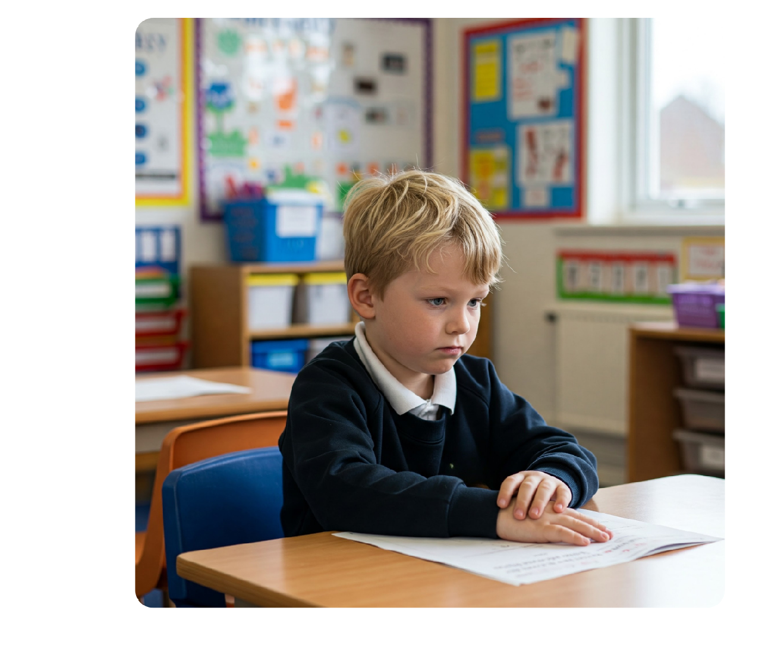
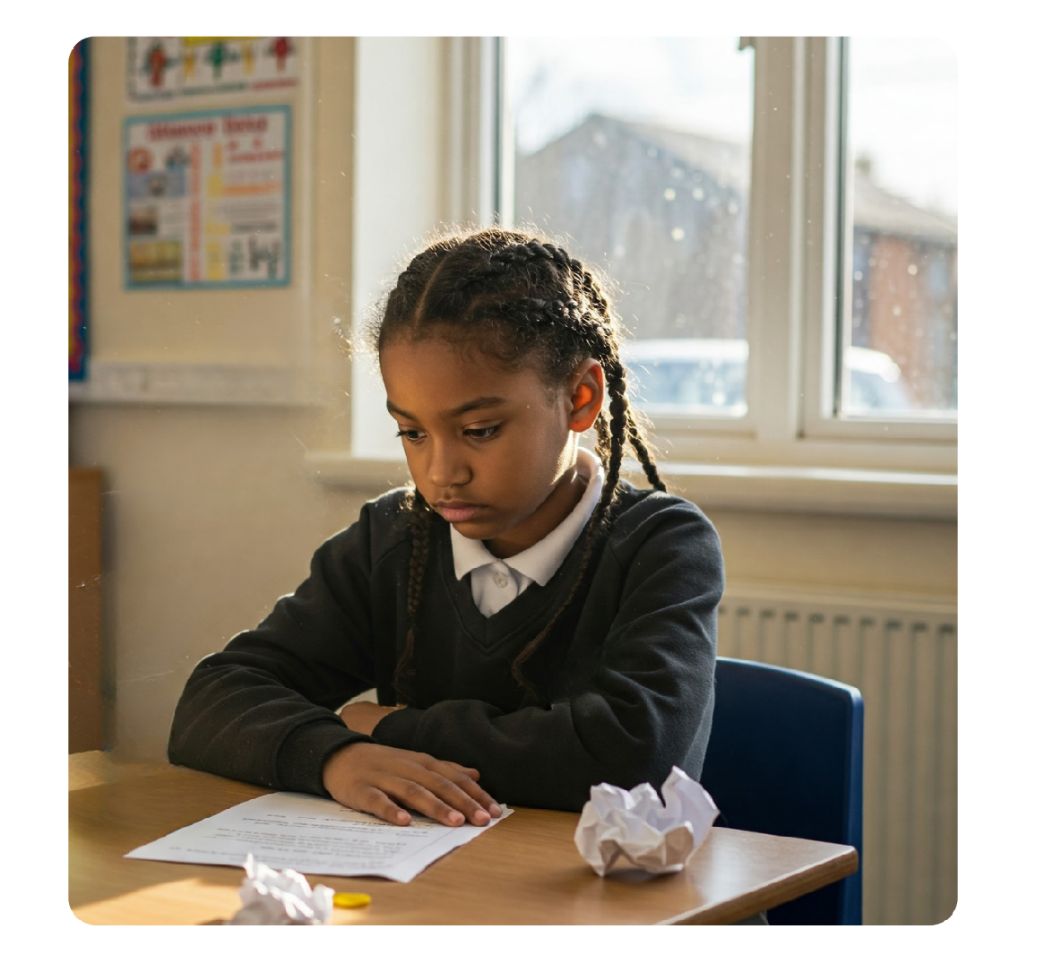
Let’s put it into practice
Practical activity
Jannik:
Signs of emotional and physical abuse
Sofi:
Signs of neglect
We can all spot possible signs of abuse. You should always report these to the DSL who will investigate further.
Notes:
Take feedback from 1 group for each scenario
Once a group has given feedback on their scenario, select to bring up the answer on screen
Confirm and clarify:
Jannik: a change in behaviour could be a sign of a safeguarding concern. Jannik has become quieter and more reluctant to participate in class, which could be a sign of abuse. Using swear words that aren’t appropriate for his age and having arguments with his peers could be a sign of emotional abuse or physical abuse. The bruises on Jannik’s arm are an indication of physical abuse and should be reported immediately to the DSL
Sofi: absence or persistent lateness from a pupil could be a sign of abuse and possible neglect. Sofi’s change in behaviour also indicates that this could be a safeguarding concern, as she even fell asleep in a lesson. Sofi talking about loud parties going on at night in her home could be a sign that neglect is taking place, but there could also be other forms of abuse happening, if strangers are coming in and out of her home. Persistent absence is also a safeguarding concern in itself.
You can see that some of the signs might be the same across different types of abuse, so you can’t say for sure what’s happening in these scenarios
Select to reveal the reminder: the main thing is that staff can spot that something might be wrong. It’s for the DSL to investigate further to find out what the cause might be

Slide 77
Key points about the 4 main types of abuse
The 4 main types of abuse are neglect, physical abuse, emotional abuse and sexual abuse
In most cases, multiple issues will overlap with each other
Abuse also takes place online, in multiple different ways, with new platforms and tools (such as AI) being used
The crucial thing is to be able to spot that something might be wrong – and act on it by reporting your concerns
Notes:
Explain that you’ve now covered the 4 main types of abuse
Give staff a minute to read these key points or read them out for staff
Ask staff if they have any questions about what you’ve covered so far

Slide 78
Section 6
How to spot the signs of poor mental health and support pupils who are struggling
Notes:
Tell staff you’re now moving on to the next learning objective. You’re going to look at how to spot the signs of poor mental health and support pupils who are struggling

Slide 79




Mental health
Everyone has mental health, just like we all have physical health
Mental health is a state of mental wellbeing that lets people:
Cope with the stresses of life
Realise their abilities
Learn well and work well
Contribute to their communities
Notes:
Before presenting – optional – this slide could be made into a mentimeter
Tell staff that everyone has mental health, just like we all have physical health
You could ask staff to connect to an interactive online tool, such as Mentimeter or Kahoot, to suggest keywords on what they think mental health is before revealing the slide
Tell staff that mental health is a state of mental wellbeing that lets people:
Cope with the stresses of life
Realise their abilities
Learn well and work well
Contribute to their communities
Please note: there are additional, more specific slides on mental health topics available in the mix and match library at the end of this pack if you wish to cover the topic of mental health in more detail
Source:
World Health Organization, Mental health: strengthening our response. https://www.who.int/news-room/fact-sheets/detail/mental-health-strengthening-our-response

Slide 80
Mental health is everyone’s responsibility
We all have a responsibility to safeguard children
This includes:
  Preventing impairment of children’s mental and physical health or development
  Taking action to enable all children to have the best outcomes
The quicker we spot the signs of poor mental health, and then act
on them, the quicker pupils can get the help and support they need
Remember: it’s not our job to diagnose, but to spot the signs and report them
Notes:
Tell staff that we all have a responsibility to safeguard children’s mental health, as explained in KCSIE. This includes:
Preventing impairment of children’s mental and physical health or development
Taking action to enable all children to have the best outcomes
Remind staff that their role is not to diagnose pupils’ mental health concerns, but to recognise the signs and report their concerns
It’s our job to notice the signs so that pupils can get help and support with their mental health and wellbeing as soon as a problem emerges
The quicker we spot the signs of poor mental health and act on them, the quicker pupils can get the help and support they need
Source:
GOV.UK – Department for Education (DfE), Keeping Children Safe in Education. https://www.gov.uk/government/publications/keeping-children-safe-in-education--2

Slide 81
Mental health and safeguarding concerns
Mental health problems can sometimes develop into safeguarding concerns
This could include:
  Self-harm
  Suicidal ideation
  Risk of suicide
They could also be an indicator that a child has suffered or is at risk of suffering abuse, neglect or exploitation
Remember: children may not feel ready or know how to tell someone that they are being abused or neglected
Notes:
Tell staff that mental health problems can sometimes develop into safeguarding concerns, such as:
Self-harm
Suicidal ideation
Risk of suicide
Explain that a child struggling with their mental health could also be an indicator that they have suffered (or are at risk of suffering) abuse, neglect or exploitation
Point out that children may not feel ready or know how to tell someone that they are being abused or neglected. They might feel embarrassed, humiliated, threatened, or they may not recognise that their experiences are harmful, and so a decline in their emotional wellbeing might be the only visible clue they get. By paying attention to these mental health signs when they first emerge, pupils can be supported before an issue develops into a severe crisis
Remind staff that not every child showing signs of mental health problems (which you’ll cover on the next slide) is suicidal or facing a severe mental health crisis, but identifying these signs early allows us to offer vital early intervention
Source:
GOV.UK – Department for Education (DfE), Keeping Children Safe in Education. https://www.gov.uk/government/publications/keeping-children-safe-in-education--2

Slide 82
Signs that a child might be struggling
Excessive fears
and worries
Being hyperactive
Changes in sleep habits
Emotional changes
Decline in school attendance, performance
or behaviour
Loss of interest in friends or favourite activities
Loss of appetite and weight changes
Being withdrawn
Being angry or irritable
Physical changes, such as feeling sick, sweating or shaking
Self-harm
Notes:
Briefly talk through the warning signs on screen
The main thing to look out for is a change in behaviour, mood or appearance. Poor mental health or mental ill health can present in many different ways. This isn’t an exhaustive list, but changes indicative of mental ill health in children include:
Having excessive fears and worries – for example, worrying about a test more than you’d expect them to
Being hyperactive
Having trouble sleeping – staff might see the child being more tired or finding it harder to concentrate because they’re tired
Showing emotional changes – for example, seeming less happy
Showing a decline in school attendance, performance or behaviour
Losing interest in friends or favourite activities
Losing their appetite and having weight changes
Being withdrawn
Being angry or irritable
Physical changes – for example, feeling sick, sweating or shaking
Self-harm
Note that you’ll look at a more detailed example on the next slide
These things will also differ depending on whether the child has a specific mental health condition. For example, children with obsessive-compulsive behaviours might have fears about dirt or contamination
Sources:
YoungMinds, Mental health conditions. https://www.youngminds.org.uk/young-person/mental-health-conditions/
Dr Dominique Thompson, GP, Buzz Consulting

Slide 83
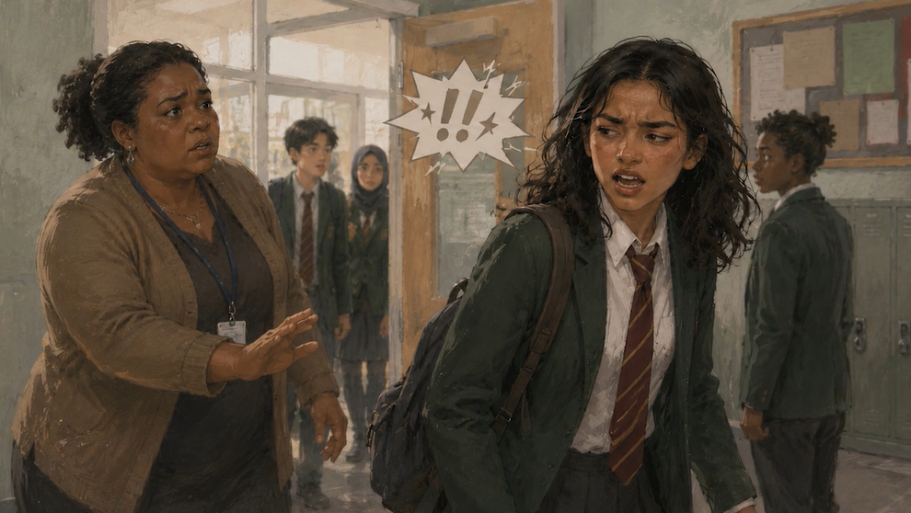
Jamila’s story
Practical activity
Signs Jamila might be struggling with her mental health:
She’s stopped going to her favourite netball club
She’s isolating herself from her friends
She looks exhausted
She’s complaining of feeling sick and shaky before lessons
She’s becoming angry and irritable
She refuses to speak to anyone
Notes:
Select to reveal the answers to question 1 in the activity – signs Jamila might be struggling with her mental health
Read through the answers and make sure staff have identified both the behavioural and physical warning signs

Slide 84
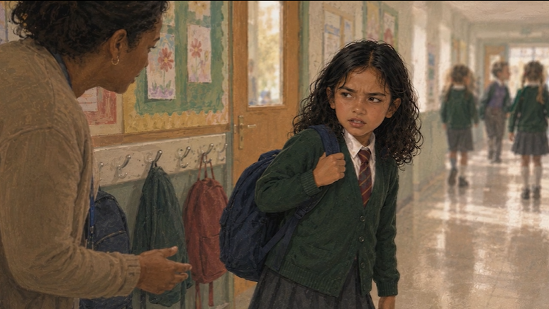
Jamila’s story
Practical activity
Signs Jamila might be struggling with her mental health:
She’s stopped going to after-school netball club
She’s isolating herself from her friends
She looks exhausted
She’s complaining of feeling sick and shaky
She’s becoming angry and irritable
She refuses to speak to anyone
Notes:
Select to reveal the answers to question 1 in the activity – signs Jamila might be struggling with her mental health
Read through the answers and make sure staff have identified both the behavioural and physical warning signs

Slide 85
Jamila’s story: what should you do now?
Practical activity
If you know Jamila well, you can find a quiet space to talk to her about her recent outbursts of anger and how she’s feeling
Reassure Jamila that you’re going to talk to someone at school, so she can get the help she needs
If a child is in immediate danger, call 999 or take them to A&E immediately
  Add details of your own emergency procedures, and how to do this
If a child needs help urgently for their mental health, but it’s not an emergency, use NHS 111 online or call 111 and select the mental health option
Any mental health concern that is also a safeguarding concern must be reported to the DSL or deputy immediately
Remember: some signs might not be linked to mental health and might be signs of abuse, neglect, or exploitation. The most important thing is to report any signs as soon as possible
Notes:
Select to reveal the answers to question 2 in the activity and read through them
Highlight to staff that is a child is in immediate danger, for example, if you think they’re going to hurt themselves, they should call 999 or take them to A&E immediately
Add that if a child needs help urgently for their mental health, but it’s not an emergency, staff can get help from NHS 111 online or call 111 and select the mental health option
Any mental health concern that is also a safeguarding concern must be reported to the DSL or a deputy DSL
Highlight to staff that some signs of poor mental health could also be signs of abuse, neglect, or exploitation. The most important thing is to report any signs as soon as possible

Slide 86

What should be recorded on CPOMS?
how small — that an adult working in or on behalf of a school may have acted in a way that is inconsistent with the staff code of conduct, including inappropriate conduct outside work, and that does not meet the harm threshold or require a referral to the Local Authority Designated Officer (LADO).
Indicators of abuse
Child on Child incidents
Prejudicial Incidents
Emotional wellbeing / mental health concerns
Online incidents
Attendance and patterns of concern
Disclosures (direct or indirect)
Contextual Information
Communications
Supporting evidence
Voice of the Child (VOC)
Notes:
Tell staff who they should talk to if they have any concerns about a child’s mental health. Make sure you cover:
Who they should take concerns to
If their concern is also a safeguarding concern, they should report their concerns to the DSL. Remind staff that the KCSIE definition of safeguarding now includes preventing impairment to children’s health or development, so any concern about mental health is likely to be a safeguarding concern too
How to report concerns – in-person, CPOMS
Remind staff that it’s not their job to diagnose a child’s mental health condition, but they do need to recognise the signs and report any concerns
Tell staff that they can’t force a child to talk if they don’t want to – they can let the child know that the school is there to support them and they can talk if they want to. However, the lack of a disclosure doesn’t mean no action should be taken. Staff must always report their observations and concerns to the DSL, even if the child doesn’t open up to them. Remind staff that they should always report a concern about mental health to the DSL even if the child doesn’t open up

Slide 87
Key points about pupil mental health
Supporting pupil mental health is everyone’s responsibility,
as part of our safeguarding duties outlined in KCSIE
The quicker we report a concern the quicker pupils can get the right support
Always report concerns to the DSL/deputy DSL
If a child is in immediate danger, stay with the child and alert the DSL/deputy DSL
If the DSL/deputy DSL isn’t available, explain process
Notes:
Tell staff you’ve now covered the objective on supporting pupil mental health
Give staff a minute to read these key points or read them out for staff
Remind staff that some signs of mental ill-health might actually be signs of abuse, neglect, or exploitation. This is why reporting any sign as soon as possible is the most important action they can take
Ask staff if they have any questions about what you’ve covered so far

Slide 88
Section 7
Specific forms of abuse and safeguarding issues you might see in our school
Notes:
Tell staff you’re now going to move on to the final learning objective. You’re going to look at specific forms of abuse and safeguarding issues beyond the 4 main types of abuse that staff need to be aware of, so they can effectively safeguard children
You’re going to look at a selection of issues that feel particularly relevant to your school and setting
You’ll also cover issues where staff have particular duties or information they need to know. These are:
Child-on-child abuse
Children who are absent from education
Radicalisation
Female genital mutilation (FGM)
Artificial intelligence (AI)
Highlight that many of these safeguarding issues can take place outside of children’s families
Note that, again, staff will have the chance to practise spotting the potential signs of these issues

Slide 89


Child-on-child abuse, including harassment and violence
  Child-on-child abuse, including harassment and violence, is abuse between children
  It can happen in and outside of school, and online
Notes:
Child-on-child abuse, including harassment and violence
Tell staff that you’re now going to look at the issue of child-on-child abuse, including harassment and violence
Tell them to read the information on the slide, and give them a minute to think about what this type of abuse might look like
Explain that child-on-child abuse includes harassment and violence, and is considered a safeguarding issue for both the victim and the alleged perpetrator
Source:
GOV.UK – DfE, Keeping Children Safe in Education. https://www.gov.uk/government/publications/keeping-children-safe-in-education--2

Slide 90

Child-on-child abuse, including harassment and violence, can include:
Bullying
Abuse in intimate personal relationships
Physical abuse
Sexual violence
Sexual harassment
Sexual activity without consent
Upskirting
Sharing nudes or semi-nude images
Initiating or hazing-type violence and rituals
Where a child shows harmful sexual behaviours towards another child, it could be a sign that they themselves have been abused and need support, too.
Notes:
Child-on-child abuse, including harassment and violence (continued)
Select to reveal each example and briefly talk through them in turn:
Bullying can include online (cyber) bullying, prejudice-based, and discriminatory bullying, including:
Bullying because of a child’s sexuality or perceived sexuality
Gender-based bullying (such as teasing, or excluding others for not conforming to gender ‘norms’)
Use of gender-based power dynamics (such as boys asserting dominance over girls through control or intimidation)
Abuse in intimate personal relationships between children. This is sometimes referred to as ‘teenage relationship abuse’, but younger children are also vulnerable to this type of abuse
Physical abuse, such as hitting, kicking, shaking biting, hair pulling
Children might also use technology to encourage physical abuse, or threaten it
Sexual violence, such as rape, assault by penetration and sexual assault
Again, children might use technology to encourage this type of abuse, or threaten it
Sexual harassment can include sexual comments or ‘jokes’, sexualised language or behaviour (such as inappropriate touching, comments about bodies), or online sexual harassment which is standalone or part of a wider pattern of abuse
Abusive messages could include misogynistic or misandrist (strongly prejudiced against men) content
Causing another child to engage in sexual activity without consent, such as forcing them to strip, touch themselves sexually or engage in sexual activity with someone else
Upskirting – where someone takes a picture under a person’s clothing without their permission, for sexual gratification or to cause the victim humiliation, distress or alarm
Sharing nude or semi-nude images and/or videos (including AI-generated images such as ‘deepfakes’)
Abuse could also include sharing images and pornography with those who don’t want to receive this content
Initiation or hazing-type violence and rituals could involve using harassment, abuse and/or humiliation as a way of initiating someone into a group, and may also include an online element
Tell staff other examples of gender violence could include (read through all the examples below, or 1 or 2 depending on the time you have):
During a PSHE lesson, a group of year 10 boys constantly interrupt the female teacher, using language like ‘red pill’ and making derogatory comments about the girls in the class. They argue that women are meant to be quiet and do as they’re told. Explain: this behaviour reflects exposure to misogynistic online influencers and must be challenged immediately to prevent normalising abuse and sexism
A year 9 girl reports that an ‘upskirting’ image of her is being shared around the school via a messaging app. She says that she feels really embarrassed and upset about the images, but the boys sharing it say that it's “just a joke". Explain: upskirting is a criminal offence, and is a serious form of child-on-child abuse that must be reported to the DSL immediately
A year 11 pupil appears increasingly withdrawn and anxious. Her friends mention that her boyfriend (also in year 11) constantly checks her phone, tells her what she is allowed to wear, and demands she sends him location updates when she isn’t with him. Explain: this is coercive and controlling behaviour, and is a form of teenage relationship abuse that requires immediate safeguarding intervention to support and protect the victim
Source:
GOV.UK – DfE, Keeping Children Safe in Education. https://www.gov.uk/government/publications/keeping-children-safe-in-education--2

Slide 91


If you suspect child-on-child abuse:
Act immediately on any concerns or disclosures
Reassure the child they’ll be supported and kept safe
Don’t dismiss or downplay any reports
[Briefly summarise your school’s reporting procedures here]
Notes:
Child-on-child abuse, including harassment and violence (continued)
In advance, edit this slide to briefly summarise your procedures for reporting possible child-on-child abuse, including who to report to and how
Explain that staff might witness child-on-child abuse between pupils, or a pupil might tell them they’ve been a victim of child-on-child abuse
Staff might also see signs that something is wrong, such as the common behavioural signs we looked at earlier. They should always be alert to changes in a child, such as in their mood, behaviour or school performance
While anyone can be affected, staff should be aware that:
It’s more likely to be girls as the victim of sexual violence and sexual harassment, and boys more likely to be the perpetrators
Children with disabilities are 3 times more likely to be abused by their peers
Whether a child makes an allegation of child-on-child abuse, or staff see something that’s a cause for concern, staff should always take immediate action, following your school’s reporting
If a child does make an allegation, staff should reassure the child that they’ll be supported and kept safe. Don’t make the child feel like they’re causing trouble by speaking up
Staff should never dismiss an allegation as “banter”, “part of growing up”, “having a laugh” or “boys being boys”. This can create a culture of unacceptable behaviours, and an unsafe environment for children. It can ‘normalise’ abuse, leading to children accepting and not reporting it
Explain that while the alleged victim must always be the priority in any case of child-on-child abuse, schools must still balance providing appropriate support and taking disciplinary action of the alleged perpetrator – they aren’t mutually exclusive
Source:
GOV.UK – DfE, Keeping Children Safe in Education. https://www.gov.uk/government/publications/keeping-children-safe-in-education--2

Slide 92

Missing school can be a vital warning sign of a safeguarding issue
Our unauthorised absence procedures are:
[Summarise your procedures here]
Our children absent from education procedures are:
[Summarise your procedures here]
Notes:
Children who are absent from education
[In advance, edit this slide to summarise your school’s absence procedures]
Explain that children being absent from education repeatedly and/or for prolonged periods are vital warning signs of a range of safeguarding issues:
It could indicate that a child is being abused or neglected, or that a child is being sexually or criminally exploited (particularly for county lines)
It might also indicate that a child has mental health problems, or is at risk of:
Substance abuse
Female genital mutilation (FGM)
Honour-based abuse or forced marriage
Exploitation
Risk of travelling to conflict zones
Early intervention is essential to identify any underlying safeguarding risks, and to help prevent children who are absent from becoming a child missing education in the future
Being absent from education could also increase known safeguarding risks within the family or in the community
Explain to staff that they need to be aware of your school’s procedures for unauthorised absence and children who are absent from education
Sources:
GOV.UK – DfE, Keeping Children Safe in Education. https://www.gov.uk/government/publications/keeping-children-safe-in-education--2
GOV.UK – DfE, Working together to improve school attendance. https://www.gov.uk/government/publications/working-together-to-improve-school-attendance

Slide 93
There’s no 1 path to radicalisation, or 1 type of person who can be radicalised
Understand who might be susceptible
Look out for changes in behaviour, mood
or appearance
Know where and how to report concerns
Notes:
Radicalisation
Tell staff that another safeguarding issue where you (as a school) have specific duties is radicalisation, under the Prevent duty
Explain to staff that when it comes to radicalisation, there’s no 1 path that leads to it, or 1 type of person who can be radicalised
Explain to staff what the Prevent duty says:
[Select to bring up point 1] One of the objectives of Prevent is to intervene early to support people who are susceptible to radicalisation. Children tend to be more easily influenced and impressionable, which can make them more susceptible
Children who are vulnerable to grooming for sexual exploitation or criminal exploitation may also be vulnerable to radicalisation. Experiencing abuse, bullying, or having personal or emotional difficulties can also make children more susceptible
[Select to bring up point 2] Look out for concerning changes in behaviour, mood or appearance. Explain to staff that, as we know, any changes in behaviour may indicate a safeguarding concern. If a child is being exposed to radicalising influences or drawn into terrorism, they might:
Have a sudden change in their general behaviour
Become more argumentative, or suddenly hold strong opinions or values
Talk in a scripted way
Refuse to engage with pupils who are different or become abusive towards them
Embrace conspiracy theories
Be unwilling or unable to discuss their views
Show interest in extremists or extreme groups
Spend a lot more time online or on their phone, which they might become more secretive about
Access extremist online content and have uncontrolled and unsupervised access to the internet
[Select to bring up point 3] Know where and how to report concerns. Staff should follow your safeguarding policies and procedures, which normally involves reporting concerns to the DSL or your Prevent lead
Explain to staff that:
Anyone can make a referral to Prevent, but staff should follow the school’s child protection policy and procedures
[Adapt to suit your school’s policies and procedures] Report any concern immediately to the DSL/Prevent lead so they can decide what action to take next and whether a referral is appropriate
If you want to go into more depth on radicalisation with your staff, use our eLearning course, ‘Preventing radicalisation’: https://safeguarding.thekeysupport.com/preventing-radicalisation/
Sources:
GOV.UK – Department for Education (DfE), The Prevent duty: safeguarding learners vulnerable to radicalisation. https://www.gov.uk/government/publications/the-prevent-duty-safeguarding-learners-vulnerable-to-radicalisation
GOV.UK – Home Office, Prevent duty guidance: England and Wales (2023). https://www.gov.uk/government/publications/prevent-duty-guidance
Educate against hate, Signs of radicalisation. https://www.educateagainsthate.com/signs-of-radicalisation/

Slide 94
What signs of radicalisation should I be alert to?
Becoming more isolated from friends and family
Not being willing or able to talk about their views
Becoming more angry
Talking as if from a script, or using new phrases
Being more secretive, especially about their internet use
[Select here to use KeyGPT to generate a scenario on radicalisation for staff]
Notes:
Radicalisation (continued)
[In advance – optional – this could be made more interactive through mentimeter – word cloud, wall etc)
Explain to staff that you’re going to look at the signs of radicalisation
Ask for suggestions on possible signs of radicalisation before going through the list on the slide. Or you can choose to ask staff to connect to Mentimeter or Kahoot with their phones and submit keywords on what they think the signs of radicalisation are before revealing the answers
Select to bring up the signs in turn:
Becoming more isolated from friends and family
Not being willing or able to talk about their views
Becoming more angry
Talking as if from a script, or using new phrases
Becoming more secretive, especially about their internet use

Slide 95
Female genital mutilation (FGM)
  FGM involves the deliberate partial or total removal of female genitals, or other injury, for non-medical reasons
  It is a criminal offence in the UK and a form of child abuse
  FGM is typically carried out between infancy and the age of 15, often during school holidays to allow time to heal
Notes:
Female genital mutilation (FGM)
Tell staff that you’re now going to look at the issue of female genital mutilation (FGM)
Remind staff that FGM is a procedure which involves the deliberate partial or total removal of external female genitalia, or other injury to the female genital organs, for non-medical reasons
Explain that FGM can never be justified by culture, tradition or religion. Emphasise that it’s a form of child abuse and illegal under UK law (including taking a child abroad for FGM)
Girls in secondary school may be at risk of FGM, or have already undergone FGM. It’s commonly carried out before puberty
Why does it happen? FGM is a form of honour or faith-based abuse, where crimes are committed to protect or defend the honour of the family and/or community. Families might believe FGM is beneficial to the girl or in her best interests, but there are no medical reasons for it to be done and it can cause serious harm, including:
Pain, infection, bleeding, urinary problems, mental health problems and, later, problems with sex and pregnancy
Tell staff they have a vital role to play in spotting the early warning signs that FGM might take place and protecting children
Note that FGM often takes place during the school holidays, so the child can be taken abroad and have enough time to heal afterwards – explain that although FGM often happens overseas, it does also take place in the UK
For a more in-depth look at this topic, see our:
FGM staff briefing: https://safeguarding.thekeysupport.com/factsheets-and-briefings/female-genital-mutilation-fgm-staff-briefing/
FGM eLearning course: https://safeguarding.thekeysupport.com/female-genital-mutilation-fgm/
Source:
NHS, Female genital mutilation (FGM). https://www.nhs.uk/conditions/female-genital-mutilation-fgm/

Slide 96
Teachers have a legal duty to report FGM
For known cases of FGM, teachers must:
  Call 101
  Say you’re making a report under the FGM mandatory reporting duty
  Have our DSL’s contact details and the girl’s age and address to hand, as well as your contact information
  Take note of the reference number you’re given
  Taking action to enable all children to have the best outcomes
Remember: girls might use terms like ‘cut’ to tell you what’s happened
Notes:
Female genital mutilation (FGM) (continued)
Explain that in addition to reporting safeguarding concerns to you (the DSL), teachers have a legal duty to personally report known cases of FGM on girls under 18 to the police
The mandatory reporting duty applies if a girl under 18 informs a teacher that she’s been a victim of FGM, or the teacher sees physical signs that appear to show the girl has been a victim of FGM. Teachers are more likely to have a girl tell them it’s happened to her, as they won’t be physically examining pupils
Note again how a child might use terms like ‘cut’ to tell someone what’s happened to her
If a child tells a teacher she’s a victim, the teacher must:
Make the report as soon as possible – best practice is by the end of the next working day. Although the maximum timeframe is 1 month, they should report much sooner than this
Call 101. The teacher should be prepared to:
Explain they’re making a report under the FGM mandatory reporting duty
Give their name, contact details, times they’ll be available to be called back, role and place of work
Give the DSL’s name, contact details and place of work
Give the girl’s name, age or date of birth, and address
Take a note of the reference number for the call that they’ll be given
Teachers should be aware that they may need to contribute to any follow-up response – and that you (the DSL) will be able to provide support and advice
If the staff member isn’t a teacher, they still have a duty to report cases of FGM to the DSL, as part of their safeguarding responsibilities
Even if a girl is already a victim of FGM, staff can get support to help her
Sources:
GOV.UK – DfE, Keeping Children Safe in Education. https://www.gov.uk/government/publications/keeping-children-safe-in-education--2
GOV.UK – Home Office and DfE, Mandatory reporting of FGM: procedural information. https://www.gov.uk/government/publications/mandatory-reporting-of-female-genital-mutilation-procedural-information
GOV.UK – Home Office, DfE and Department of Health and Social care, Multi-agency statutory guidance on female genital mutilation. https://www.gov.uk/government/publications/multi-agency-statutory-guidance-on-female-genital-mutilation
NHS, Overview: Female genital mutilation (FGM). https://www.nhs.uk/conditions/female-genital-mutilation-fgm/

Slide 97

What are the signs of FGM?
Signs a child might be at risk:
Requests for extended holidays
Talking about a special ceremony or trip abroad
Mentioning ‘becoming a woman’ or a secret procedure
Signs that FGM may have already taken place:
Changes in behaviour
Obvious discomfort
Reluctance to go to the toilet
Notes:
Female genital mutilation (FGM) (continued)
Tell staff that the signs that a child might be at risk of FGM include:
Requests for extended holidays and/or talking about an upcoming trip or holiday abroad, particularly to countries where FGM is frequently practiced (such as certain regions of Africa, Asia and the Middle East)
You might hear a child talking about looking forward to taking part in a special or secret ceremony, or referring to “becoming a woman”
Signs that FGM has already taken place include:
Changes in behaviour, such as being withdrawn, anxious, in pain or displaying signs of trauma
Discomfort or difficultly when walking, sitting or standing or suddenly preferring very loose-fitting clothes
Reluctance to go to the toilet, or taking a long time when doing so
Withdrawal from classes like PE or swimming, or being reluctant to get changed in front of others
Also note how the child’s friend might share her concerns, or the child herself might confide in you
Be alert to how they might use terms like ‘cut’ to tell someone what’s going to happen/or what has happened to her

Slide 98
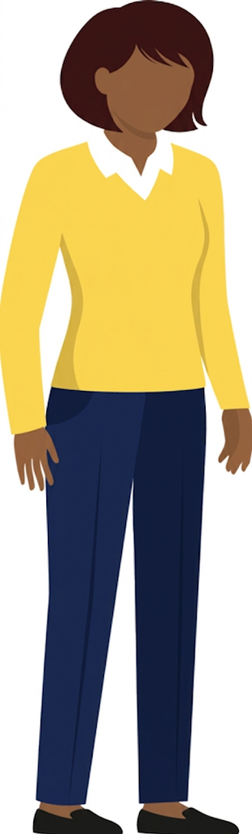
This is Ngozi …
Ngozi is a bright and chatty girl who joined your school at the start of year 8. She lives with her parents and younger sister. Before the half-term holidays, you heard Ngozi mention that she was going to be travelling abroad for a ‘special family celebration’. She tells her form tutor and friends:
“I'm going to miss the first week of next term because Mum is taking me overseas for a really important family party.
It's a big celebration just for the girls in my family, but I'm really nervous about what I have to do.”
When Ngozi comes back to school after an extended absence, her personality has completely changed. She’s much quieter and withdrawn, and when you ask about her trip, she seems anxious and avoids giving you any details.
You notice that she seems to be in pain when sitting down in class. She’s repeatedly refusing to take part in PE and doesn’t want to use the school toilets. When her form tutor asks her why, she says:
“Mum told me I shouldn’t be using dirty school toilets after our trip.”
Notes:
[Note: staff can also read the scenario in section 5 of the activity pack]
Give staff 5 minutes to do this activity
Read the scenario on the slide out loud
Then, ask staff some questions from the following list (pick 2 or 3, if you’re short on time) and take responses:
What are the potential warning signs of FGM in this scenario?
What action should Ngozi’s teacher take?
What are your responsibilities if you suspect a pupil is at risk of FGM (for all school staff, and for teachers specifically)?
Would you speak to Ngozi’s parents? Why/why not?
What role does the DSL play in this situation?
What do you understand about the ‘mandatory reporting duty’ for FGM?
How might you support Ngozi in the classroom while your concerns are being addressed?
After you’ve discussed the scenario, highlight how:
FGM may be framed positively by children who have been groomed to believe it’s natural, or the right thing to do
Warning signs can be subtle, including changes in behaviour, withdrawal from activities, or unusual language about maturity and bravery
Remind staff how they must not investigate or question the child about any medical or physical aspects, because their role is to observe, record and report, and that they shouldn’t speak to the parents/carers themselves

Slide 99

Artificial intelligence (AI): concerns to be aware of
Hacking and scams
AI-generated child sexual abuse images
Sharing self-generated intimate images or videos, including
AI-generated ‘deepfakes’
Catfishing
Sextortion
Fake news and misinformation
Relationships with chatbots
Notes:
Artificial intelligence (AI)
Tell staff that you’re now going to look at the issue of AI
Explain how generative AI takes a written prompt and runs it through an algorithm to generate new, ‘natural’-seeming content. It includes chatbots like ChatGPT, Google Gemini and text-to-image programmes like DALL-E and Midjourney
Tell staff that AI can impact other safeguarding issues
This means that rather than being its own issue with its own signs to spot, staff should be aware of how AI might be used with other safeguarding concerns, such as cyber-bullying or sextortion
AI can also be used by children to facilitate child-on-child abuse
Select to reveal each of the issues on the slide, and explain what they are:
Hacking and scams – AI can be used to write convincing emails and messages to trick children into giving people access to their accounts, or their parents’/carers’ accounts
AI-generated child sexual abuse (CSA) images – some AI tools (such as ‘nudifying’ apps) could be used to generate child sexual exploitation material for sexual gratification, or as a means of bullying another pupil. Explain to staff that under the Crime and Policing Act 2026 it’s a criminal offence to make, adapt, or supply CSA image-generators. Previously ‘nudifying’ apps were not illegal
Sharing self-generated intimate images or videos, including AI-generated ‘deepfakes’ – AI can be used to superimpose a person’s face on to pornographic images or videos for sexual gratification, or to humiliate the person in the images. AI is used to make the image or video look more convincing. Say how we’ll go into more detail about deepfakes on the next slide
Catfishing – criminals can use generative AI apps to pose as children or young adults with the intention of grooming or exploiting their victim for sexual, criminal, financial or other reasons
Sextortion – this is a form of online blackmail where someone threatens to share sexual images or information unless the victim complies with their demands. Criminals can use AI-generated profile pictures to appear younger than they are to befriend and groom children and young people, then solicit information and/or images from them (such as nude or semi-nude photos)
Fake news and misinformation – AI tools can be used to create convincing fake photos of world events, which could be used to promote certain beliefs (including hateful ones)
Relationships with chatbots – AI ‘companions’ are chatbot apps, designed to simulate real relationships through human-like conversations. The chatbots adapt to inputs from users and learn to respond in ways that feel realistic. Children can:
Pose unlimited questions to chatbots, and the unmoderated answers could offer dangerous advice and/or harmful content
Easily become dependent on using chatbots, and this can reduce their opportunities to establish healthy relationships in the real world
Remind staff that AI technology is developing rapidly, and these tools will only become more sophisticated over time
Highlight to staff that filtering and monitoring requirements also apply to the use of generative AI, as set out in KCSIE 2026
Signpost our AI risks staff briefing for practice scenarios, and a more in-depth look at this topic: https://safeguarding.thekeysupport.com/factsheets-and-briefings/artificial-intelligence-ai-risks-staff-briefing/
Sources:
GOV.UK – DfE, Keeping Children Safe in Education. https://www.gov.uk/government/publications/keeping-children-safe-in-education--2
GOV.UK – Crime and Policing Act 2026. https://www.legislation.gov.uk/ukpga/2026/20/contents/enacted
Aaron King, consultant

Slide 100
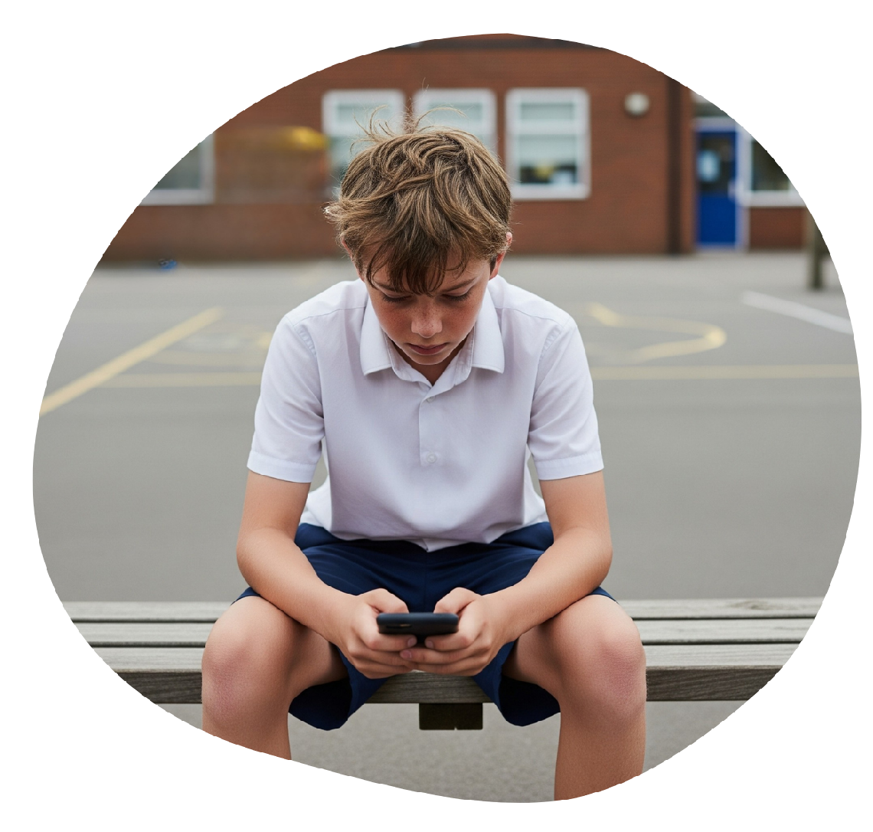
Deepfake images and videos
Children may encounter or share deepfakes without realising they’re fake
Can be used in child-on-child abuse, bullying, pranks
or spreading misinformation
Can convincingly imitate the faces, movements and voices of ‘real’ people
Are easy to create and share with the use of apps and websites
Notes:
Artificial intelligence (AI) (continued)
Explain to staff that deepfake images or videos can be used in child-on-child abuse, bullying, pranks or spreading misinformation. The non-consensual sharing of intimate images, including AI-generated deepfakes, is a recognised form of child-on-child abuse and online sexual harassment
Explain how the use of deepfake images to blackmail or humiliate others, including children and teachers, is on the rise
Deepfake creation technology is moving fast, and images created are extremely realistic
Children may struggle to identify when images and videos are fake
Children who are the victim of deepfakes (even if it’s intended as a silly ‘joke’) might be humiliated and traumatised
Remind staff not to assume that younger teens wouldn’t be capable of creating these images/videos – tools to create deepfakes are increasingly accessible to them. There are plenty of apps that make it easy for anyone to generate realistic images, and share them
Source:
GOV.UK – DfE, Keeping Children Safe in Education. https://www.gov.uk/government/publications/keeping-children-safe-in-education--2

Slide 101

More safeguarding issues you should be aware of
Child abduction and community safety incidents
Children and the court system
Children missing from home or care
Gang involvement
Drugs
Fabricated or induced illness
Honour or faith-based abuse
Financial exploitation
Homelessness
Modern slavery
Private fostering
Children with family members in custody or prison
Forced marriage
Remember: we must always have an attitude of 'it could happen here’
Notes:
Explain that there are many safeguarding issues staff need to be aware of. We’ve already covered some of these issues today, but not all of them
Tell staff that as they saw earlier, safeguarding issues are rarely standalone events. In most cases, multiple issues will overlap (e.g. a child with family members in prison might be at higher risk of homelessness, or a child missing from care may be at risk of modern slavery or criminal exploitation)
Select to bring up the list of safeguarding issues that you haven’t already covered, and give staff a moment to read the slide
Ask staff: how confident are you, when it comes to knowing about these?
Explain that you don’t have time to cover all of these issues in detail in today, but it’s important that we have an attitude of 'it could happen here' for every issue mentioned
Tell staff that if they’re unsure about any of the issues, you can give them more information after the session
See The Key Safeguarding for more specific resources: https://safeguarding.thekeysupport.com/factsheets-and-briefings/
Tell staff that KCSIE, including Annex A, outlines a wider range of specific safeguarding issues that all staff need to be aware of and should familiarise themselves with
All staff, whether they work directly with children or not, must read part 1 of KCSIE guidance in its entirety, so they can effectively safeguard children
Remind staff that if they notice any changes in a child's behaviour or have any nagging doubts relating to these or any other issues, they must not wait, and must report them immediately to the DSL
Source:
GOV.UK – DfE, Keeping Children Safe in Education. https://www.gov.uk/government/publications/keeping-children-safe-in-education--2

Slide 102
The following slides make up a ‘mix and match’ library of INSET content around 11 safeguarding issues. Choose which slides feel most appropriate for your school and delete any you don’t wish to use.
KCH advises to save these slides for a 7-minute briefing at the beginning of staff training – an effective way to plug key safeguarding issues, keeping staff’s knowledge up to date.
Notes:
[This slide is a reminder to choose from the following selection of specific forms of abuse and safeguarding issues. Delete this slide, and any others you don’t wish to cover, before carrying out this part of the training. You can always come back to this pack and cover other slides in other training sessions throughout the school year]
If you’re unsure which safeguarding issues to cover, you may wish to consider:
Recent safeguarding incidents in your school
Safeguarding issues that are particularly prevalent in your local area (your LA may be able to help with this)
Which safeguarding issues staff have been trained on recently, and which issues may be more in need of a ‘refresher’
How much time you have available for this INSET training
The topics we’ll be covering on these slides are:
Online grooming
Online toxic masculinity
Disinformation, misinformation and conspiracy theories
Sextortion
Child criminal exploitation (CCE)
Bullying, including cyber-bullying
Eating disorders
Anxiety and panic attacks
Trauma and PTSD
Parental conflict
Domestic abuse

Slide 103
Online grooming
Online grooming
What is it?
Grooming involves someone building a relationship with a child and gaining their trust, in preparation for abuse
Online platforms make it easier for groomers to target several children at once, which can make the grooming process quicker
After making contact online, a groomer may convince a child to meet in person or persuade them to take part in online sexual activity
Who is at risk?
Grooming can affect any child, regardless of age, gender, race or socio-economic background
However, some children are more vulnerable than others
© The Key Support Services Ltd | For terms of use, visit thekeysupport.com/terms
Notes:
Safeguarding issue 1: online grooming
[Before presenting – if you choose to use an interactive online tool such as Kahoot or Mentimeter, set the page up beforehand]
Tell staff that you’re now going to look at the issue of online grooming
You could ask staff to connect to Mentimeter or Kahoot with their phones and submit keywords on what they think online grooming is before revealing the answers
Select to reveal the answers to ‘What is it?’
Explain that groomers can:
Use online platforms like social media, gaming platforms or instant messaging apps to connect with a child
Learn about a child’s interests from their online profiles, then use this knowledge to help build a relationship with them
Easily hide their true identity online
You could then choose to ask staff to connect to Mentimeter or Kahoot with their phones and submit keywords on who they think is at risk of online grooming is before revealing the following answers
Select to reveal the answers to ‘Who is at risk?’
Tell staff that while grooming can affect any child, some children are more vulnerable than others. This includes:
Looked-after children
Children with SEND
Children with low self-esteem
Children who are experiencing mental health issues
Children whose online activity isn’t monitored or supervised
Remember: grooming can happen to any child who spends time online
Sources:
NSPCC, Grooming: https://www.nspcc.org.uk/keeping-children-safe/types-of-abuse/grooming/?utm_old=grooming
Children Safe in Education. https://www.gov.uk/government/publications/keeping-children-safe-in-education--2
GOV.UK – DfE, Keeping

Slide 104
Online grooming: what to look out for
Online grooming
Unexplained gifts or having more money than usual
Spending less time with friends
“He was the only person who paid attention to my posts online, so I started messaging him all the time instead of hanging out with my friends. He made me feel special.”
“When he asked me to send him photos and do things on camera, I felt trapped.”
“I didn’t tell my mum because he told me if I blocked him or told anyone, he’d send the pictures to everyone at school.”
Spending more or less time online than usual
Being secretive about their devices or what they do online
Signs of sexual abuse
Notes:
Safeguarding issue 1: online grooming (continued)
Explain that staff may notice the following signs that grooming is being carried out online:
The child may suddenly have more money than usual or new things like clothes, jewellery or electronics that they can’t explain
The child may be spending more time online, or offline (this might be reported by their parents or carers). They might also complain of being tired because they were online all night
The child is secretive about their use of the internet or a device – they may refuse to hand their phone in if that’s school policy, or refuse to tell you what they get up to online
If a pupil tells you that they often use their device unsupervised – for example, they watch videos on their iPad when they go to bed – this could also be a red flag
Explain how the more general signs of sexual abuse could also indicate a child is being sexually abused online, including:
Changes in behaviour, such as being aggressive, withdrawn or being tired in class due to sleeping difficulties and nightmares
Sexually inappropriate behaviour, such as using sexually explicit language or knowing things you wouldn’t expect them to at their age
Difficulty concentrating at school
Dropping hints or clues that the abuse is happening, without explicitly revealing it
Remind staff that, as with all safeguarding issues, they should always be alert to changes in a child. Although the signs above might not mean a child is being abused online, the key is to notice something might be wrong, and act on those concerns. It’s the DSL’s job to investigate those concerns further
Read the quote on the slide to staff:
Explain that it can be difficult to spot the signs that a child is being groomed online
Also highlight that children may not seek help because they:
Believe they’re in a caring relationship and see the perpetrator as their ‘only real friend,’ so they don’t want to risk losing that connection
Are worried about having their devices confiscated by their parents/carers if they speak out, which would leave them feeling isolated
Have been manipulated into keeping the relationship a secret right from the start
Feel trapped, scared, or ashamed once the conversation shifts to uncomfortable demands, such as asking for photos or videos
Sources:
Elizabeth Rose, safeguarding consultant
NSPCC, Grooming: https://www.nspcc.org.uk/keeping-children-safe/types-of-abuse/grooming/?utm_old=grooming

Slide 105
What to do if you have a concern
Online grooming
Follow our policy:
Add here how staff should follow your safeguarding or online safety policy for reporting concerns, e.g. speak to our DSL or deputy immediately. If they aren’t available, speak to someone from the SLT
Record concerns using [x] form
Notes:
Safeguarding issue 1: online grooming (continued)
[In advance, adapt the slide to include your policy for reporting concerns]
Remind staff that if they think a child is suffering harm, is likely to suffer harm, or is in immediate danger and the DSL or deputy, or a member of the SLT aren’t available, they can make a referral to the local authority’s children’s social care themselves and contact the police, if appropriate

Slide 106
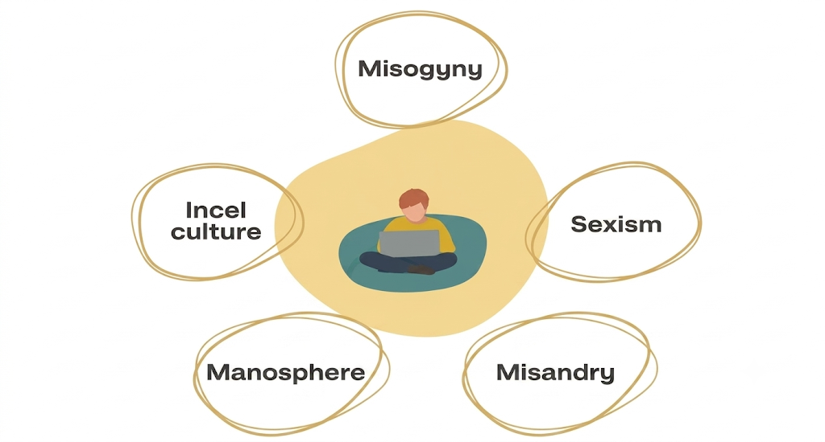
Online toxic masculinity
Online toxic masculinity
Notes:
Safeguarding issue 2: online toxic masculinity
Explain that toxic masculinity is a set of harmful beliefs and behaviours rooted in extreme definitions of what ‘manliness’ should be – for example, not showing weakness. Men and boys can feel pressure to conform to these ideals, which are often shared online and on social media. It doesn’t mean that masculinity or being a boy is bad or harmful, however
Explain how online toxic masculinity exposes children to harmful ideologies that could influence their attitudes, behaviour and relationships
Online toxic masculinity can often appear to ‘normalise’ abuse and harassment
Explain that the ‘manosphere’ is the name for a collection of online communities where misogynistic views are shared
These groups discuss ‘masculinity’ and promote sexist beliefs, but they also discuss everyday topics such as gaming, and health and fitness
A lot of groups in the manosphere use jokes and memes to share their views, so it might not be obvious at first that they’re spreading hateful content
Children (and especially boys) might get involved in these online communities as it gives them a sense of worth, belonging and security. They can be strongly influenced, and even radicalised, by what they see
Explain to staff that it’s important to challenge all derogatory behaviour to create a culture of zero tolerance and ensure a safe environment for children
Sources:
The Children’s Society, Protecting young people from misogyny and the manosphere. https://www.childrenssociety.org.uk/what-we-do/blogs/protecting-children-from-misogyny-manosphere
Ofcom, A window into young children’s online worlds, 2024, https://www.ofcom.org.uk/media-use-and-attitudes/media-habits-children/a-window-into-young-childrens-online-worlds

Slide 107

Be alert to key vocabulary, including:
Online toxic masculinity
Incel
80/20 rule
Red pill/redpilled
Chad and Stacey
Pickup artists (PUA)
Notes:
Safeguarding issue 2: online toxic masculinity (continued)
Explain to staff that research has shown that 13% of young men 13 to 17 have a positive view of Andrew Tate, the well-known social media influencer who shares misogynistic content
You might also want to signpost our digital dictionary when explaining key terms (but tell staff you’re going to cover some of them here): https://schoolleaders.thekeysupport.com/uid/56fa8895-a1fd-4153-ac3d-d32cf479b55f/
Select to reveal each of the key terms on the slide, and explain to staff what they are:
Incel – short for involuntary celibate. This refers to a man who believes he’s unable to form a romantic or sexual relationship with a woman, despite wanting to
Red pill/redpilled – those who have ‘taken the red pill’ have ‘seen the truth’ which in the context of the manosphere means they believe that society treats women too well, as well as other ideas that undermine equality and fairness between genders
Pickup artists (PUA) – people who persuade, force or trick women into having sex with them, and claim to be able to teach others to do the same
80/20 rule – a fake theory, that some claim is ‘scientific’, that 80% of women are only attracted to the top 20% of men. This is used to blame women for men’s feelings of inadequacy and rejection
Chad – a boy/man who is very popular, good-looking and successful with women and girls
Stacey – a girl/woman who is very popular and good-looking, and will usually only be attracted to ‘Chads’
Note that emojis might be used instead of words, such as those shown on this slide
Tell staff that it’s also important to be alert to generalisations being made about women and men, online and offline. For example, if a child is showing a sudden disrespectful attitude towards women and girls, such as making statements about how ‘all’ women and girls act, or about how women and men are ‘different species’
Also, explain how it’s just as important for girls to know about online misogyny – what it is, why it’s wrong and what to do it they see or hear this kind of behaviour/vocabulary at school
Acknowledge that this is a high-profile topic at the moment, and it’s easy to assume that all boys are involved when that might not be the case. Explain how it’s important to stay open-minded about things you hear from pupils, rather than jumping to the worst conclusions
Source:
YouGov, Young men, masculinity and misogyny. https://yougov.com/en-gb/articles/52863-young-men-masculinity-and-misogyny

Slide 108
Disinformation, misinformation and conspiracy theories
Disinformation, misinformation and conspiracy theories
Disinformation, misinformation and conspiracy theories are online safety risks for children
They refer to the spread of false information or ‘fake news’ online
Children can be more at risk of taking this content at face value
Advanced AI tools can be used to present the information as fact, making it appear realistic, including the use of AI-generated images and videos, such as deepfakes
As school staff we all have a role to play to make sure pupils are kept safe online from this risk
It’s important that we find opportunities to discuss where pupils get their information from, so they understand the risks
Notes:
Safeguarding issue 3: misinformation, disinformation and conspiracy theories
Explain that KCSIE includes misinformation, disinformation and conspiracy theories as online safety risks for children
Explain that disinformation, misinformation, and conspiracy theories refer to the spread of false information or ‘fake news’ online
Children can be more at risk of taking this potentially harmful and inappropriate content at face value
Explain how advanced AI tools can be used to present the information as fact, making it appear highly realistic. This includes the increasing use of AI-generated images and videos, such as deepfakes
Remind them that, as school staff, we all have a role to play to make sure pupils are kept safe online from this risk
Explain how, as a school, it’s important that you find opportunities to discuss where pupils are getting their information from, to protect and educate them so they fully understand the risks
Source:
GOV.UK – Department for Education (DfE), Keeping Children Safe in Education. https://www.gov.uk/government/publications/keeping-children-safe-in-education--2

Slide 109

Sextortion
Sextortion: what is it?
Sextortion is a form of online blackmail where someone threatens to share sexual images or information unless the victim complies with their demands.
It might begin with grooming, where an offender has built up a relationship of trust with the victim first.
Offenders don’t always need to befriend the victim and can sometimes use photos taken from a victim's public social media profile to blackmail them.
Notes:
Safeguarding issue 4: sextortion
Tell staff that you’re now going to look at the issue of sextortion
Give staff a couple of minutes to read the information on the slide
Explain to staff that:
Financially motivated sexual extortion is commonly referred to as ‘sextortion’
It’s when an adult threatens to release nudes or semi-nudes of a child unless they pay money, or do something to benefit them
Sexual images or videos used to threaten the victim don’t have to be real. They can also be AI-generated, such as deepfakes
It’s often carried out by organised crime groups, motivated by profit
These groups tend to:
Coerce the child into sending nudes/semi-nudes to blackmail them
Use images stolen from the child through hacking their account
Use digitally manipulated images, such as AI-generated images
Source:
Department for Science, Innovation and Technology and UK Council for Internet Safety, Sharing nudes and semi-nudes: advice for education settings working with children and young people. https://www.gov.uk/government/publications/sharing-nudes-and-semi-nudes-advice-for-education-settings-working-with-children-and-young-people

Slide 110
I don’t know why, but I sent some photos of myself to this man online …
Looking back, it seems obvious, but I thought I could trust him because we’d been talking online for ages. But the second I sent the photos, he said he’d post them on my school's social media pages unless I bought him online gift cards.
I felt trapped, and I was so embarrassed about what people would think if they found out.
Sextortion
Notes:
Safeguarding issue 4: sextortion (continued)
Ask staff to read the quote on the slide
Explain how sextortion is more common among older children, but any child could be at risk due to access to phones and other devices, and if they have unsupervised internet use at home
Potential platforms for sextortion threats include:
Social media
Online gaming platforms
Messaging apps

Slide 111



Sextortion
Sextortion: what are the warning signs?
Sudden changes in mood
Excessive secrecy about online activity
Signs of being distracted, upset or afraid after being online
Report concerns to the DSL or deputy DSL.
Notes:
Safeguarding issue 4: sextortion (continued)
Explain to staff that the warning signs of sextortion might include:
Sudden changes in mood
The child could have stronger emotional responses or outbursts – for example, they may get unusually angry, upset or distant after checking their phone or using their computer/tablet
Being secretive about their use of the internet or a device – they may refuse to hand their phone in at school, or refuse to tell you what they get up to online
The child may be spending more time online, or more time offline. They might complain of being tired because they were online all night
Being distracted, upset or afraid after being online
If a pupil tells you that they often use their device unsupervised – for example, they use their iPad when they go to bed – this could also be a red flag
Tell staff:
Make sure you take any disclosures of sextortion seriously, as the child is likely to be embarrassed and worried about the consequences
Remember: do not intentionally view any images or ask to see them
If you’re aware of an incident, report it to the DSL as soon as possible
Remind staff that, as with other safeguarding issues, they should always look for changes in behaviour or mood. Although a change might not suggest a child is being abused online, the DSL can look into the situation further
You might want to share/signpost our financially-motivated factsheets: https://safeguarding.thekeysupport.com/factsheets-and-briefings/financially-motivated-sexual-extortion-sextortion-parent-and-staff-factsheets/
Source:
GOV.UK – Department for Education (DfE), Keeping Children Safe in Education. https://www.gov.uk/government/publications/keeping-children-safe-in-education--2

Slide 112

CCE
Child criminal exploitation (CCE)
What is it?
Child criminal exploitation (CCE) is a form of abuse where a child is coerced, manipulated or deceived into taking part in criminal activity.
It can be carried out or started by an organised network or gang, and the victim may see themselves as being part of this group.
It’s often linked with serious violence, such as knife or gun crime. The exploitation could be:
In exchange for something the child needs or wants (like money)
For the financial gain of the perpetrator(s)
Through violence, or the threat of violence, to children or their families
It may constitute modern slavery, due to the sometimes extreme coercion and control involved in exploiting the victim.
Notes:
Safeguarding issue 5: child criminal exploitation (CCE)
Explain what child criminal exploitation is:
It’s a form of abuse where an individual or group takes advantage of an imbalance in power to coerce, manipulate or deceive a child into taking part in criminal activity
Age is the most obvious imbalance, but it could also be related to gender, sexual identity, cognitive ability, physical strength or status
While the crimes committed by children through CCE might seem consensual, it’s important to remember that these children are still victims
Younger children aren’t safe from CCE – gangs can use older siblings to begin targeting them. Gangs will sometimes target younger children for exploitation, as they’re less likely to be suspected by the police and other adults
All children are vulnerable, but some are more likely to be at risk, including pupils who:
Have been frequently absent or permanently excluded from school
Have experienced child maltreatment
Have been previously involved in offending
Live in poverty or in a deprived community
Have SEN or mental health needs
Boys are more likely to be targeted by gangs, but non-gang related CCE reveals a more even split between girls and boys. It’s important to remember that all children are vulnerable to exploitation
The most well-known form of CCE is ‘county lines’ (you’ll cover more on this in the next slides). Other forms of CCE can include children being forced or manipulated into working in cannabis factories, shoplifting, pickpocketing, or committing vehicle crime or serious violence

Slide 113
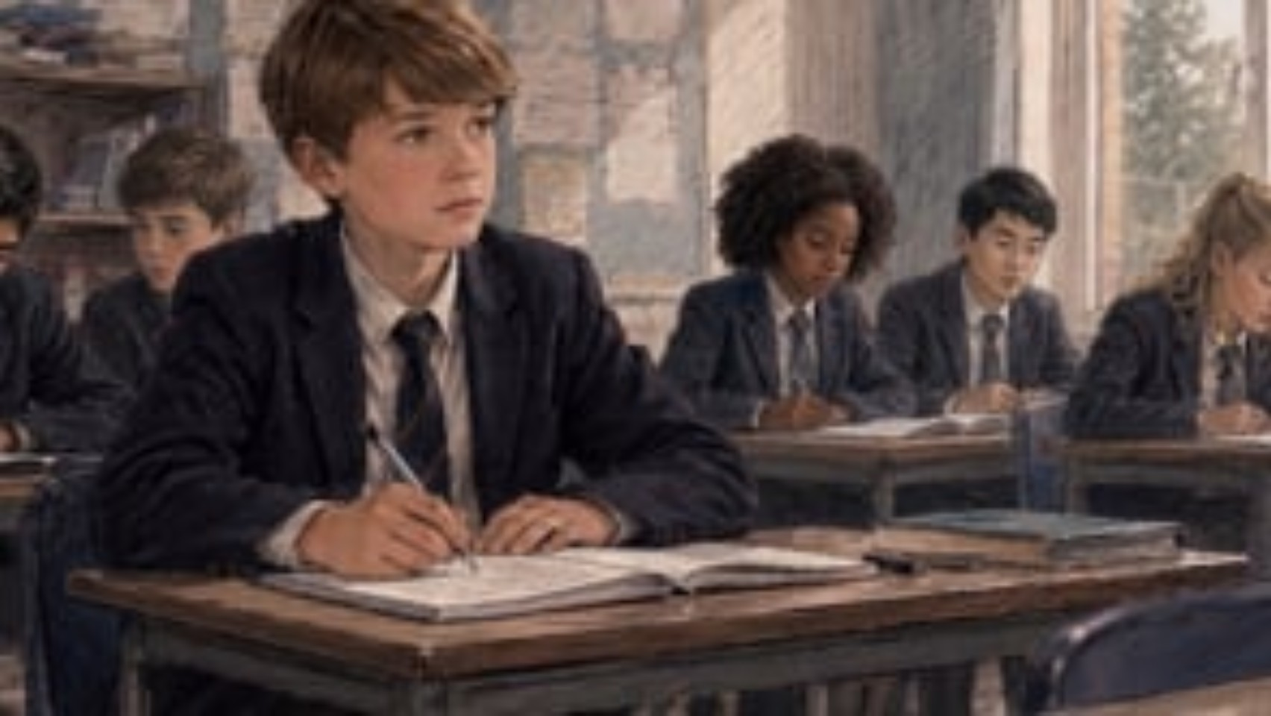
This is Leo…
Leo’s been seen hanging around with a group of
new, older friends.
CCE
He:
Has new, unexplained belongings, including a second phone and expensive trainers
Is missing school more often, and was recently found in an area far away from his home
Seems anxious and tired
Has unexplained injuries and bruising
Notes:
Safeguarding issue 5: child criminal exploitation (CCE) (continued)
[In advance, prepare to briefly explain your local procedures for managing risks associated with criminal exploitation and serious violence]
Play the video (1:23)
Recap the main points with staff. Leo has been seen hanging around with a group of new friends, who are all older than him. As well as this, you’ve also noticed some other changes:
Select to bring up the first bullet point. Leo suddenly has new, unexplained belongings, including a second 'burner' phone and expensive trainers. Unexplained wealth and burner phones are key indicators of exploitation
Select to bring up the second bullet point. He’s missing school more often, and was recently found in an area far away from his home. Missing school and being found out of the area are strong warning signs of involvement in county lines
Select to bring up the third bullet point. His emotional wellbeing has changed, and he seems increasingly anxious and tired. The impact of what is happening to him is having a significant effect on his mental health
Select to bring up the last bullet point. He has unexplained bruising. This can happen if exploiters use violence or the threat of violence as a way of intimidating him. He might have other injuries you can’t see, such as from sexual abuse or being made to carry drugs inside his body
Ask: is Leo a victim or a perpetrator here?
Explain that, although it may appear that children are choosing to take part in crime, they cannot give informed consent to engage in criminal or exploitative activity, and are still victims
Once involved in crime, they’re often intimidated into staying through the threat of violence against them and their families, or they can be coerced into debt
They might also be coerced into carrying a weapon, or start carrying one for a sense of protection from harm
Tell staff that Leo is a victim of child criminal exploitation (CCE)
Explain that the slide shows the main signs to look out for that a child might be involved in serious violence or criminal exploitation
Highlight:
Girls can also be victims, but their experience can be very different to that of boys
Children involved in criminal exploitation may also be at higher risk of sexual exploitation
Briefly explain your local procedures for managing the risks of criminal exploitation and serious violence
Sources:
GOV.UK – DfE, Keeping Children Safe in Education. https://www.gov.uk/government/publications/keeping-children-safe-in-education--2
GOV.UK – Home Office, Criminal exploitation of children and vulnerable adults: county lines. https://www.gov.uk/government/publications/criminal-exploitation-of-children-and-vulnerable-adults-county-lines
Video link: https://vimeo.com/share/daac367a-3c0a-4b5b-af56-bc2a558705e6?share=copy&fl=tl&fe=ec

Slide 114
County lines
CCE
What is it?
A form of criminal exploitation where children are coerced and forced into moving, storing and selling drugs and drug money.
Who is involved?
Children are groomed in person or online (for example, through social media gang ‘influencers’) and then threatened into staying.
Signs to look out for
  Going missing and being found in areas away from their home
  A decline in school attendance, results or performance
  Signs of unexplained wealth such as new clothes or devices
  Receiving lots of texts, phone calls or having a ‘burner phone’ with unregistered SIM cards
  Spending time with older children or adults
Notes:
Safeguarding issue 5: child criminal exploitation (continued)
As you mentioned on the previous slide, one form of CCE is county lines (if relevant, explain that it’s particularly prevalent in your area)
Ask staff for a definition of ‘county lines’ and take a few responses before revealing the definition on the slide
Select to reveal the first section on the slide
Tell staff that county lines is a form of criminal exploitation, usually done by children who are coerced and forced into moving, storing and selling drugs and drug money. It’s where illegal drugs are transported from one area to another, often across police and local authority boundaries. The ‘lines’ refer to the mobile phone line used to take the orders of drugs
Select to reveal the second section on the slide
Explain how children can be targeted and recruited in different ways, through connections with siblings or schools or using social media, such as through adverts designed to target children. They’re then trapped, as gangs create drug debts which need to be worked off, or they threaten serious violence towards victims and their families
Select to reveal the final section on the slide
Think back to Leo’s story, which showed us the signs of a child being drawn into criminal exploitation. Discuss what specific signs there might be, when children have been exploited into county lines. For example, children may:
Go missing and be found in areas away from their home
Have a decline in school attendance, results or performance
Have signs of unexplained wealth such as money, clothes, devices or things you wouldn’t expect them to be able to afford
Receive lots of texts, phone calls or have a ‘burner phone’ – often older phones with an unregistered SIM card
Spend time with older children or adults
Have other changes in behaviour, such as self-harm or changes in emotions
If you want to go into more depth with staff on this issue, use our briefing on county lines, which includes a video explainer: https://safeguarding.thekeysupport.com/factsheets-and-briefings/county-lines-essentials/
Sources:
National Crime Agency, County Lines. https://www.nationalcrimeagency.gov.uk/what-we-do/crime-threats/drug-trafficking/county-lines
GOV.UK – DfE, Keeping Children Safe in Education. https://www.gov.uk/government/publications/keeping-children-safe-in-education--2
GOV.UK – Home Office, Criminal exploitation of children and vulnerable adults: county lines. https://www.gov.uk/government/publications/criminal-exploitation-of-children-and-vulnerable-adults-county-lines

Slide 115

Bullying and cyber-bullying
Bullying, including cyber-bullying
Bullying is behaviour by an individual or group, repeated over time, that intentionally causes physical or emotional harm, or both.
It can happen in person or online, both in and out of school, and can
be prejudice-based or discriminatory.
[Select here to use KeyGPT to generate a scenario on bullying for staff]
Notes:
Safeguarding issue 6: bullying and cyber-bullying
[In advance: use KeyGPT to generate a scenario on bullying for staff and prepare to discuss it briefly, or delete this from the slide]
Tell staff that you’re now going to look at the issue of bullying, including cyber-bullying
Ask them to read the information on the slide
Highlight how bullying can have significant effects on children’s mental health, including into adulthood
Some children may be more vulnerable to bullying, such as:
Children with SEND
Children with other health needs
Those with caring responsibilities
Children who are adopted, in care, or who have previously been in care
Characteristics such as a child’s race, gender identity or sexual orientation (or perceived orientation) might make them more of a target of bullying
Optional: if you’ve created a scenario using KeyGPT, briefly discuss it with staff

Slide 116

Bullying and cyber-bullying
What are the warning signs?
Not wanting to go to school or feeling ‘ill’ every morning
Physical injuries
Belongings getting ‘lost’ or damaged
Not doing as well at school
Being nervous, losing confidence, or becoming distressed and withdrawn
Being nervous or secretive when using their mobile phone or computer
Problems with eating or sleeping
Bullying behaviour towards others
Notes:
Safeguarding issue 6: bullying and cyber-bullying (continued)
[Before presenting – if you choose to use an interactive online tool such as Kahoot or Mentimeter, set the page up beforehand]
Give staff 2 minutes to think, or talk with the person next to them about possible signs to spot that a child is being bullied. Or you could ask staff to connect to your choice of interactive online tool, such as Mentimeter or Kahoot, with their phones and digitally submit their ideas
Select to reveal each warning sign
Ask for any additional suggestions
Source:
NSPCC, Bullying and cyberbullying. https://www.nspcc.org.uk/what-is-child-abuse/types-of-abuse/bullying-and-cyberbullying/

Slide 117

Bullying and cyber-bullying
How to act on bullying
  Always follow our school’s anti-bullying and child protection policy and procedures:
  Report any concerns as soon as possible to [add name(s) of staff responsible for anti-bullying in your school]
  [Add any additional steps you take in your school when reporting bullying]
  Find our anti-bullying policy and child protection policy [add details of where staff can find the policies]
  Remember, always report safeguarding concerns to our DSL [add name(s) of your school’s DSL and any deputies] and don’t delay getting help if a child is at risk of harm, or in immediate danger
Notes:
Safeguarding issue 6: bullying and cyber-bullying (continued)
[Note: edit this slide in advance to reflect your school’s policies and procedures]
Tell staff that they should always act on bullying and follow your school’s anti-bullying policy, and child protection policy and procedures where appropriate
Explain who staff should report their concerns to
Explain any additional steps you take in your school to report bullying
Let staff know where they can find the policies
Tell staff that bullying is a safeguarding concern and that they should always speak to the DSL or deputy about any concerns, no matter how ‘small’ they might seem
Remind staff that if a child has been harmed, is at risk of harm or in immediate danger, they should tell the DSL or deputy, as soon as possible. If the DSL or deputy, or member of the SLT isn’t available they can make a referral to the local authority’s children’s social care themselves or the police, if appropriate

Slide 118
Eating disorders
Eating disorders
What are eating disorders?
  Eating disorders can be serious mental health conditions
  They’re characterised by disturbances in behaviours, thoughts and feelings around body weight, appetite and/or food
  It takes an expert to decide whether somebody meets the diagnostic criteria for an eating disorder
  There are different types of eating disorders, and they don’t all manifest in the same way, but there are some common factors
Notes:
Safeguarding issue 7: eating disorders
Tell staff that you’re now going to look at the issue of eating disorders
Explain how it’s estimated there are 1.25 million people in the UK with an eating disorder, and a disproportionate number are below 25 years old
Rates of eating disorders in young people have been steadily rising and hospital admissions for young people due to eating disorders has also sharply risen in recent years
Anorexia nervosa is known to have the highest mortality rate of any psychiatric condition
While the large majority of those affected are young women, hospital admissions of young men have more than doubled
Source:
Children’s Commissioner, Young people with eating disorders on the rise in England, https://www.childrenscommissioner.gov.uk/media-centre/young-people-with-eating-disorders-on-the-rise-in-england/

Slide 119
Eating disorders
Different types of eating disorders
Avoidant/
restrictive food intake disorder (ARFID)
Anorexia nervosa
Bulimia nervosa
Other specified feeding or eating disorder (OSFED)
Binge-eating disorder
Pica
Notes:
Safeguarding issue 7: eating disorders (continued)
Select to reveal each eating disorder and explain:
Anorexia nervosa: a type of eating disorder where people try to keep their weight as low as possible and often have a fear of gaining weight. Anyone can get anorexia, but it’s most common in young women and typically starts in the mid-teens
Bulimia nervosa: people who have bulimia often go through cycles of eating a lot of food in a short amount of time (binge eating) and then getting rid of the food (purging) by vomiting, using laxatives or diuretics, fasting or through excessive exercise
ARFID (avoidant/restrictive food intake disorder): when someone avoids certain foods and/or limits how much they eat. It isn’t usually about weight or body shape but might be linked to negative feelings or sensitivity over the smell, taste or texture of foods, or a previous upsetting experience with food such as choking or being sick after eating something
Binge-eating disorder: when someone regularly eats large quantities of food over a short period of time, until they’re uncomfortable. Binges might be planned or spontaneous and are often accompanied by feelings of shame or guilt
Pica: when someone experiences cravings to eat things that aren’t food, including soap, chalk, paint or paper. It’s important to seek help straightaway as sometimes someone may have an urge to eat substances that are dangerous
Other specified feeding or eating disorder (OSFED): the most common eating disorder in the UK. A person may have an OSFED if their symptoms don’t exactly fit the expected symptoms for a specific eating disorder. Examples include night-eating syndrome, or atypical anorexia (where a person’s weight stays in the ‘normal’ range despite experiencing anorexia symptoms)
Sources:
Beat, Other specified feeding or eating disorder (OSFED), https://www.beateatingdisorders.org.uk/get-information-and-support/about-eating-disorders/types/osfed/
Beat, Pica, https://www.beateatingdisorders.org.uk/get-information-and-support/about-eating-disorders/types/other-eating-feeding-problems/pica/
NHS, Bulima, https://www.nhs.uk/mental-health/conditions/bulimia/
NHS, Overview – Anorexia nervosa, https://www.nhs.uk/mental-health/conditions/anorexia/overview/
NHS, Overview - Binge eating disorder, https://www.nhs.uk/mental-health/conditions/binge-eating/overview/

Slide 120

Signs that a pupil may have a form of disordered eating:
Eating disorders
Changes in weight
General changes in behaviour
Changes in eating habits
Refusing to change their clothes in front of others
Exercising more
Wearing loose-fitting clothes
Lying about their eating or weight
Absence from school or lessons
Going to the toilet a lot after eating
Notes:
Safeguarding issue 7: eating disorders (continued)
Explain to staff that it’s important to remember that every child is different, so each child may show different signs. Signs may also differ based on the type of eating disorder they have. People with eating disorders also tend to try and hide their behaviour as much as possible
Select to bring up each sign on screen and talk through the list below. Some signs staff might see include:
Changes in weight, especially if the child’s weight fluctuates rapidly, or their weight is significantly lower or higher than expected for their age. This could include weight gain or loss, regardless of the size of the child
Changes in eating habits. For example:
Eating lots of food very quickly
Eating very slowly
Hoarding food
Eating alone – for example, they might find a secret place in school to eat
Putting themselves on restrictive diets or calorie counting, or they might use fitness apps to log everything they’re eating
Exercising more than before, or over exercising
Lying about how much they’ve eaten, when they’ve eaten or their weight
Not coming into school, or being frequently absent from lessons
Going to the toilet a lot after eating – they may be purging
Wearing loose-fitting clothing, or thick coats and jumpers to hide changes in weight
Refusing to get changed for lessons like PE, or getting changed in private
General changes in behaviour may indicate an eating disorder or another safeguarding concern, for example, changes in mood, being more withdrawn or tiredness
For bulimia nervosa and binge-eating disorder, a child might steal food from classmates or the school canteen
Sources:
Anne Marie Christian, safeguarding consultant and expert
Deanne Jade, National Centre for Eating Disorders https://eating-disorders.org.uk/
NHS, Overview – Eating disorders, https://www.nhs.uk/mental-health/feelings-symptoms-behaviours/behaviours/eating-disorders/overview/

Slide 121
Eating disorders
Meet Yusuf …
  Yusuf is a pupil in your school. He’s 9 years old
  He enjoys PE, and plays football after school
  He’s started wearing baggy, loose-fitting clothes, even on warm days
  For the past month or so, he hasn’t been finishing his lunch
Do you think there are signs for concern?
Take a few minutes to discuss this in smalls group and jot down any concerns you may have.
Notes:
Safeguarding issue 7: eating disorders (continued)
[Note: staff can also read the scenario in part 4 of the activity pack]
Give staff 5 minutes for this activity
Ask staff to read the scenario on the slide
Then, ask them to discuss any concerns they might have in small groups, or with the person next to them
Ask 1 or 2 groups to feed back
Make sure your discussion involves the following points:
We can’t know for sure in this situation. However, there are potential signs for concern which should be reported to the DSL. These include:
Wearing overly baggy clothes, even on warm days
Not eating as much as usual
This doesn’t mean Yusuf has an eating disorder, but it’s important to report these changes
Your DSL might have more information, and this will help them build a clearer picture
Remember, eating disorders can affect anyone, so it doesn’t matter that Yusuf is a boy. His sudden use of baggy clothes could be masking physical changes such as weight loss
Only trained professionals can diagnose eating disorders, but this information may be a key indicator that Yusuf needs more support
If you need a more in-depth look at this topic, you can use our:
Staff factsheet: https://safeguarding.thekeysupport.com/factsheets-and-briefings/eating-disorders-staff-factsheet
Staff briefing: https://safeguarding.thekeysupport.com/factsheets-and-briefings/pupil-mental-health-eating-disorders/
eLearning course: https://safeguarding.thekeysupport.com/pupil-mental-health-eating-disorders/

Slide 122
Eating disorders
Report your concerns
  Always report any concerns you have, even if you’re not sure what the problem is
  Spotting any of the signs we’ve just discussed doesn’t mean a pupil has a potential eating disorder
  But it’s important you still report your concerns and any signs you notice, so that children can get help early if they need it
  This is especially important with eating disorders, as the child may be much sicker than they appear
  Remember, always report concerns to the DSL or deputy DSL if you think a pupil is at risk or in immediate danger
Notes:
Safeguarding issue 7: eating disorders (continued)
Remind staff that, under KCSIE, if they have a mental health concern about a child that’s also a safeguarding concern, they should follow your child protection policy and tell the DSL or deputy without delay
If a child has an eating disorder, they are likely at risk of harm, so it will be a safeguarding concern

Slide 123
What can make children anxious?
Anxiety and panic attacks
Anxiety and panic attacks
Younger children
Older children
  Facing a new situation or change
  Strangers
  Separation anxiety
  Fears and phobias
  Impact of a physical health problem
  Change, stress and pressure
  Relationships with family and friends
  World events and the news
  Their physical health, especially if there have been changes
  Bullying or abuse
Notes:
Safeguarding issue 8: anxiety and panic attacks
Tell staff that you’re going to talk about anxiety and panic attacks
Explain to staff that anxiety disorders can be rooted in different things. Some children are born more anxious and are less able to cope with stress. Some children develop anxiety after certain events or in certain circumstance, like the examples on this slide. Children can also pick up anxious behaviour from being around anxious people
Note that anxiety can relate to a specific thing, or it can be more general. Sometimes it’s not clear what the cause is
Some common causes of anxiety in children can be:
Facing a new situation or change
Strangers
Separation anxiety
Fears and phobias
Impact of a health crisis
Explain that for older children, their anxiety may also be rooted in:
Change, stress and pressure, such as moving house, starting a new school or school tests
Relationships with family and friends
World events and the news
Their physical health, especially if there have been changes
Bullying or abuse
Remind staff that a child might be affected by any of these factors, regardless of their age
For more in-depth training on anxiety and panic attacks, signpost staff to our:
On-demand eLearning course on pupil mental health and anxiety: https://safeguarding.thekeysupport.com/pupil-mental-health-anxiety/
Staff briefing on anxiety: https://safeguarding.thekeysupport.com/factsheets-and-briefings/pupil-mental-health-anxiety
Source:
NHS inform, Anxiety disorders in children, https://www.nhsinform.scot/illnesses-and-conditions/mental-health/anxiety-disorders-in-children/

Slide 124
Anxiety and panic attacks
Signs that a child’s anxiety may be a problem
Turning down invitations and spending time alone
Outbursts or ‘freezing’ if asked to do something
Not interacting in class
Physical signs like looking tense or shaky
Difficulty concentrating
Tiredness
Clinginess towards their parents or carers
Panic attacks
Eating more or less than usual
Notes:
Safeguarding issue 8: anxiety and panic attacks (continued)
Tell staff that now that they’ve got a better understanding of what anxiety is, you’re going to look at how to spot children who may be struggling with it
Run through the signs on the slide. Staff should look out for these indicators that a pupil might be feeling anxiety that has gone beyond normal worries:
Not interacting in class: this could be not taking part in discussions or group work, not answering questions or going the toilet to avoid things
Turning down invitations and spending time alone
Outbursts or ‘freezing’ if asked to do something: a child might get angry or irritable quickly, seem out of control during outbursts or they might be completely unable to act
Physical signs: looking tense or shaky, complaining about headaches or stomach aches, or feeling hot or sweaty. A child might have trouble sitting still or ask to use the toilet more. Staff might also see behaviours such as nail biting or skin picking
Difficulty concentrating: a child’s concentration might be poor, or they might lack focus on schoolwork
Tiredness due to poor sleep
Clinginess towards parents or carers
Panic attacks (note that you’ll cover these in more detail later)
Eating more or less than usual
Note that many of these signs reflect a ‘fight, flight or freeze’ response. For example, turning down invitations could be a ‘flight’ response and having an outburst could be their ‘fight’ response
Sources:
GOV.UK – DfE, Keeping Children Safe in Education. https://www.gov.uk/government/publications/keeping-children-safe-in-education--2
NHS, Anxiety disorders in children, https://www.nhs.uk/mental-health/children-and-young-adults/advice-for-parents/anxiety-disorders-in-children/
Young Minds, Anxiety, https://www.youngminds.org.uk/young-person/mental-health-conditions/anxiety/
Young Minds, Signs of anxiety in children and young people, https://www.youngminds.org.uk/parent/parents-a-z-mental-health-guide/anxiety/#Signsofanxietyinchildrenandyoungpeople

Slide 125
Report your concerns
Report any non-urgent concerns to the DSL and/or mental health lead
If a child is in immediate danger, call 999 or take them to A&E immediately
  Add details of your own emergency procedures, and how to do this
If a child needs help urgently for their mental health, but it’s not an emergency, use NHS 111 online or call 111 and select the mental health option
  Add details of how to report concerns, e.g.: Use [x] form or system
Anxiety and panic attacks
Notes:
Safeguarding issue 8: anxiety and panic attacks (continued)
[In advance, edit this slide with your procedures for reporting concerns]
Tell staff that you’re now going to focus on how to make sure that pupils who are showing possible signs of anxiety get the support they need
Remind them that their safeguarding responsibilities under KCSIE include “preventing the impairment of children’s mental and physical health or development.” Reporting concerns is an important part of this
Emphasise that staff aren’t expected to diagnose anxiety themselves. Their job is to report any signs they spot, so that potential issues are identified early, and that a mental health professional can make a diagnosis, if appropriate. Emphasise how all school staff are well-placed to notice changes in children, including signs that a child may be developing more problematic anxiety
Explain your school’s procedures for reporting concerns about a pupil’s mental health. Emphasise that any non-urgent mental health or safeguarding concerns should be reported to the designated safeguarding lead (DSL) or mental health lead. However, if they feel a child is in immediate danger, they must call 999 or take them to A&E immediately. For situations where a child needs urgent mental health support but it is not a 999 emergency, staff should use NHS 111 online or call 111 and select the mental health option
Make sure staff know:
Who to report concerns to
How to report concerns – for example, what form/system to use and how to access it
That if a mental health concern is also a safeguarding concern, they should take immediate action and follow your safeguarding procedures to report it (this is an expectation under KCSIE). A mental health concern is also a safeguarding concern if you think a child may be at risk of harm, or if you have concerns about the child’s welfare. Make sure staff know how to report safeguarding concerns, in line with your school’s procedures

Slide 126
Anxiety and panic attacks
How to respond to a panic attack
Help them focus on positive, peaceful and relaxing images
Remind them it’s not life threatening
Help the child breathe slowly and deeply
Reassure them that it’s a panic attack and it will pass
If you think it could be an asthma attack or a heart attack, get medical help immediately.
Notes:
Safeguarding issue 8: anxiety and panic attacks (continued)
Tell staff that you’re now going to look at panic attacks
Explain that panic is a severe form of anxiety. A panic attack can come on quickly, and for no apparent reason. They tend to last between 5 and 20 minutes but can last longer. A panic attack can be frightening, whether you’re a child or an adult. During a panic attack, our bodies experience a rush of mental and physical symptoms, and these include:
Feeling faint
A racing heartbeat
Sweating
Nausea
Chest pain
Shortness of breath
Trembling, or shaky limbs
Hot flushes
Chills
A choking sensation
Dizziness
Numbness, pins and needles or tingling fingers
Dry mouth
Needing to go to the toilet
Ringing in ears
Feeling of dread or fear of dying
Churning stomach
Feeling like you’re not connected to your body
Emphasise that if staff are in any doubt about whether a child is having a panic attack, or an asthma attack or a heart attack, they should get medical help immediately. (Heart attacks are rare in children, but can happen.) There are some overlapping symptoms, but a few key differences to look out for include:
A panic attack will usually involve symptoms beyond breathing difficulties, while asthma attacks are more limited to breathing difficulties. If a child is wheezing or coughing, it’s likely to be an asthma attack
With a panic attack, chest pains are usually sharp or stabbing, while with a heart attack the pain may feel like pressure or a squeezing sensation. Pains in panic attacks are usually concentrated in the middle of the chest, while in heart attacks they can radiate from the chest to the arm, jaw or shoulder blades
Panic attacks are usually brought on by extreme stress, while heart attacks are more likely to be brought on by physical exertion
Source:
NHS, Panic disorder, https://www.nhs.uk/mental-health/conditions/panic-disorder/

Slide 127
Trauma and PTSD
Trauma and PTSD
Trauma
The lasting effects after a very stressful, frightening or distressing experience
Adverse childhood experiences (ACEs)
Stressful and potentially traumatic events or circumstances that happen before the age of 18
Trauma-informed practice
Takes traumatic events into account and creates a safe environment for pupils and staff, to avoid re-traumatisation
Notes:
Safeguarding issue 9: trauma and PTSD
[If you want to go into more detail about your school’s own trauma-informed approach during this session, have your approach ready to share with staff]
Explain to staff that you’re going to look at some of the key terms around trauma and PTSD
Select to bring up the first term
Tell staff that the first term to define is trauma
When we experience something that’s very stressful, frightening or distressing, it can have lasting adverse effects on our mental, physical, social or emotional wellbeing. This is trauma. Trauma can be the result of an event, series of events, or set of circumstances
The effects of trauma can be different depending on the individual
Experiencing trauma isn’t a mental health condition, but can lead someone to struggle with their mental health
Select to bring up the second term
Adverse childhood experiences are stressful and potentially traumatic events or circumstances that happen before the age of 18
Select to bring up the third term
Tell staff that it’s likely they’ve heard the term ‘trauma-informed practice’
Trauma-informed practice takes traumatic events into account and creates a safe environment, to avoid re-traumatisation
Schools that are ‘trauma informed’:
Are aware of previous experiences and events in a child’s life
Understand that those experiences and events will have an impact on the child’s present
Can identify which pupils have experienced trauma
Know that trauma doesn't manifest in all pupils equally
Know that trauma can affect whole groups and communities
Recognise that adults within the school may also be impacted by experiences from their childhood
Trauma-informed practice acknowledges the need to ask, ‘What does this person need?’ rather than ‘What’s wrong with this person?’
If you’ve chosen to go into more detail about your school’s approach to trauma-informed practice, share some details with staff.
For more in-depth training on trauma and PTSD, signpost staff to our:
On demand eLearning course on trauma and PTSD: https://safeguarding.thekeysupport.com/factsheets-and-briefings/pupil-mental-health-anxiety
Staff briefing on trauma and PTSD: https://safeguarding.thekeysupport.com/factsheets-and-briefings/how-support-children-who-may-have-experienced-trauma-staff-briefing/
Sources:
Trauma Informed Schools UK (TISUK), https://www.trauma-informed.uk/
Office for Health Improvement & Disparities, Working definition of trauma-informed practice, https://www.gov.uk/government/publications/working-definition-of-trauma-informed-practice/working-definition-of-trauma-informed-practice
Young Minds, Trauma, https://www.youngminds.org.uk/parent/parents-a-z-mental-health-guide/trauma/#Whatistrauma
Young Minds, Trauma, https://www.youngminds.org.uk/young-person/coping-with-life/trauma/

Slide 128

What is PTSD and how is it different to trauma?
Trauma and PTSD
Key differences:
Post-traumatic stress disorder (PTSD) is a mental health condition
Sometimes trauma can lead to PTSD, but not always
Possible signs of internalised distress:
Possible signs of externalised distress:
  Being robotically ‘good’, through fear of being noticed
  Rarely participating in class
  Looking morose/gloomy, not really smiling
  Not engaging in or sustaining learning
  Non-compliance, arguing or refusing to do things
  Being aggressive
  Finding it difficult to:
    Engage with learning
    Manage friendships
Notes:
Safeguarding issue 9: trauma and PTSD (continued)
Explain to staff that, as we discussed, experiencing trauma isn’t a mental health condition, but it can lead someone to struggle with their mental health
Unlike trauma, post-traumatic stress disorder (PTSD) is a mental health condition. Someone with PTSD often relives a traumatic event through nightmares and flashbacks, and may experience feelings of isolation, irritability and guilt. Say how we’ll be covering the symptoms of PTSD in more detail later
PTSD can develop straightaway, but also weeks, months or years later – everyone’s experiences are different
Sometimes, experiencing trauma can lead to a child developing PTSD, but not everyone who experiences trauma will develop PTSD. It’s not fully understood why some people develop PTSD, and why some don’t
Complex PTSD has additional symptoms around managing emotions and having relationships
Explain that as members of staff, we need to recognise that children who have experienced trauma need to find people they can trust. As they’re often in a hypervigilant state, it can be difficult for them to feel safe enough to learn and these children need extra support to do well in school
Source:
NHS, Post-traumatic stress disorder (PTSD), https://www.nhs.uk/mental-health/conditions/post-traumatic-stress-disorder-ptsd/

Slide 129
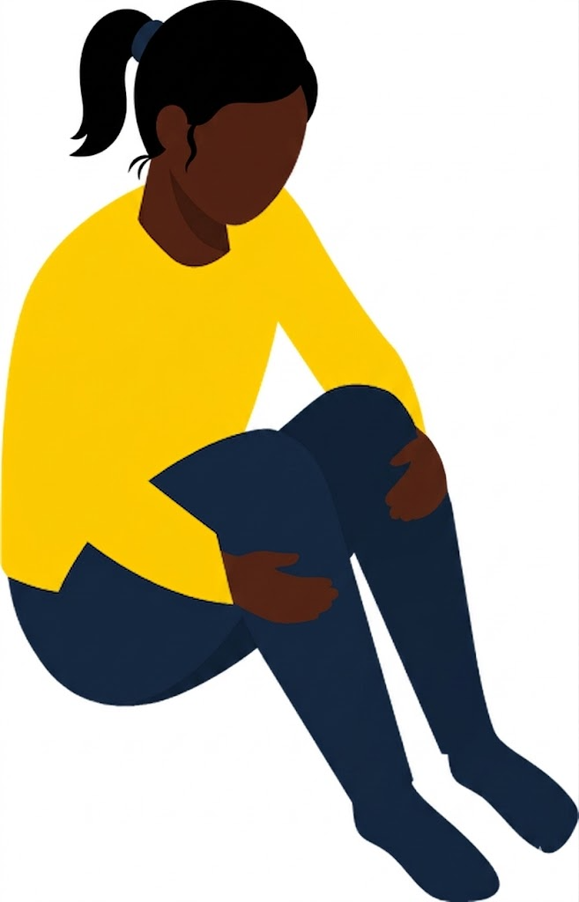
Signs that a child might have PTSD
Trauma and PTSD
Re-experiencing trauma
Avoidance and emotional numbing
Hyperarousal
Changes in behaviour
Physical symptoms
Other mental health difficulties
Notes:
Safeguarding issue 9: trauma and PTSD (continued)
Explain to staff that, as PTSD is a diagnosable mental health condition, it’s associated with more specific symptoms
The 3 main symptoms that children with PTSD experience are:
Re-experiencing trauma: when someone involuntarily and vividly relives trauma, including intrusive memories and flashbacks, and recurring nightmares. There may also be physical elements, such as pain, nausea, sweating and trembling
When a child is exposed to something that reminds them of a traumatic experience, they may react with a fight, flight or freeze response (for example, a ‘fight’ response might be being physically or verbally aggressive, a ‘flight’ response might involve fidgeting or leaving the room without permission and a ‘freeze’ response could include not making eye contact and not speaking or giving 1-word answers)
Avoidance of traumatic triggers: this can include people, places and things. Typically, it will also result in someone trying not to feel anything at all. This is emotional numbing
Chronic physiological hyperarousal: this can manifest as sleep disturbance, poor concentration, feeling irritable and grouchy, and hypervigilance to threat
They may also show more general signs such as:
Changes in behaviour. As we saw on the previous slide, children who have experienced trauma may show different types of internalised or externalised behaviours
Physical symptoms, such as headaches and stomach aches. They may have trouble sleeping or have upsetting nightmares, so may be tired at school
Signs of other mental health struggles, such as depression or anxiety
Remind staff that it’s not their job to diagnose a mental health problem. However, as members of school staff they’re well placed to observe children day to day and identify those whose behaviour suggests they may be experiencing a mental health problem or be at risk of developing one. This is the responsibility of staff as set out in KCSIE
As always, they should report any concerns to the DSL or deputy, and/or mental health lead (which we’ll cover on the next slide)
Source:
NHS, Symptoms – Post-traumatic stress disorder. https://www.nhs.uk/mental-health/conditions/post-traumatic-stress-disorder-ptsd/symptoms/

Slide 130
Share your concerns
Trauma and PTSD
ACT
Report to the DSL (or deputy) and/or mental health lead and make a written record
Add details of your own procedures and how to report concerns
If you have a mental health concern that’s also a safeguarding concern, report it to the DSL
Notes:
Safeguarding issue 9: trauma and PTSD (continued)
[In advance: edit this slide to cover your school’s reporting procedures]
Explain to staff that:
They might see signs in children who they know have experienced a traumatic event, such as abuse or neglect. But they might also see signs in children who, as far as they know, haven’t experienced such events
Either way, if staff are seeing any of the signs or behaviours you’ve talked through in the last few slides, they should report them. For example, if a child isn’t known to your local authority’s children’s social care team, reporting concerns might lead to a referral for investigation and action
Even if the child’s issue is already known, sharing concerns is still an essential part of your school’s approach to safeguarding and promoting children’s welfare
Staff have an opportunity to act between a child experiencing trauma and developing lasting problems, including mental health problems. Reporting concerns will help make sure we intervene early
Go through your procedures for reporting safeguarding and mental health concerns. Explain:
Who to report concerns to, and how to report concerns – for example, what form/system to use, and what to include
If staff have a mental health concern that’s also a safeguarding concern, they should report it to the DSL. As protecting mental health is also part of safeguarding, mental health concerns are also likely to be safeguarding concerns
The DSL and/or mental health lead can find out more and decide what steps to take next. This might include a plan for how to respond to a child and put proactive measures in place to help them feel safe and secure in school

Slide 131

What would you do?
Trauma and PTSD
Jayden is 14 years old and in year 9.
You know that he recently experienced a distressing event involving serious violence in his community.
Lately, his behaviour seems to be one of two extremes. Some days he’s quiet, withdrawn, and almost afraid of being noticed. Other days, he’s arguing with staff, refusing to take part in lessons, and falling out with his friends.
Today, during a lesson transition, a pupil jokingly grabs his backpack from behind. Jayden becomes very aggressive, shouts at the pupil, and then totally disengages, staring blankly at the wall and refusing to move.
ACT
Notes:
Safeguarding issue 9: trauma and PTSD (continued)
[Note: staff can also read the scenario in part 7 of their activity pack]
Tell staff that they’re now going to do a live role-play activity to practise responding ‘in the moment’
Ask staff to get into groups of 3 and assign the following roles:
Person 1 (Jayden): act out Jayden’s reaction to having his bag grabbed
Person 2 (the staff member): respond to Jayden 'in the moment', de-escalate the situation, and try to support him
Person 3 (the observer): watch the interaction and listen out for best practice or mistakes, such as the staff member incorrectly promising to keep the situation a secret
Select to bring up the scenario on the screen
Give staff 5 minutes for the activity
After the activity, ask the observers from 1 or 2 groups to explain what they saw and heard
Tell staff that a good response should include the following:
Following specific plans that Jayden has or techniques you know that will help de-escalate his distress and hyperarousal, such as finding a quiet space
Asking if he’s OK and keeping your language consistent and simple, and your voice low and slow (this is particularly important to help de-escalate his initial aggression)
If Jayden isn’t able to talk about it (as he is currently disengaged and staring blankly), reassuring him that you’re ready to listen when he’s ready to talk
Trying to offer Jayden a choice – for example, to have a small break or try to focus on his work again once he is ready
Reporting this to your DSL, deputy and/or other relevant members of staff afterwards, so they can advise what to do next and follow up with the situation

Slide 132
Parental conflict
Parental conflict
Unresolved arguing
Silence
Lack of respect
Lack of resolution
Look out for pupils who:
Seem less ready to learn when they come to school
Have poor attention or concentration due to lack of sleep
Struggle with their emotions, mental health or behaviour, including social difficulties with their peers
Notes:
Safeguarding issue 10: parental conflict
Tell staff you’re now going to look at the issue of parental conflict
Explain that Working Together to Safeguard Children says that everyone working with children and families needs appropriate training to help them understand their role in identifying emerging safeguarding problems
Part of this is having an understanding of parental conflict that is frequent, intense and unresolved
Emphasise that some level of arguing and parental conflict is often a normal part of everyday life, but that harmful parental conflict is a pattern of damaging behaviour
Explain that parental conflict can become a safeguarding concern if it’s frequent, intense, unresolved or damaging, as this can have a significant negative impact on children’s mental health, which can be long-term
Ask staff what they think parental conflict might look like. Take 1 or 2 answers
Select to bring up the text on the slide, and explain that it can look like:
Unresolved arguing
Silence
Lack of respect – hostile or dismissive behaviour between parents/carers, or talking down to each other, can negatively impact the child's home life and emotional wellbeing
Lack of resolution – this means the arguments are ongoing and never truly settled, creating a continuously stressful environment for the child
Highlight how it’s understandable that certain periods are more stressful for families, and they’ll likely need more support. For example:
Bereavement
A new baby
Children starting a new school
Separation or divorce
Periods of financial difficulty
Although it won’t always be the case, these situations can increase the likelihood of harmful conflict
Parents/carers may also experience drug or substance abuse and their own mental health problems, which can contribute to conflict
Select to bring up the final points on the slide. As with other safeguarding issues, school staff are well placed to spot signs of concern and are often the first professionals to see that children are being affected by damaging conflict at home. They should look out for pupils who:
Seem less ready to learn when they come to school
Have poor attention or concentration due to lack of sleep
Have emotional or behavioural problems, including social difficulties with their peers
Sources:
GOV.UK – Working together to safeguard children. https://www.gov.uk/government/publications/working-together-to-safeguard-children--2
GOV.UK – Department for Work and Pensions, Reducing Parental Conflict: what is parental conflict? https://www.gov.uk/guidance/reducing-parental-conflict-what-is-parental-conflict
GOV.UK – Department for Work and Pensions, Reducing Parental Conflict: training and tools for practitioners and their managers. https://www.gov.uk/guidance/reducing-parental-conflict-training-and-tools-for-practitioners-and-their-managers
GOV.UK – Department for Work and Pensions, Reducing Parental Conflict: the impact on local services. https://www.gov.uk/guidance/reducing-parental-conflict-the-impact-on-local-services#education
Barnardo’s – Parental conflict. https://families.barnardos.org.uk/families/parental-conflicts

Slide 133
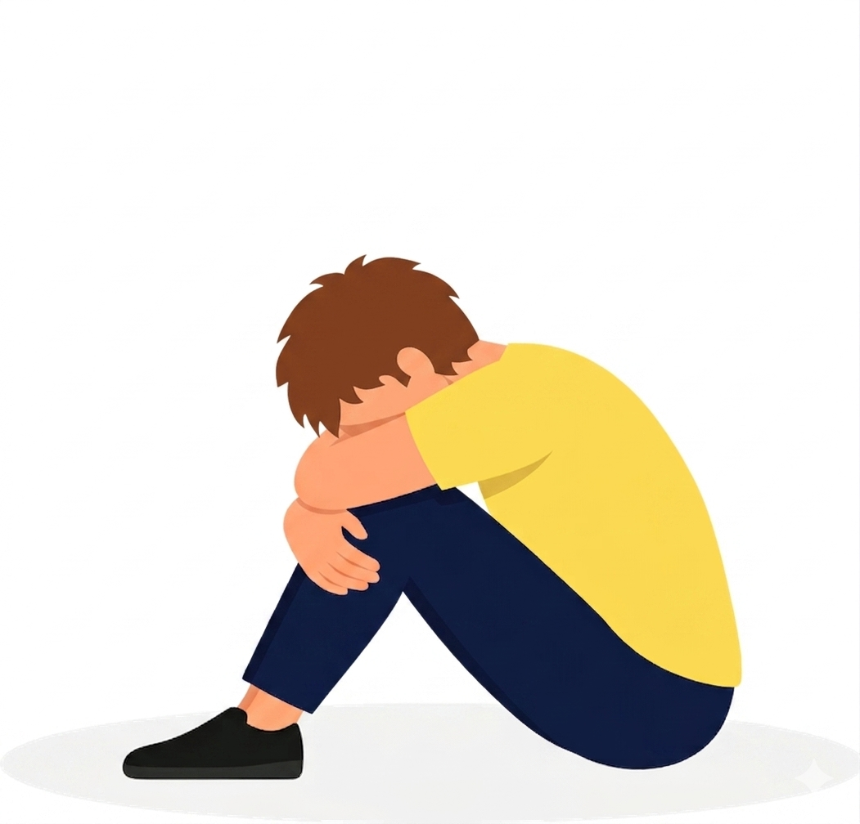
Domestic abuse
Domestic abuse
Domestic abuse is when one person intentionally controls or forces another person to do something against their will
Children may see, hear, or experience the effects of abuse at home
It can be a single incident or a pattern of behaviour, and covers a wide range, such as:
Physical abuse
Financial abuse
Sexual abuse
Emotional abuse
Psychological abuse
Teenage relationship abuse
Child to parent or caregiver abuse
Notes:
Safeguarding issue 11: domestic abuse
Tell staff you’re now going to look at the issue of domestic abuse
Explain that domestic abuse covers a wide range of behaviours, which often overlap. These include:
Physical abuse and sexual abuse, including violence, assault, or sexual coercion
Emotional and psychological abuse, including persistent emotional maltreatment. It often includes controlling or coercive behaviour, which are deliberate tactics used to hurt, humiliate, intimidate, isolate, and dominate the victim
Financial abuse, including stopping someone from getting, spending, or keeping their own money to force them to depend on an abuser
Child to parent or caregiver abuse, including a child physically assaulting a parent/caregiver (e.g. kicking or hitting), or emotionally abusing them (e.g. persistent name-calling or making threats)
Children can be victims of domestic abuse and see, hear, or experience the effects of it at home – it can have a detrimental and long-term impact on their health, wellbeing, development, and ability to learn
Tell staff that it’s important to remember that pupils can experience these types of domestic abuse within their own intimate personal relationships. This is sometimes referred to as teenage relationship abuse
Sources:
GOV.UK – Department for Education (DfE), Keeping Children Safe in Education. https://www.gov.uk/government/publications/keeping-children-safe-in-education--2
GOV.UK – Working together to safeguard children. https://www.gov.uk/government/publications/working-together-to-safeguard-children--2

Slide 134
Report your concerns
Domestic abuse
ACT
Report concerns to the DSL (or deputy) and make a written record
  Add details of your own procedures and how to report concerns
Remember:
  Don’t presume that another staff member will report it and share information on your behalf
  If a child is in immediate danger or needs urgent medical attention, call 999 or take them to A&E immediately
    Add details of your own emergency procedures, and how to do this
Notes:
Safeguarding issue 11: domestic abuse (continued)
[In advance: edit this slide to cover your school’s reporting procedures]
Explain that Working Together to Safeguard Children says that all staff must consider the impact of domestic abuse on a child. It reinforces that under the Domestic Abuse Act 2021, children who see, hear, or experience the effects of domestic abuse at home are legally recognised as victims of domestic abuse. If staff suspect a pupil may be a victim of domestic abuse, they must:
Act immediately – speak to the DSL or a deputy straight away
Never assume others will act – don’t presume that another staff member will act and share critical information on their behalf
Act in emergencies – if a child is in immediate danger or needs urgent medical attention, staff should call 999 or take them to A&E immediately
Maintain appropriate confidentiality without making promises – staff should reassure the child that they are being taken seriously but must never promise to keep a report of abuse a secret
Keep clear records – all concerns, discussions, and decisions made about the child must be clearly recorded in writing
Source:
GOV.UK – Working together to safeguard children. https://www.gov.uk/government/publications/working-together-to-safeguard-children--2

Slide 135
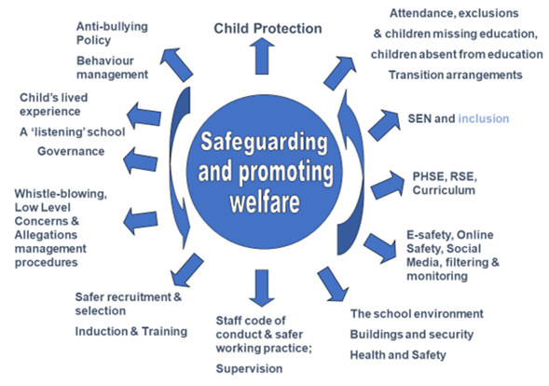

Safeguarding is
everyone’s responsibility
Katie Cash
Executive Advisor for
Safeguarding & Behaviour

Slide 136


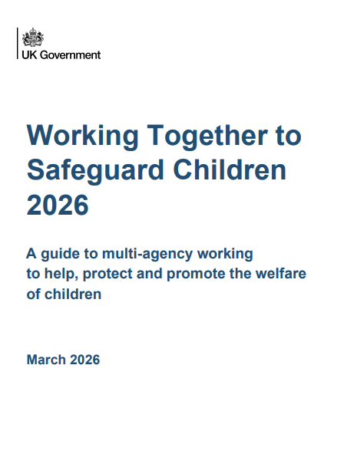
Safeguarding is
everyone’s responsibility
Underpinned by Statutory documents:
Keeping Children Safe in Education (KCSIE);
Working Together to Safeguard Children;
Relationships Education, Relationships and Sex Education (RSE) and Health Education
and DFE guidance documents:
What to do if you’re worried a child is being abused;
Information Sharing Advice for practitioners providing safeguarding services for children, young people, parents and carers
Key MAT Policy Documents:
Child Protection & Safeguarding Policy
Adult Safeguarding Policy
Staff Code of Conduct, Low Level Concerns and Allegations Policy
Restrictive physical intervention including the use of reasonable force and seclusion Policy
Online Safety Policy
Artificial Intelligence Policy
Educational Visits Policy

Slide 137

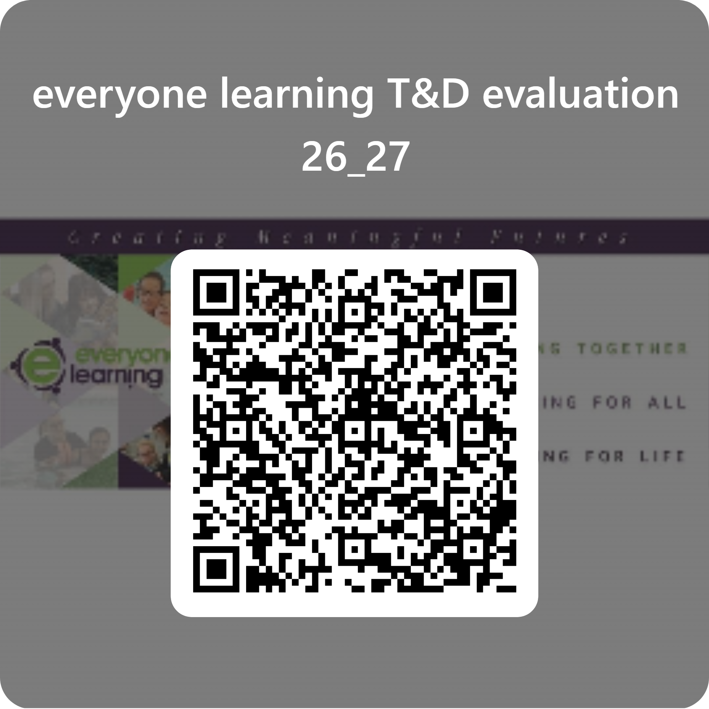

Slide 138
Questions?

